Slide 1
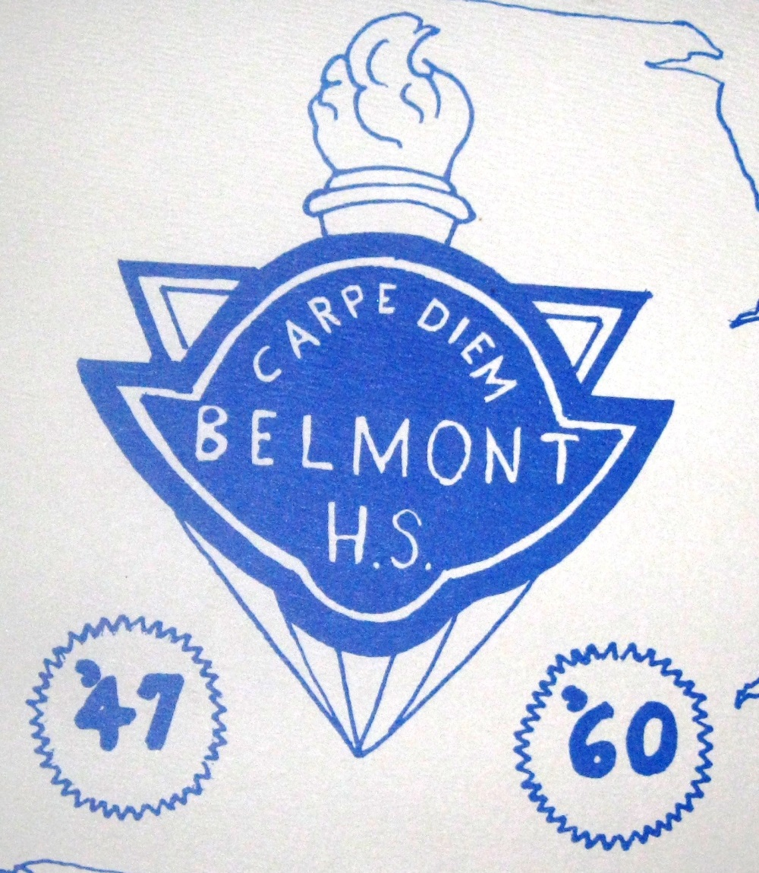
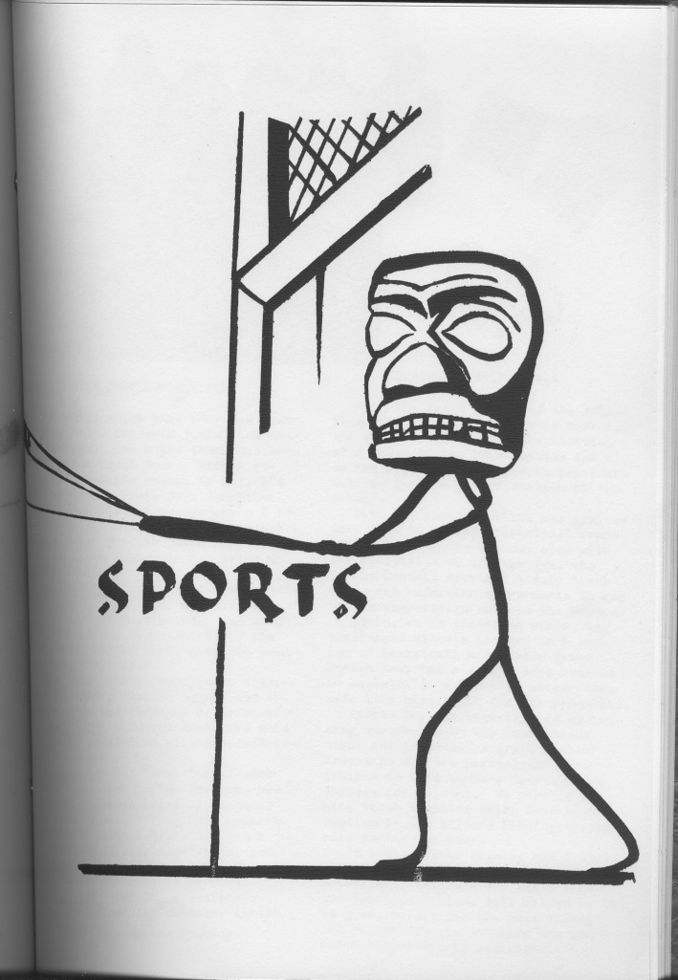
Belmont Sports Photos: 1947-1959

Slide 2
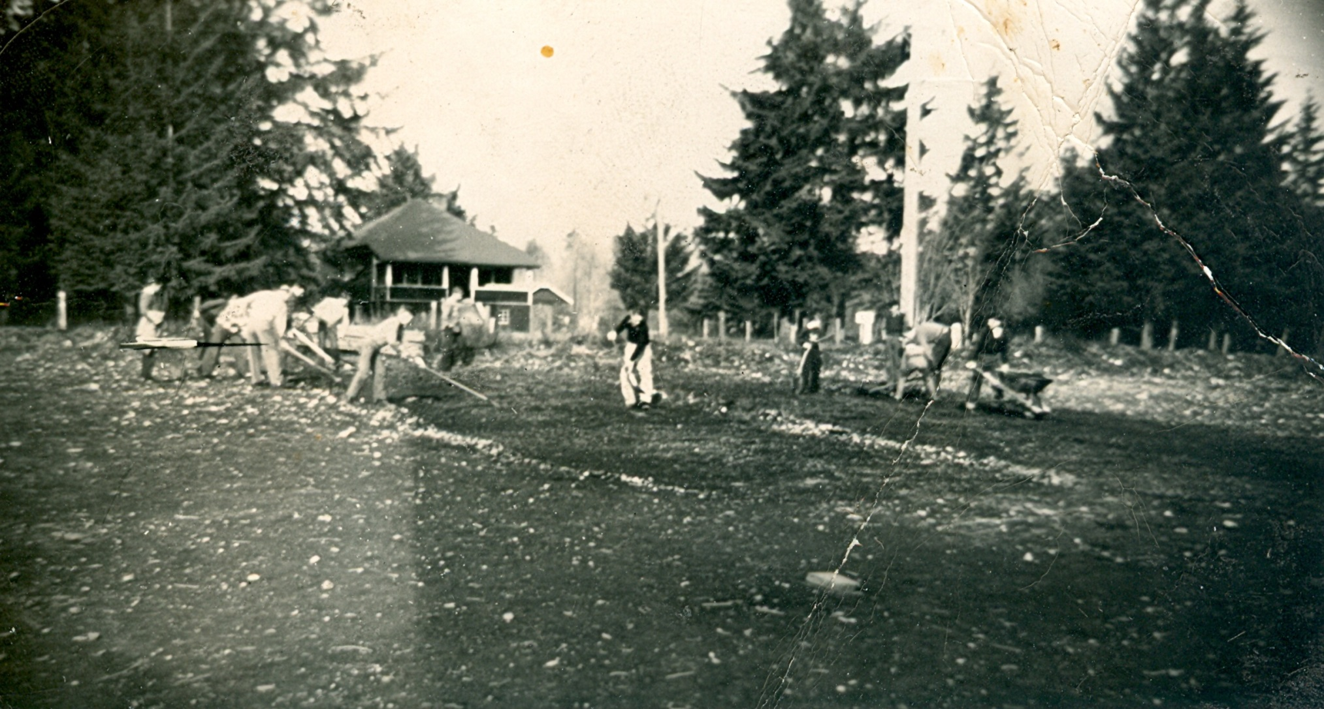
Before competitive sporting activities could occur at the new Belmont site,
the field had to be prepared. For many years, students and staff manned
shovels, rakes and wheelbarrows to perform the laborious task of
clearing away rocks, roots and branches.

Slide 3
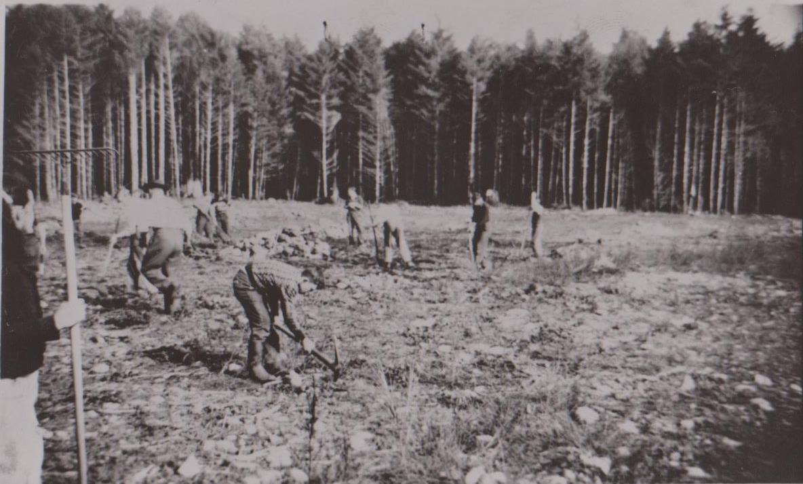
Clearing the field was tough physical work, as many of the larger
boulders and stumps had to be loosened with a pick-axe and then loaded
into a wheelbarrows or trucks to be taken away.

Slide 4
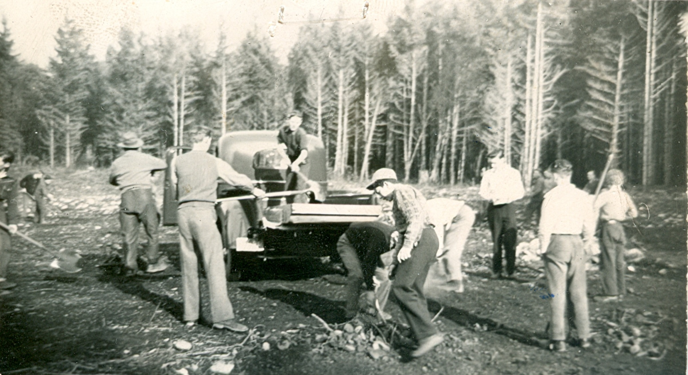
A crew of students and adults hauling away debris under the
supervision of the teaching staff.

Slide 5
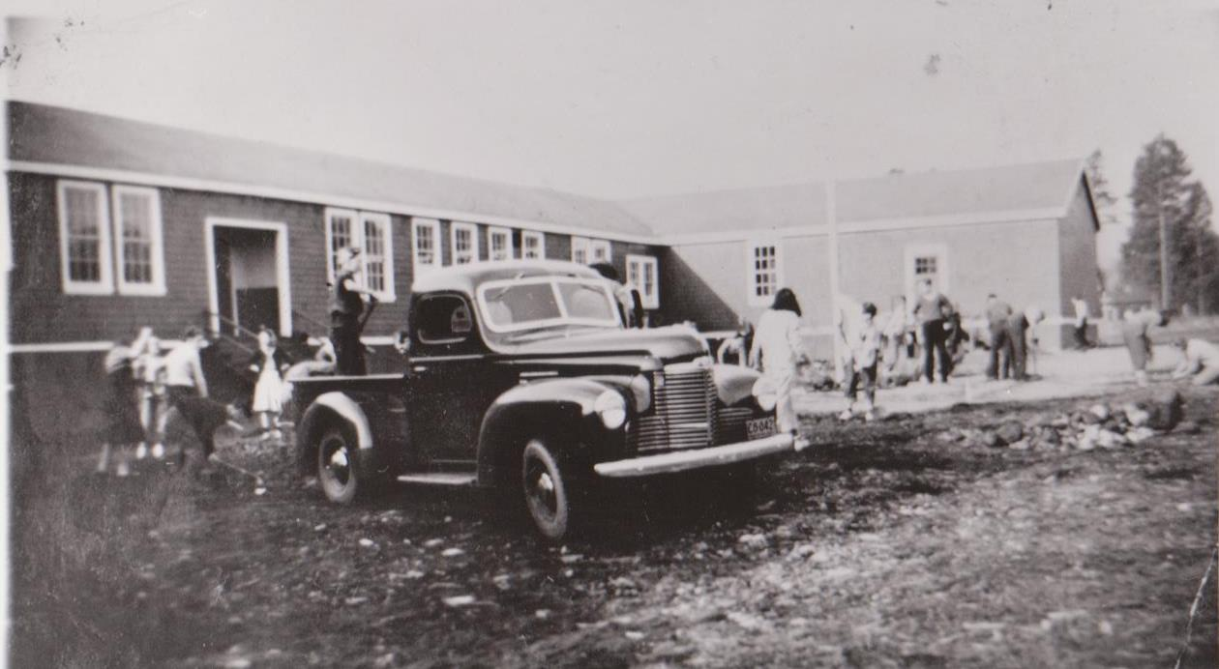
This photo shows how the rough terrain extended right up to the
entrance of the school. The students would help to clear an area on
the right that would be used as an outdoor basketball court for many
years until the new gym was constructed.

Slide 6
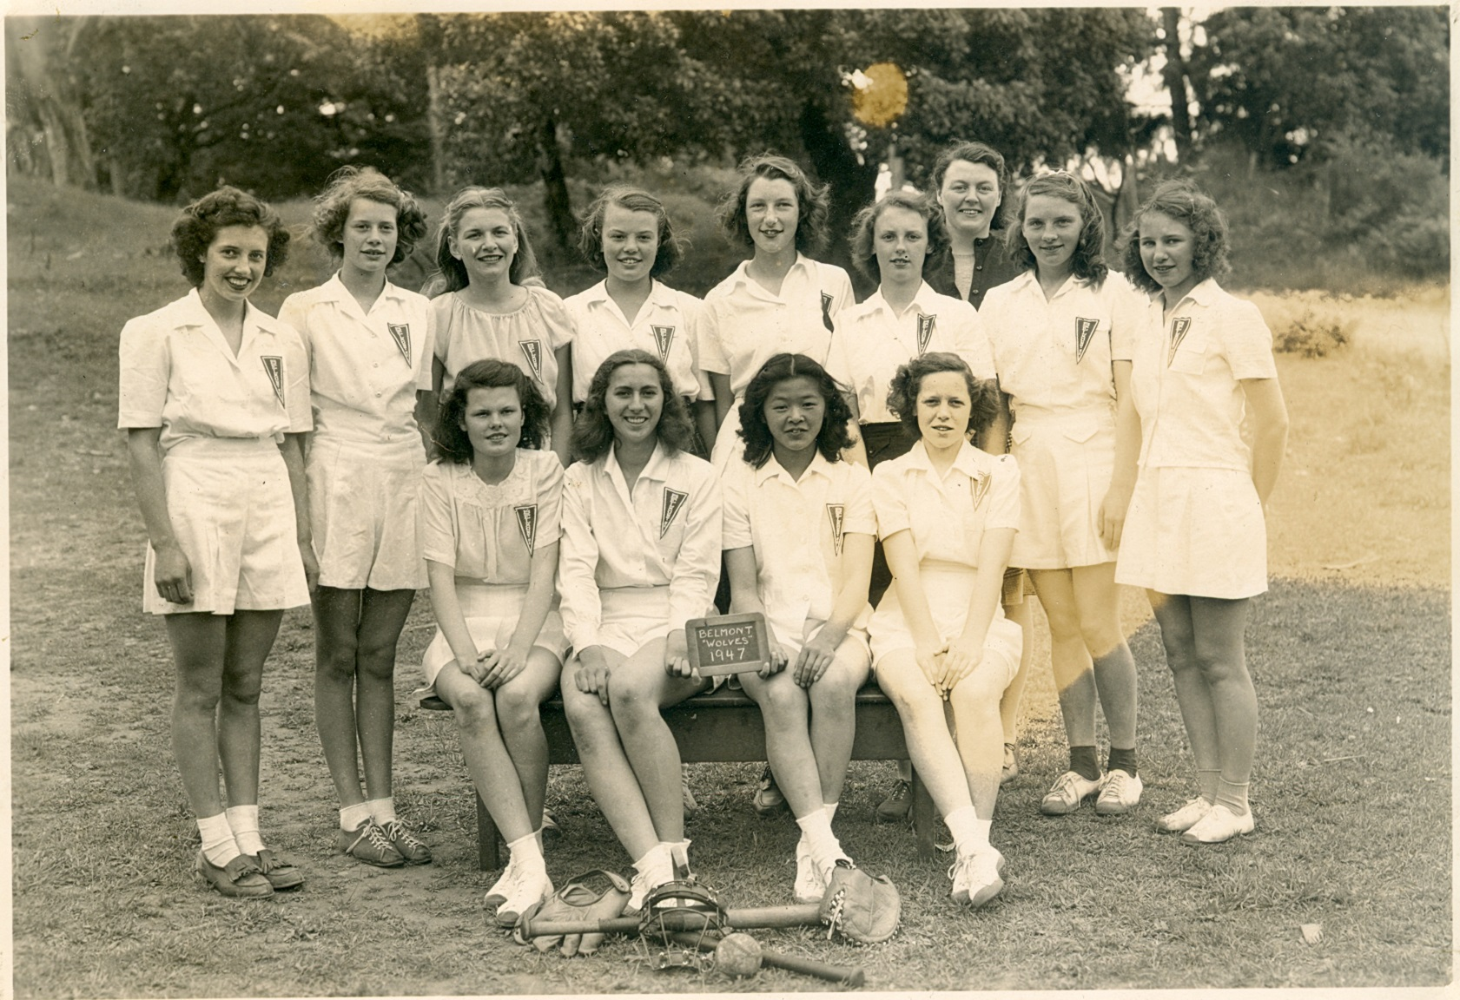
The 1947 Belmont Wolves were the first girls’ sports team.
Back Row L-R: Shirley Williams, Isabel Helgesen, Helen Cuche, Helen Vallis,
Edith Richardson, Kay Rhode, Mrs. Maughan, Mona Hansen, Elsie Mae Hornett
Front Row L-R: Mary Guiney, Ruth Conibear, May Chow, Joan Hernsworth

Slide 7
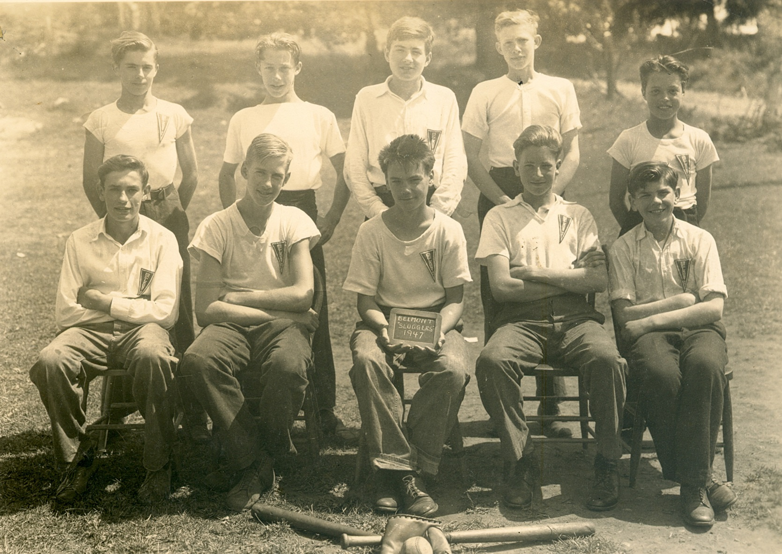
The 1947 Belmont Sluggers were the first boys’ sports team.
Back row L-R: Dale Alsalm, Ian Thow, Harry Mathias, Clarence Creasser, Ronnie
Brousseau
Front row L-R: Norris Mills, Ray Helgesen, Ray McTavish, Bill Eminson, Werner
Schneider

Slide 8
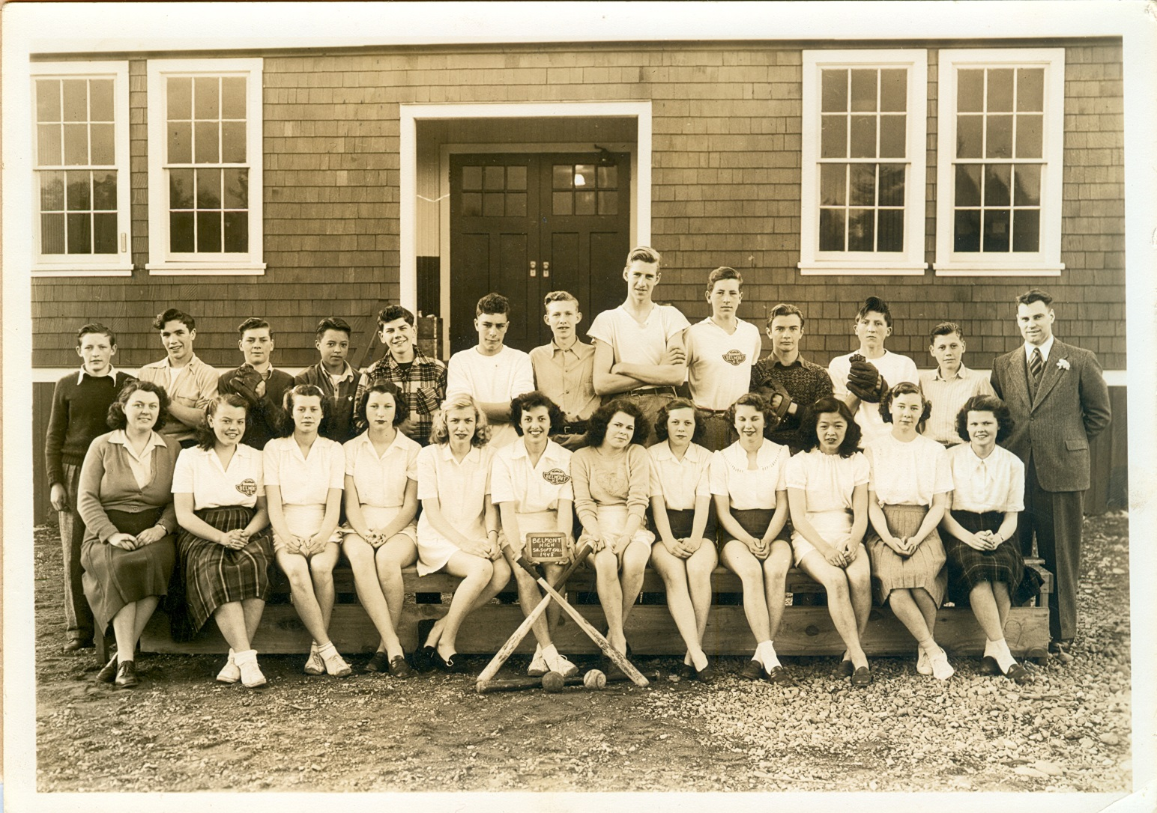
1947-48 Girls’ and Boys’ softball teams
Back: Roy Mills, Reg Osborn, Don Shortt, Ron Brousseau, Werner Schneider,
Bill Clevette, Clarence Creasser, Ray Helgesen, Bill Eminson, Claude Huot,
Alan Robertson, Wally Helgesen, Mr. Harold Parrott
Front: Mrs. Maughan, Helen Vallis, Isabel Helgesen, Edith Richardson, Helen
Cuche, Shirley Williams, Delores Mitchell, Joan Hemsworth, Elsie Thornett,
May Chow, Ada Van-Horn, Mary Guiney

Slide 9
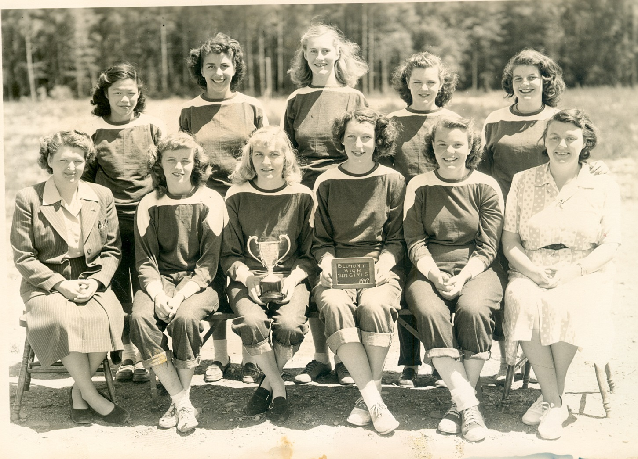
1948-49 Girls Softball team
Back: Mary Chow, Lois Poirier, Eileen Helgesen, Shirley Benson, Kay
Schneider
Front: Miss Frewing, Beverly Soderholm, Helen Cuche (captain),
Edith Robertson, Helen Vallis, Mrs. Maughan

Slide 10
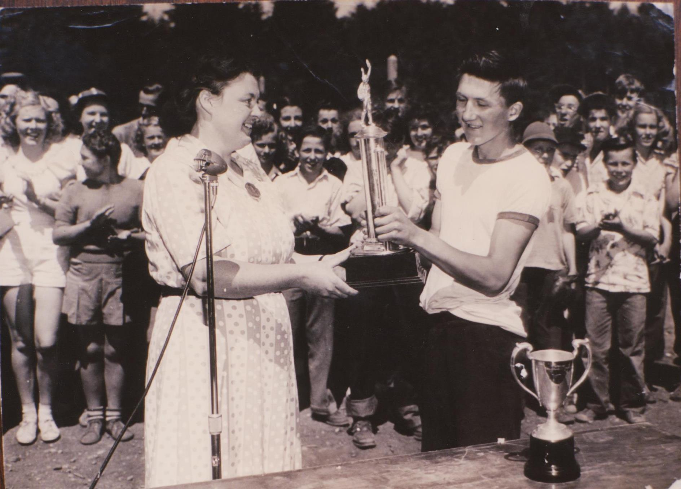
Mrs. Maughan presents captain Alan Robertson with the Maughan Cup in
June 1949, after Belmont’s softball team defeated their Milnes Landing rivals.

Slide 11
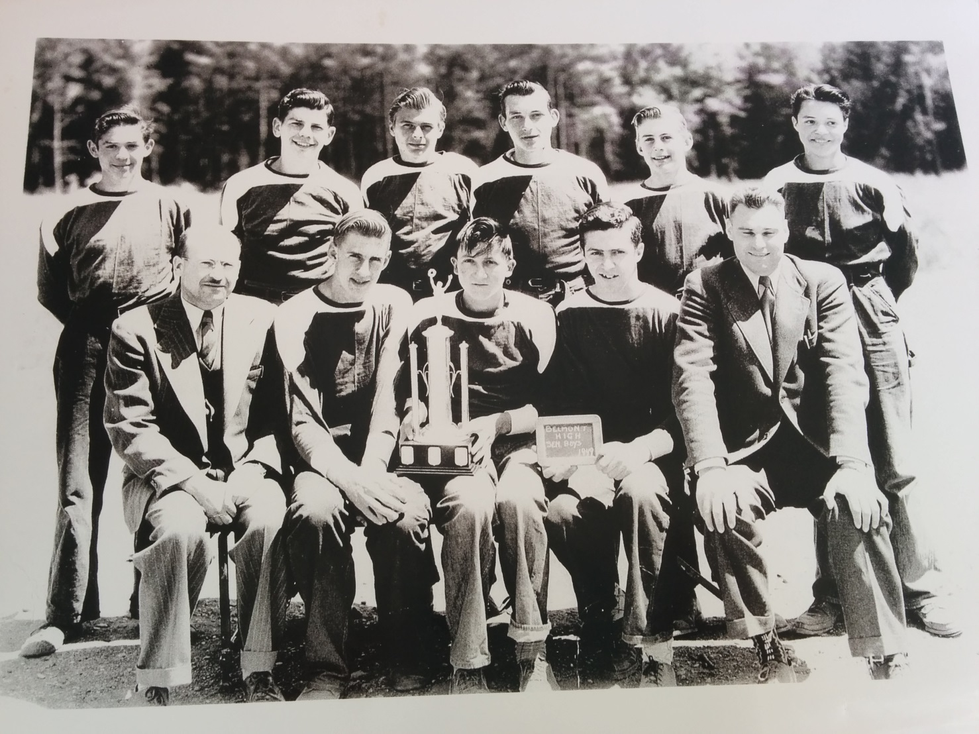
1949 Senior Boys’ Softball Team
Back Row: Terry Ridley, Werner Schneider, Vern Smith, Norm Richardson,
Eric Helgesen, Ron Brousseau
Front Row: Mr. Stephenson, Ray Helgesen, Alan “Herk” Robertson, Bill
Parker, Mr. Parrott

Slide 12
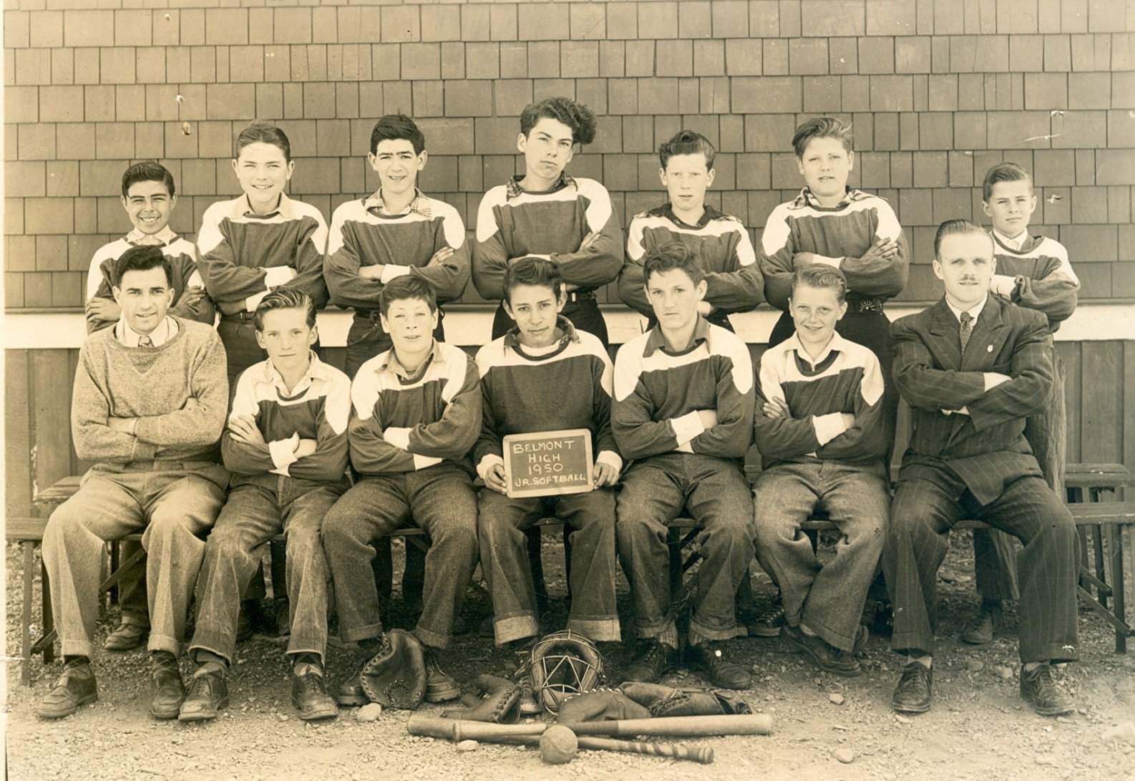
The 1949-50 junior boys’ softball team
Back: Stanley Stevens, Bernie Wachter, Bert Ridley, Tom Swanson, Gerald
Braithwaite, Marlin Reinhart, Alvin Helgesen
Front: Mr. Cox, Alan Le Quesne, Lem Mowat, Charlie Poirier, Bob Mills,
Bruce Payne, Mr. Kerley

Slide 13
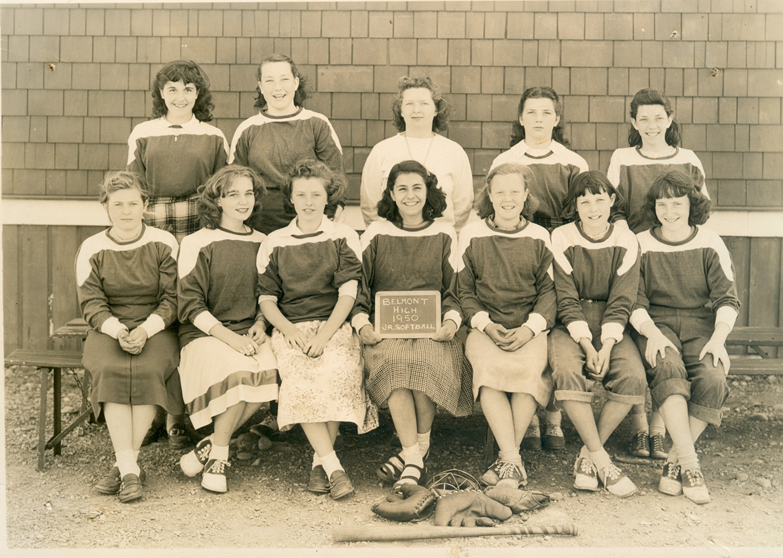
The 1949-50 junior girls’ softball team.
Back row L-R: ----- ----, Joan Richardson, Miss Frewing, Shirley Moseley, Louise Carnegie
Front row L-R: Barb Rainey, Judy Ranns, Pat Kennedy, Arlene Fortin, Irene Woodruff, Cynthia Lelliot, Jo-Ann Malloch

Slide 14
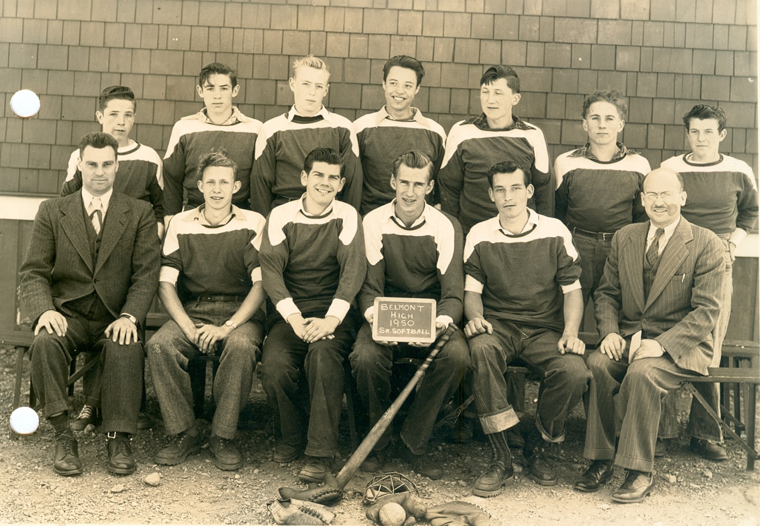
The 1949-50 boys’ senior boys’ softball team,
Back: Des Moseley, Terry Ridley, Michael Waterman, Ronnie Brousseau,
Alan Robertson, David Cann, Paul Auringer
Front: Mr. Harold Parrott, Clarence Creasser, Werner Schneider, Ray Helgesen,
Norman Richardson, Mr. Archie Stephenson

Slide 15
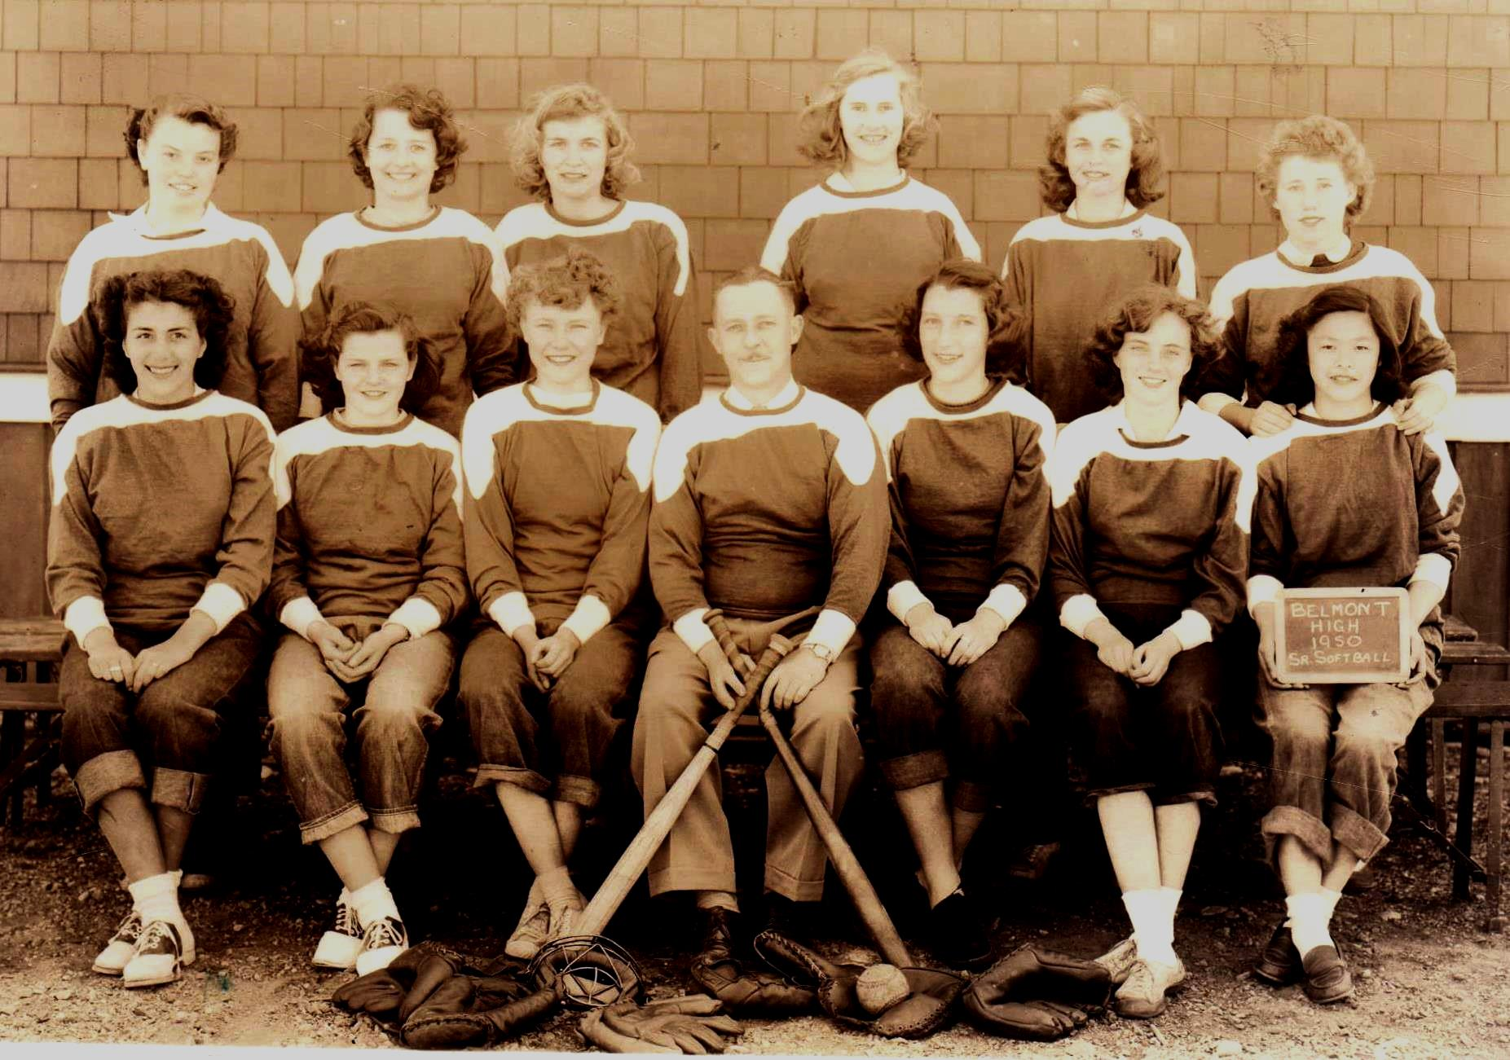
Belmont’s 1949- 50 senior girls’ softball team.
Back: Helen Vallis, Lorene Murray, Helen Cuche, Eileen Helgesen, Denise
Cuche, Lois Wilkinson
Front: Lois Poirier, Shirley Benson, Frances McCormick, Mr. Palsson,
Edith Richardson, Beverly Soderholm, Mary Chow

Slide 16
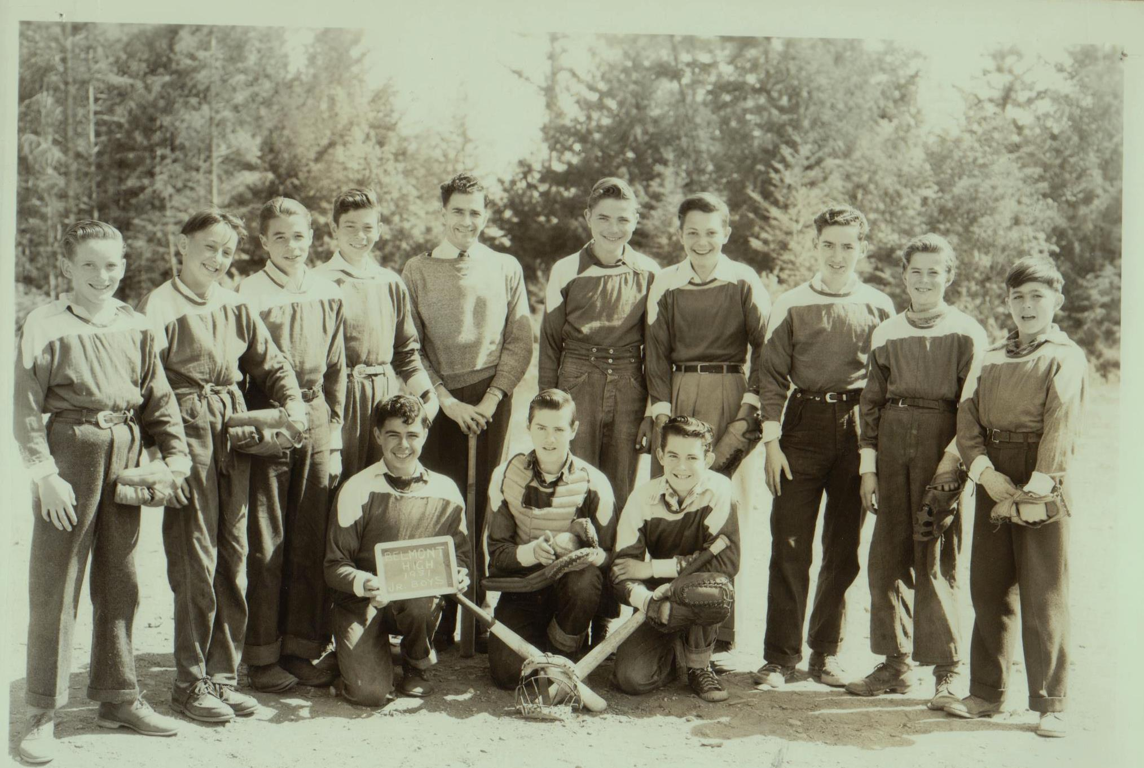
1950-51 Junior Boys Softball Team
Back: Allan Le Quesne, Ken Brousseau, Eugene Valcourt, Erwin Pollock,
Mr. Cox, Bernie Wachter, Monty Findly, Don Hurst, Alvin Helgesen,
Robert Desmoreaux
Front: Stanley Stevens,_________________, Gary Kershaw

Slide 17
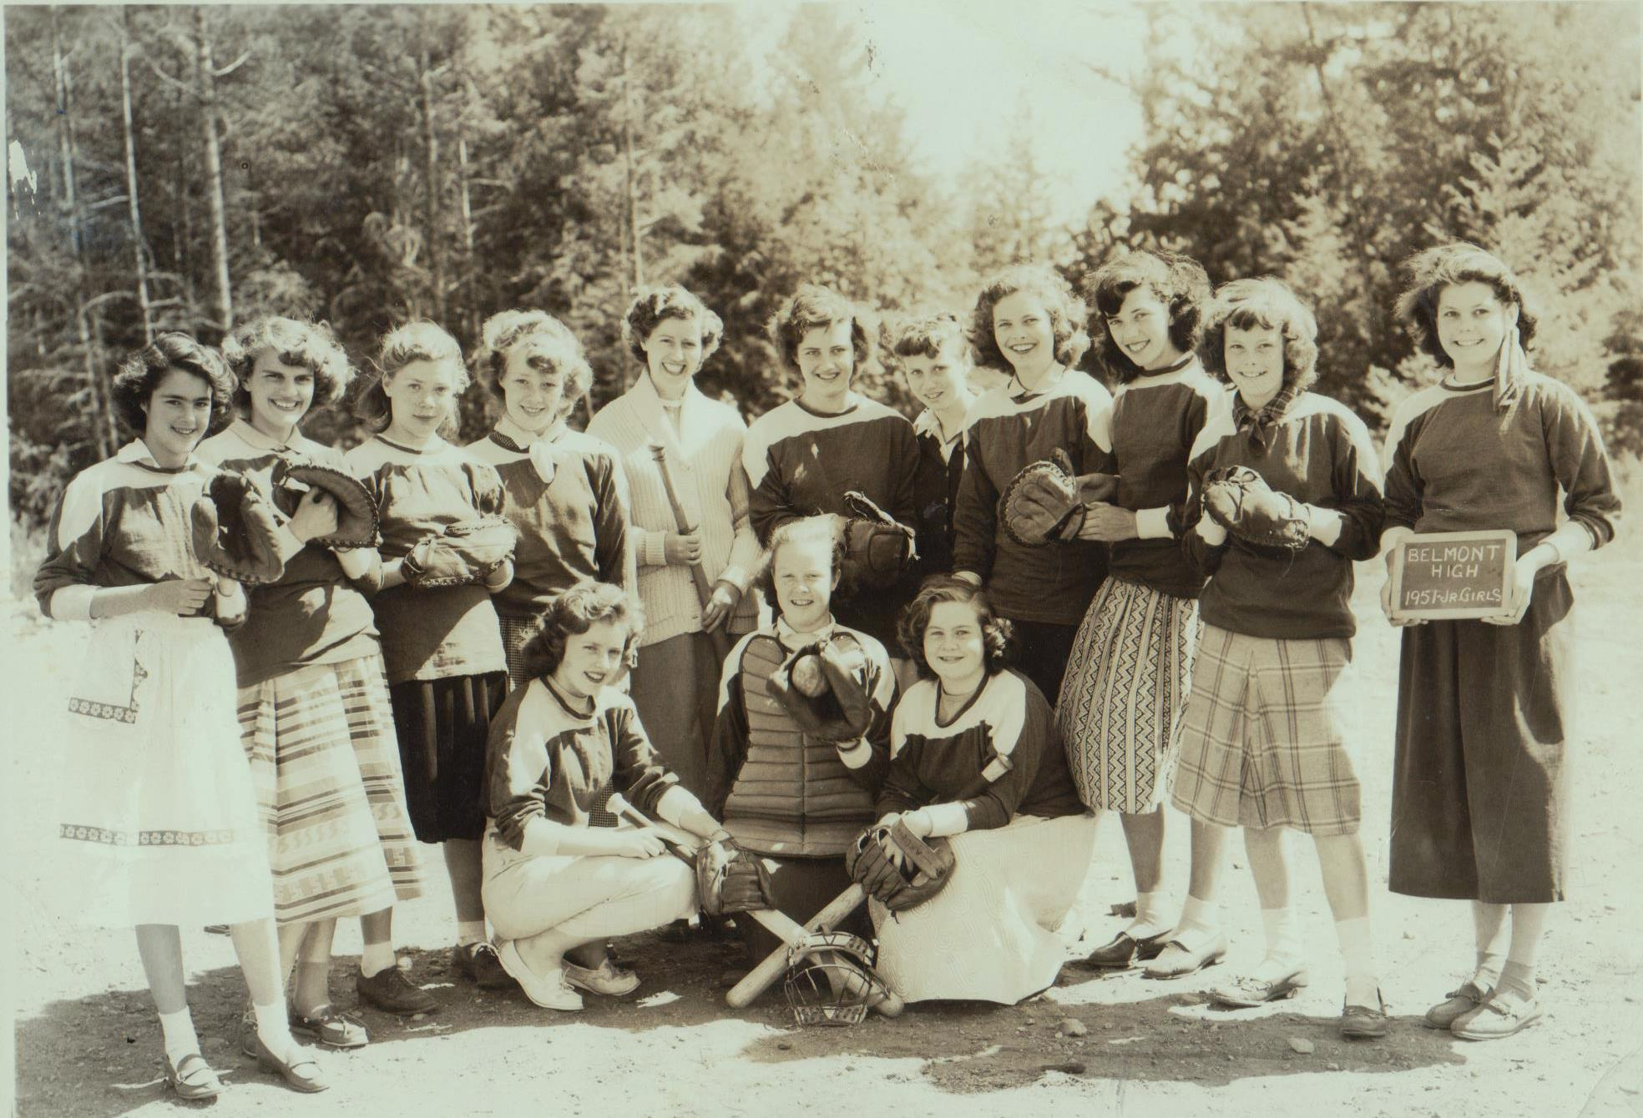
1950-51 Junior Girls Softball Team
Back: Geraldine Wilkinson, Karen Schneider, Babe Moseley, Sheilla Arden,
Miss Wade, Helene Nichols, Joan Rhodes, Pat Kennedy, Louise Carnegie,
Maxine Kennedy, Marilyn Goodenough
Front: Carol Borden, Irene Woodruff, Barbara Rainey

Slide 18
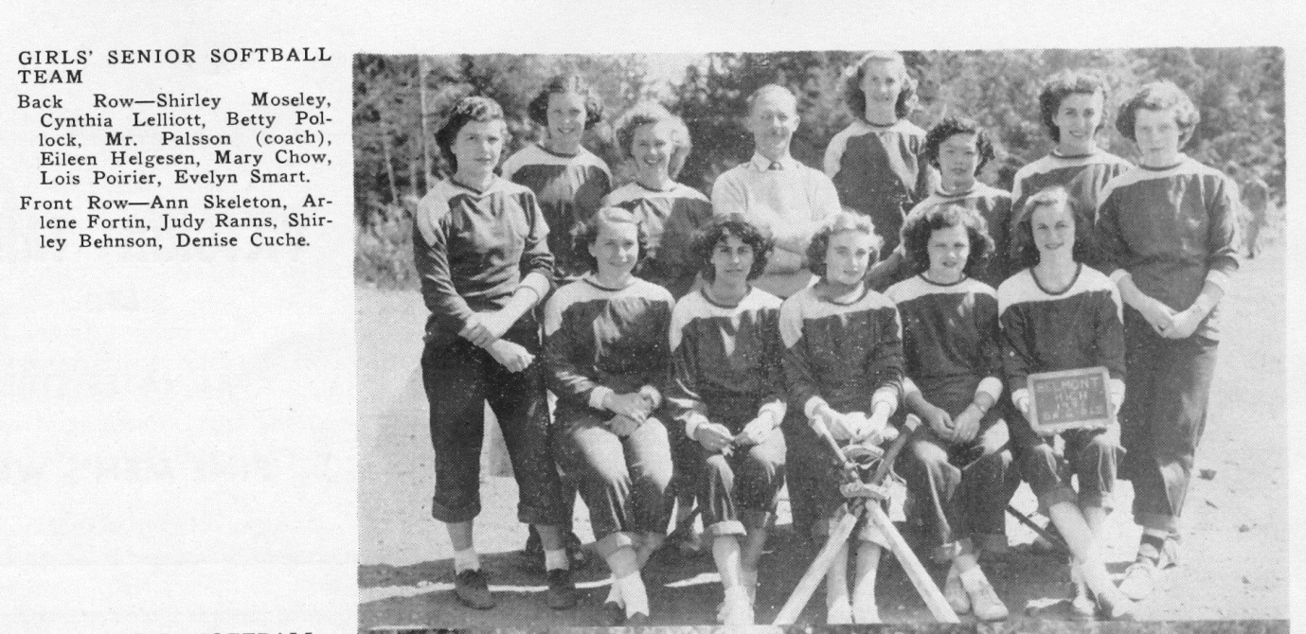
The 1950-51 girls’ softball team. Notice the rough rocky surface on which the girls played their games.

Slide 19
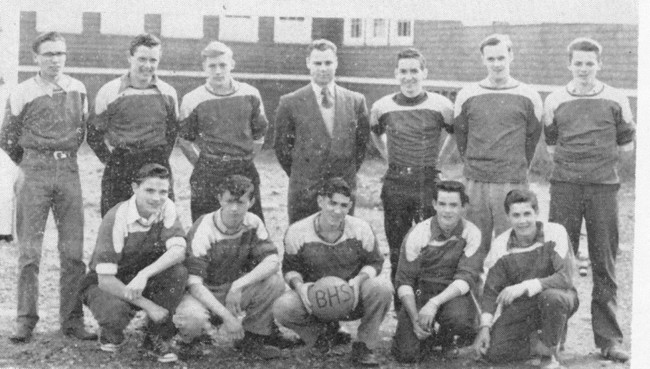
The 1952-53 senior boys’ basketball team had to practice outdoors on
the asphalt surface since there was still no gymnasium at Belmont.

Slide 20
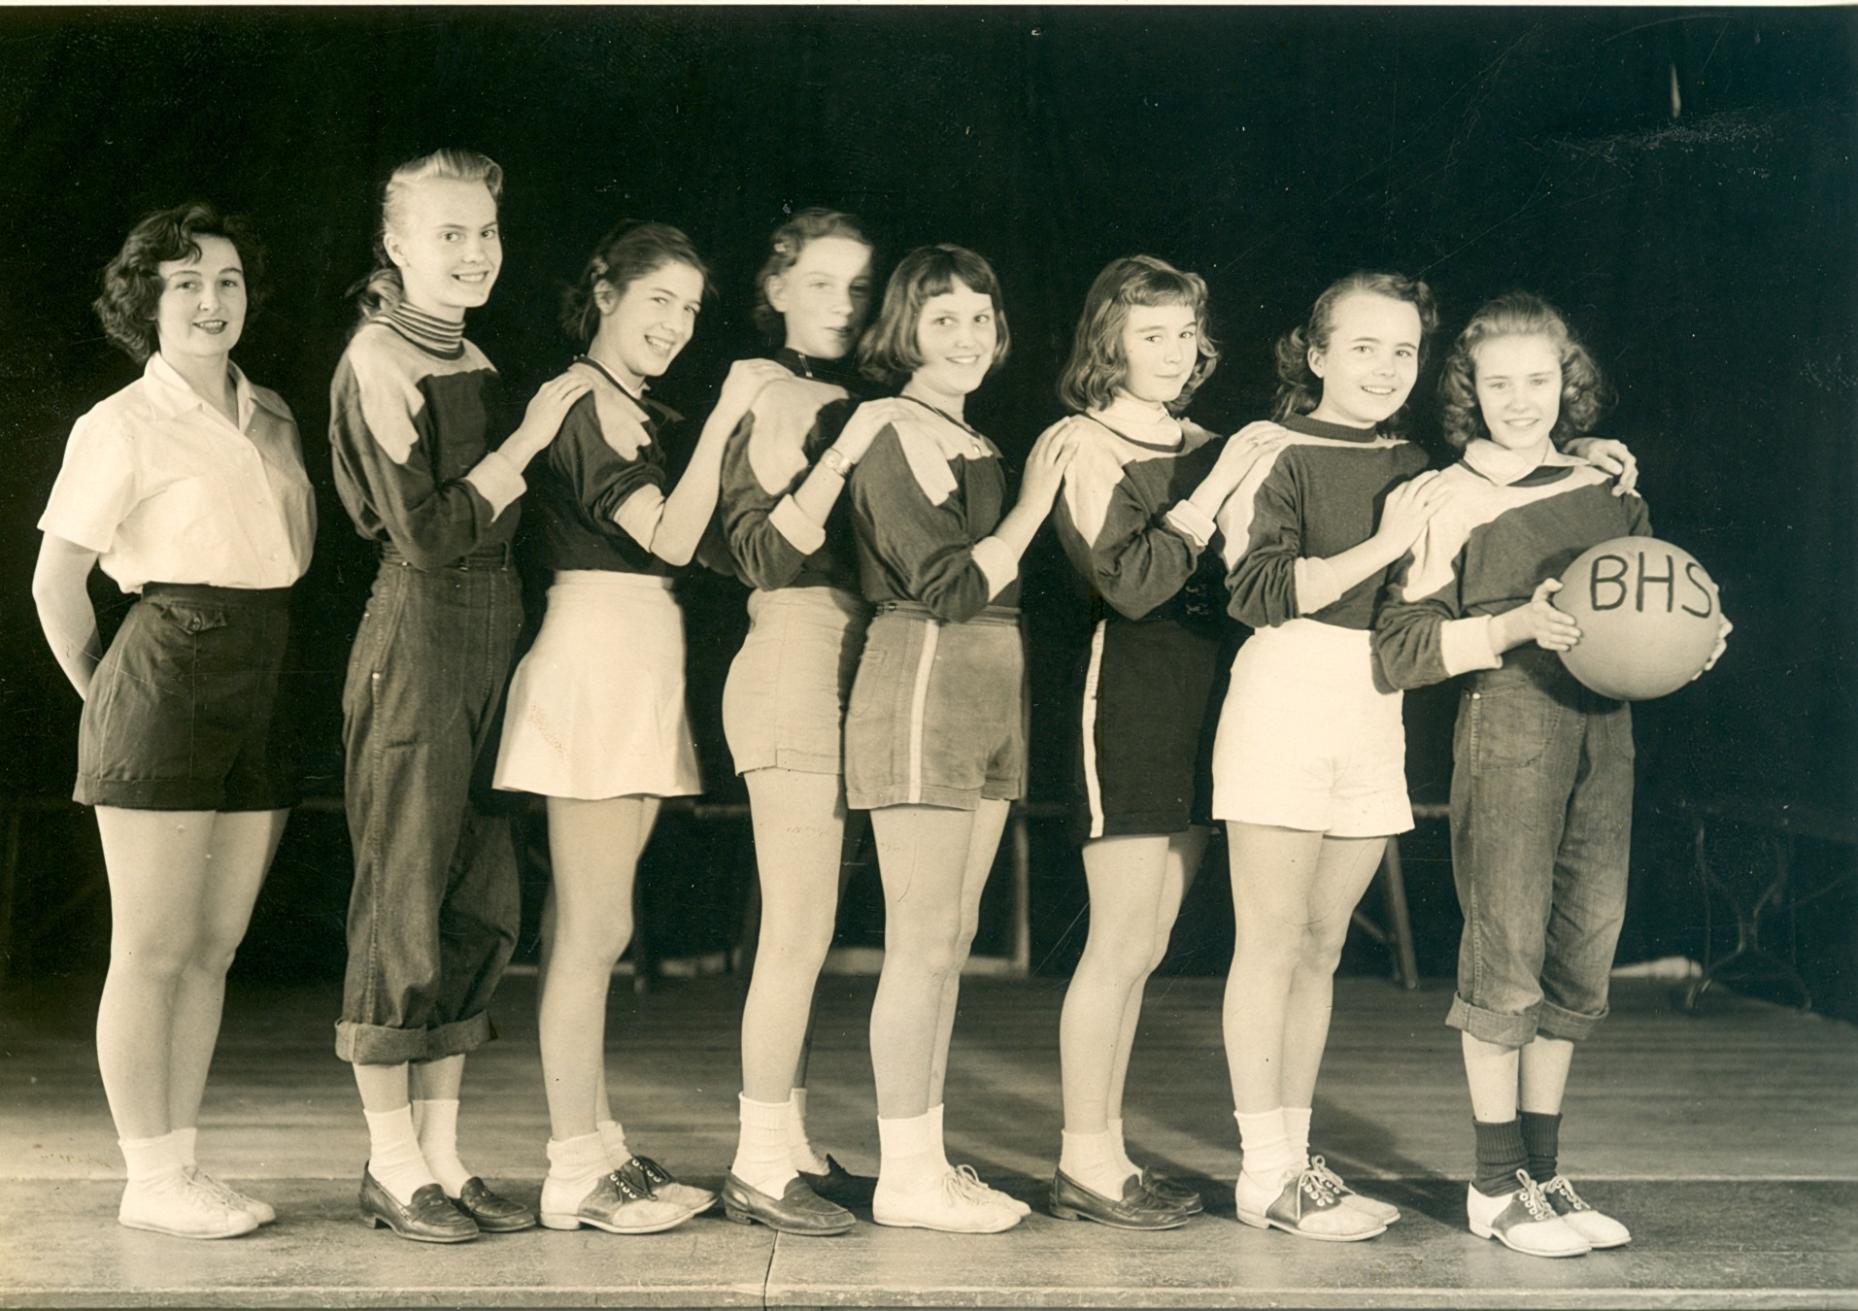
The 1952-53 junior girls’ basketball team

Slide 21
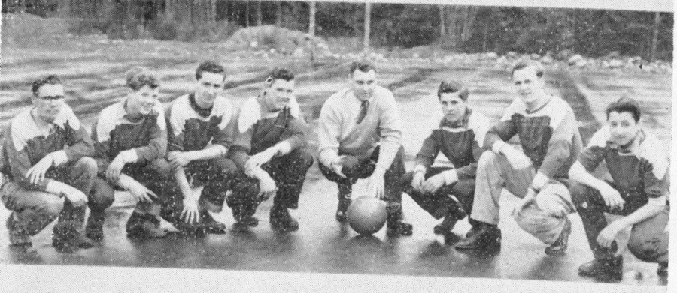
The 1952-53 boys’ soccer team. The guys had to deal with the rough
school field that was still littered with gravelly deposits, despite the best
efforts of Archie Stephenson and the student body.

Slide 22
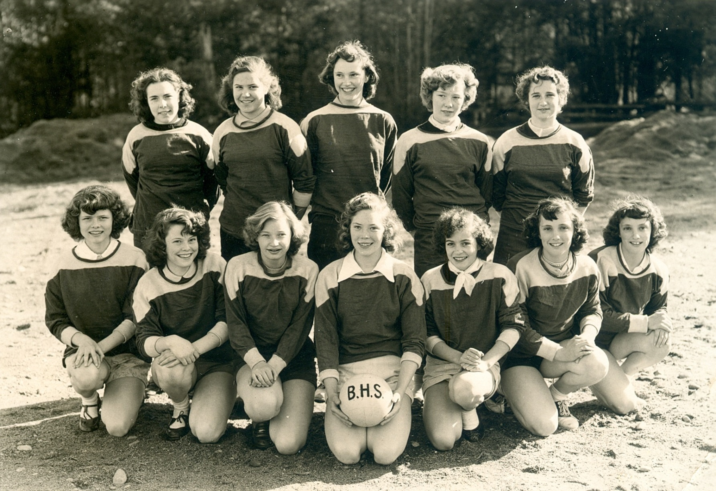
1952-53 Girl’s Volleyball Team
Back Row L-R: Joyce Borden, ______________, Robin Price, Sheilla Arden, Sandra Futcher,
Front Row L-R: Carolyn Hiscock, Maxine Kennedy, Shirley Darrin, Marilyn (Babe) Moseley, Peggy
Hurst, Francis Price, Freda Price

Slide 23
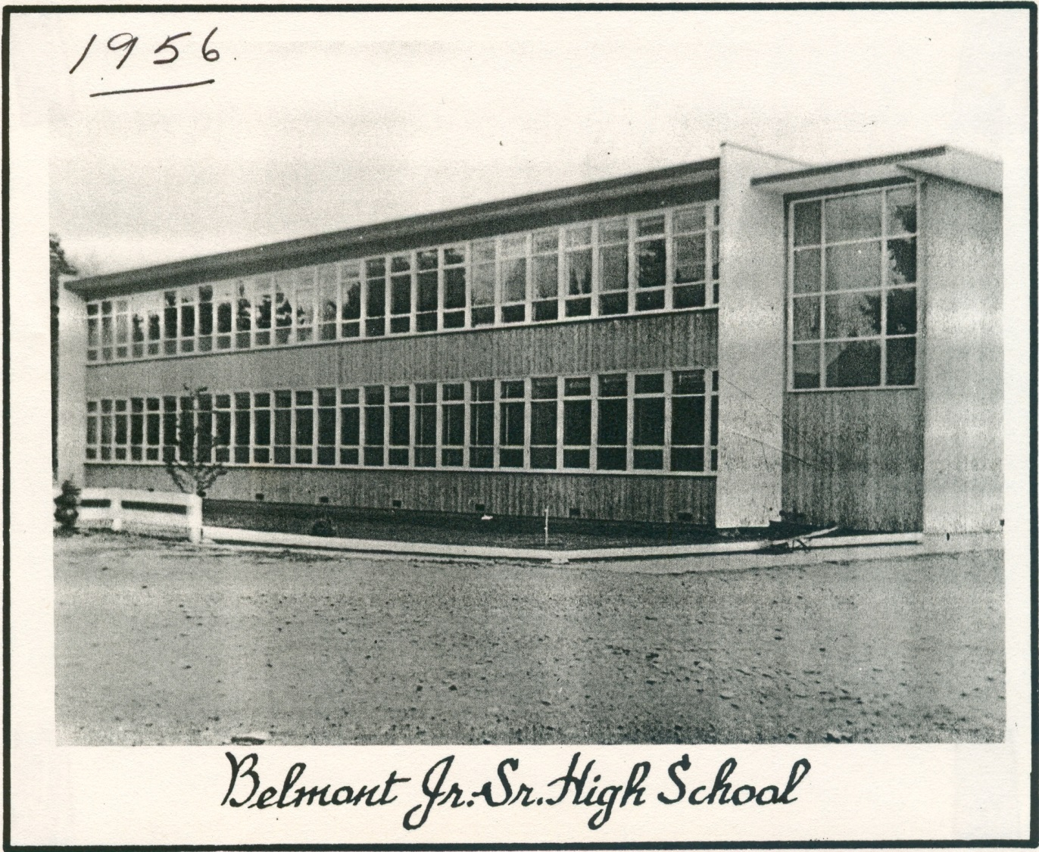
The completion of the new Belmont building meant that the students
now had a proper gymnasium, and indoor sports such as basketball,
volleyball, floor hockey and badminton could be played all year. This
resulted in a greater variety of extracurricular sporting activities, and
Belmont teams became able to compete with more established Victoria
schools such as Oak Bay and Vic High.

Slide 24
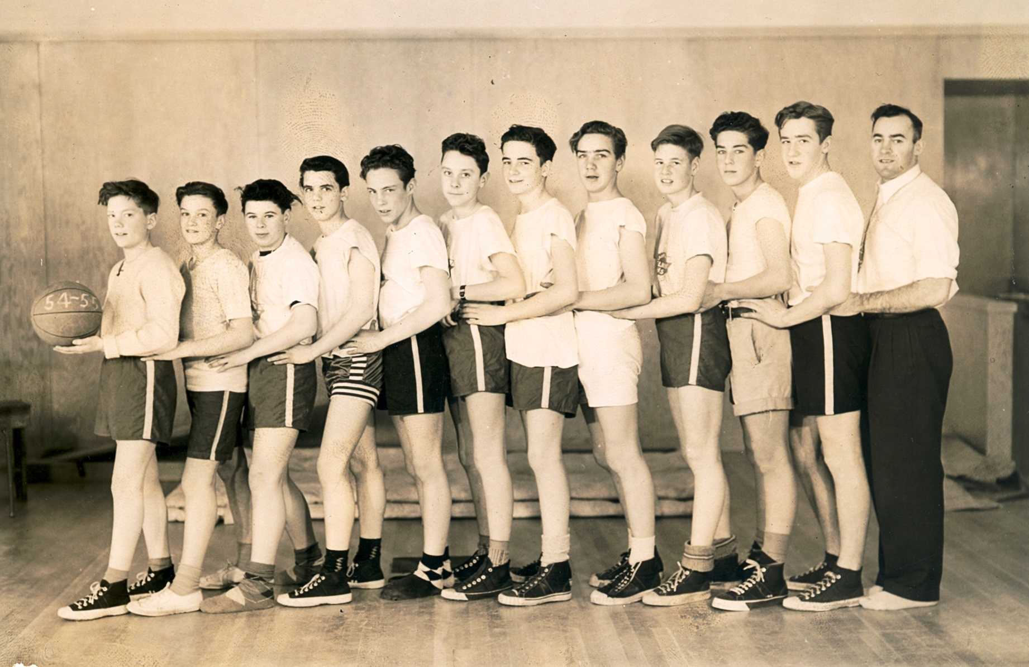
The 1955 junior boys’ basketball team

Slide 25
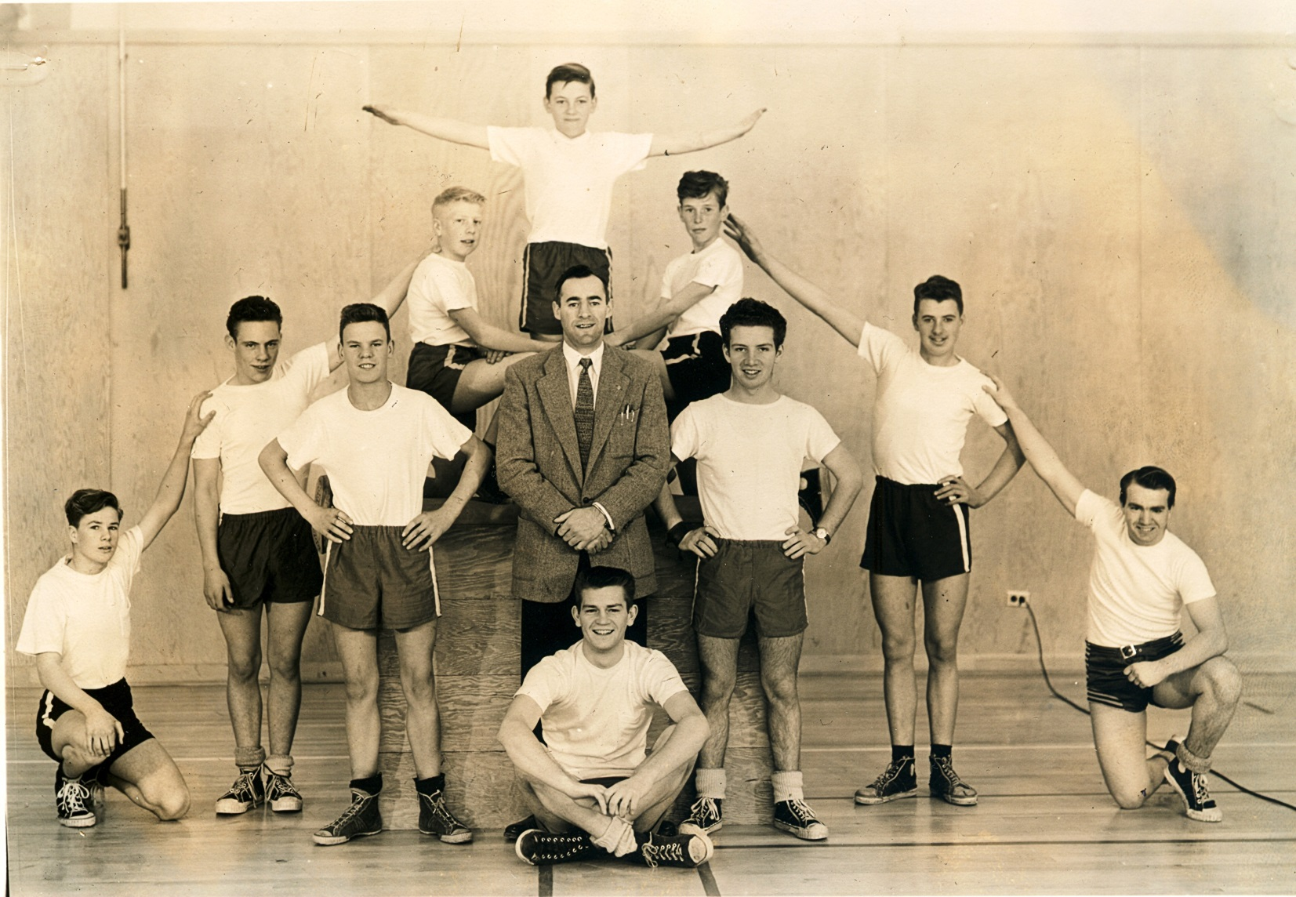
Tumbling was a new activity added in the mid 1950’s. Here, the 1955-56
boys’ squad creates an interesting team photo under the capable leadership
of Mr. Frank Gower.

Slide 26
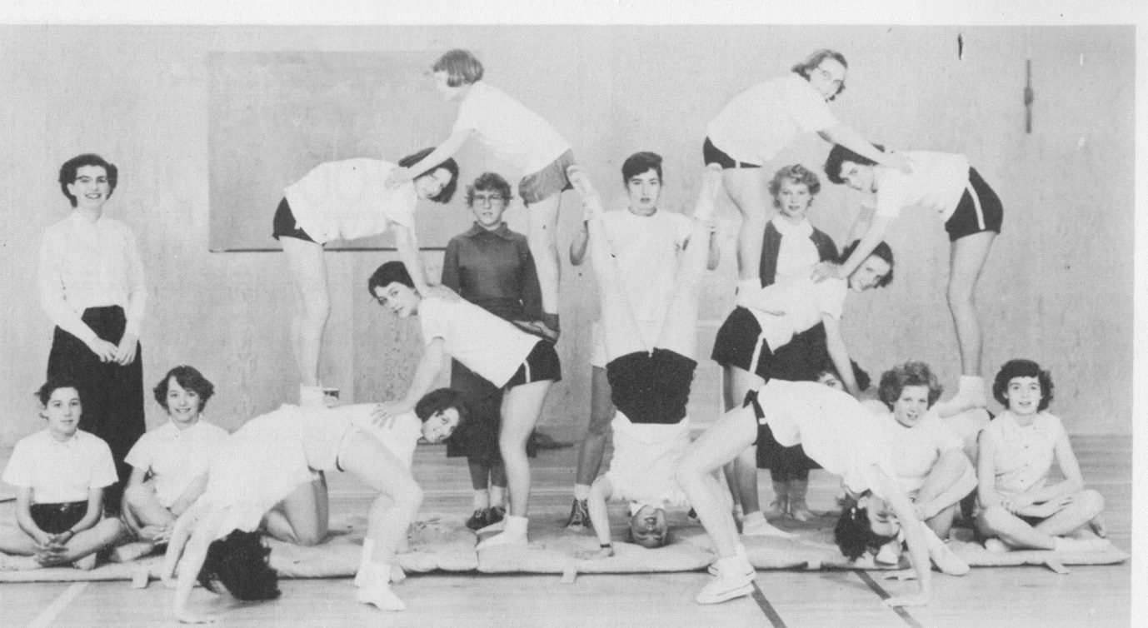
Not to be outdone by the boys, the 1955-56 girls’ tumbling club create
an impressive pose.

Slide 27
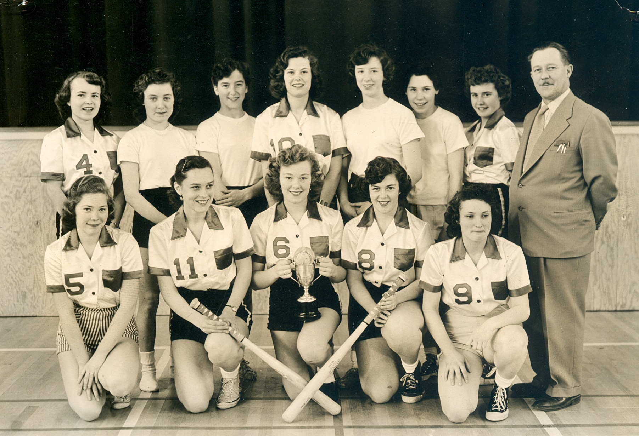
The 1955-56 senior girl’s softball team,
Back: L. Simms, R. Wakeman, S. Futcher, M. Kennedy, J. Fraser, M. Poirier,
G. Peden, Coach Mr. Palsson
Front: M. Moseley, C. Sudhues, S. Arden, D. Price, F. Price

Slide 28
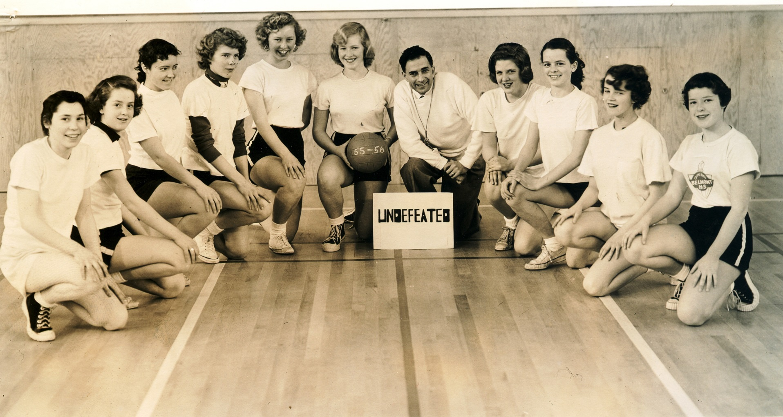
The 1955-56 girls’ junior girls’ basketball team enjoyed
a very successful season.

Slide 29
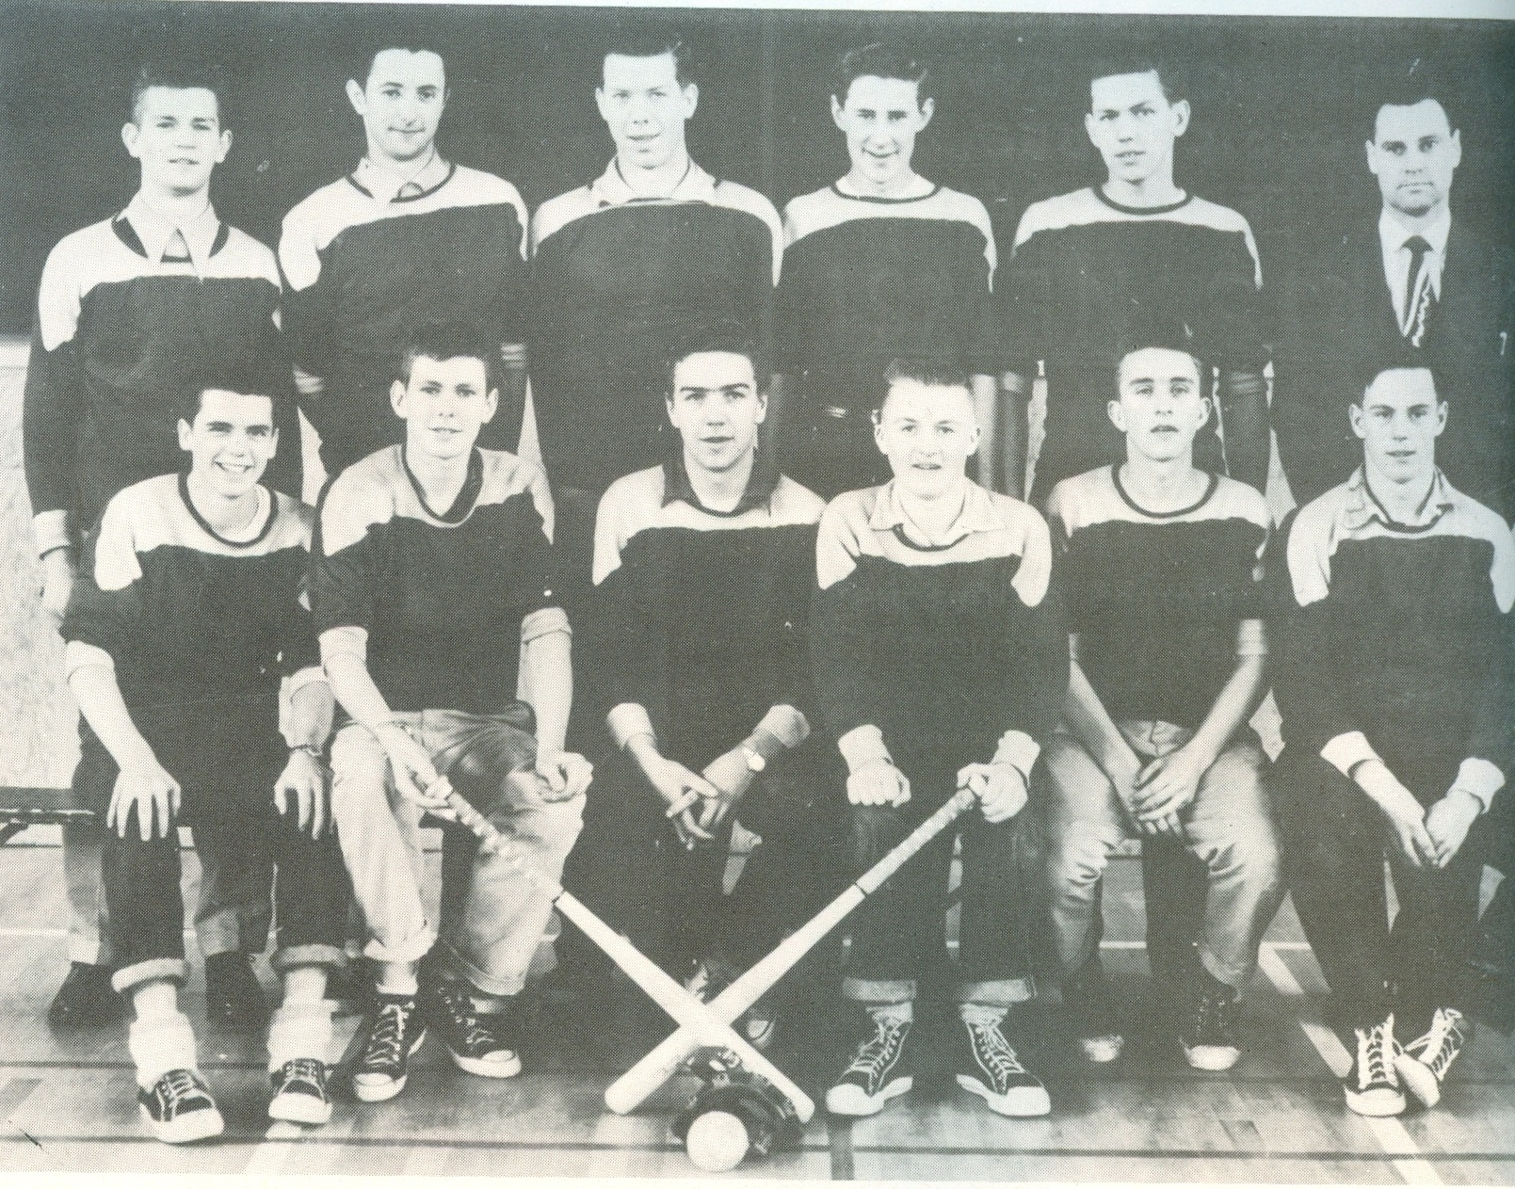
1955-56 Senior Boys’ Softball Team

Slide 30
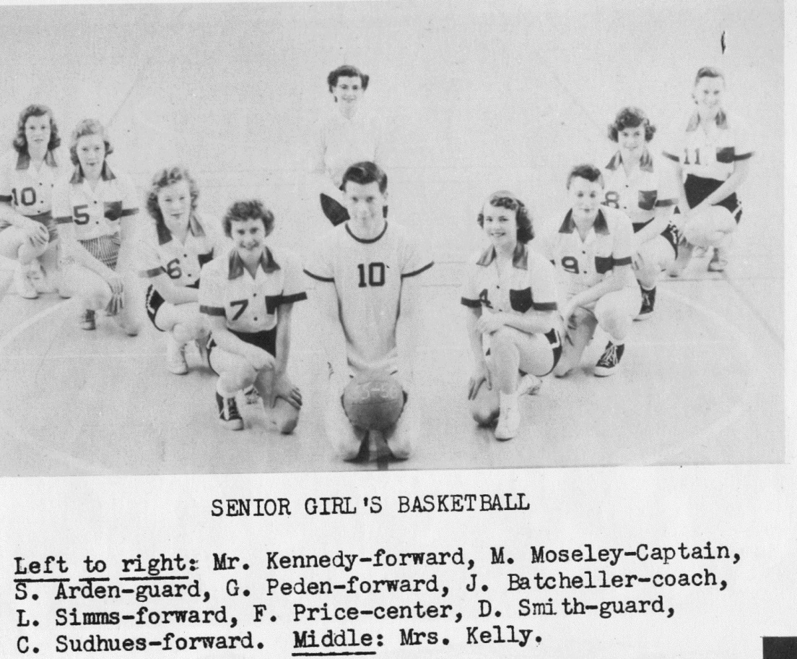
The 1955-56 girls’ basketball team. Rumour has it there was a
larger-than-usual turnout that year when the girls learned that
Braves’ star John Batchellor had volunteered to coach the team.

Slide 31
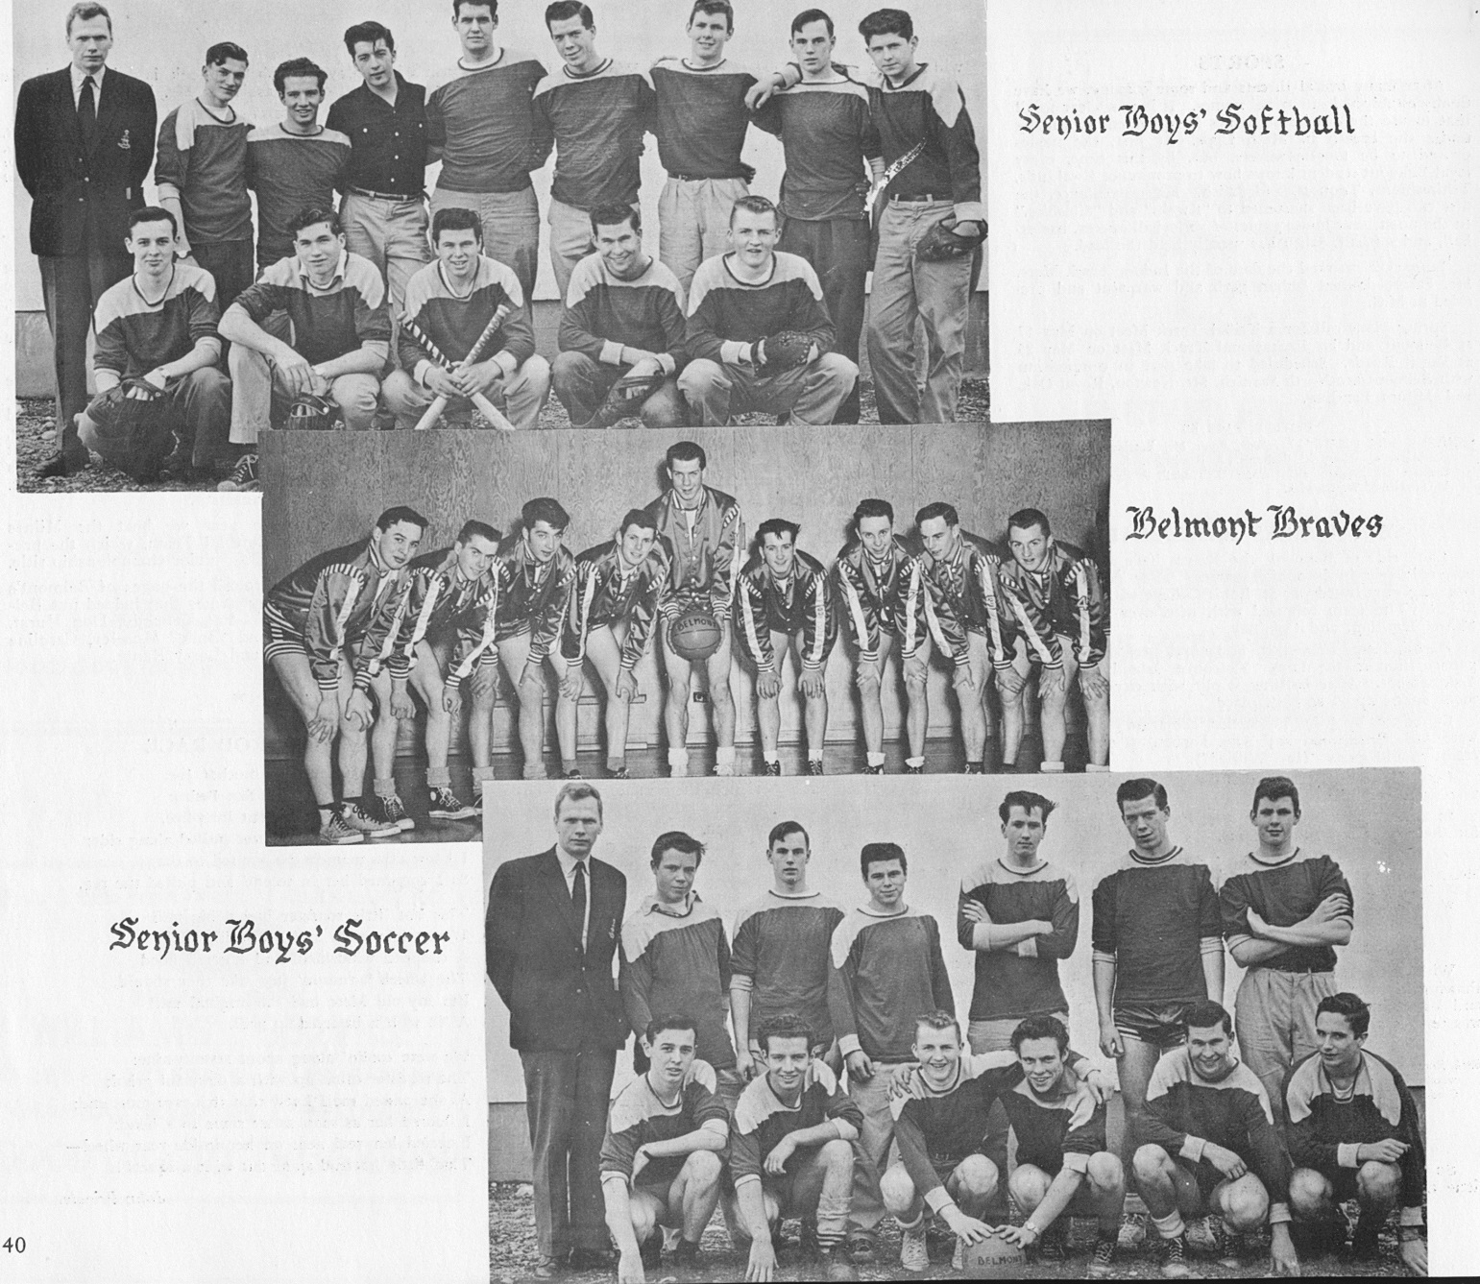
Some of the high profile senior boys’ teams from1956-57 teams. The
basketball boys appear to have gotten new flashy uniforms.

