Slide 1
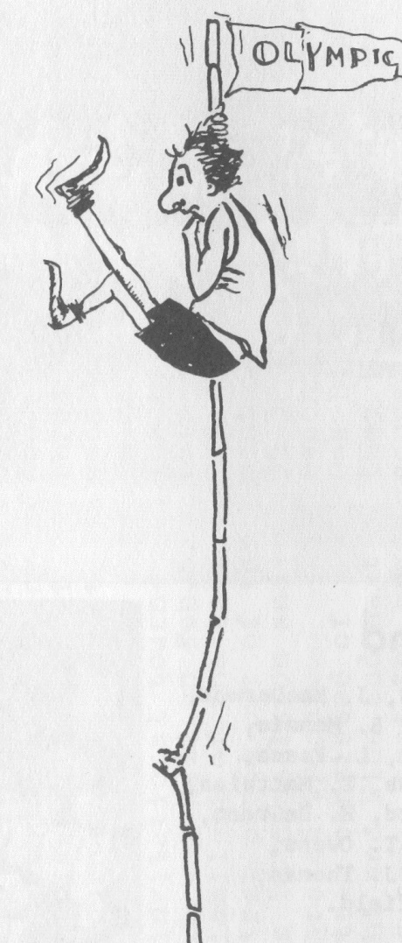
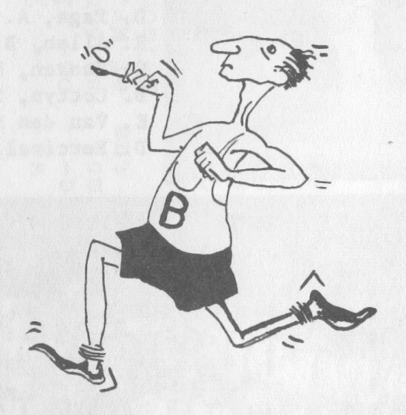
Belmont Sports Photos from the 1960’s

Slide 2
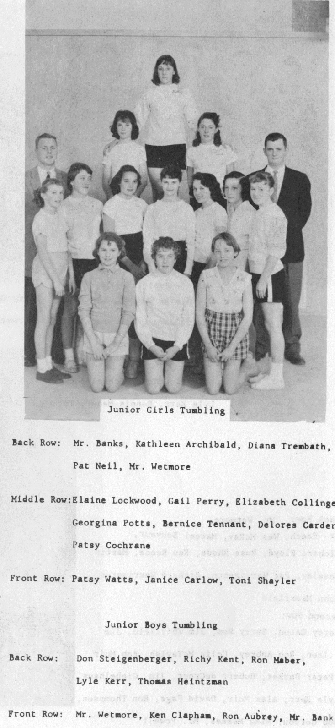
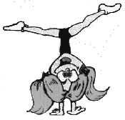
Belmont’s Girls Tumbling Team
1960

Slide 3
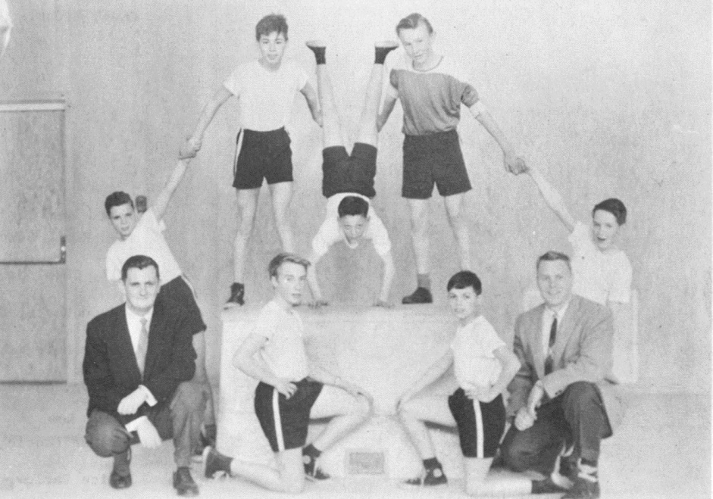
Junior Boys Tumbling Team

Slide 4
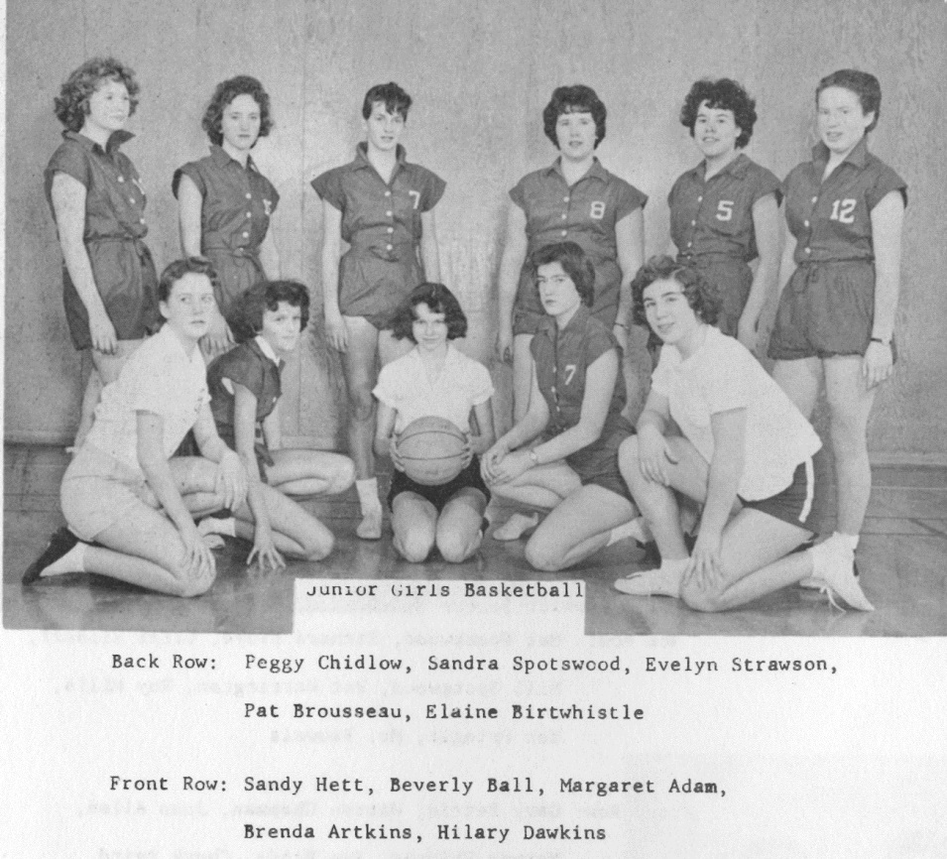
Junior Girls Basketball Team

Slide 5
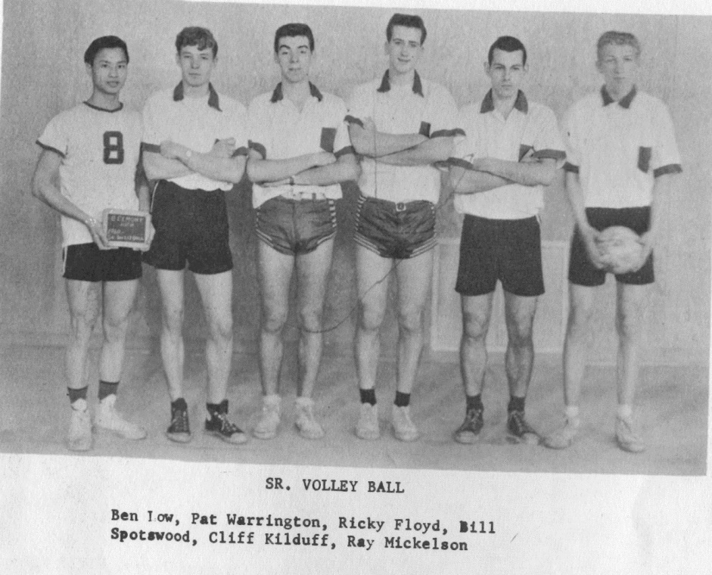
Senior Boys Volleyball Team

Slide 6
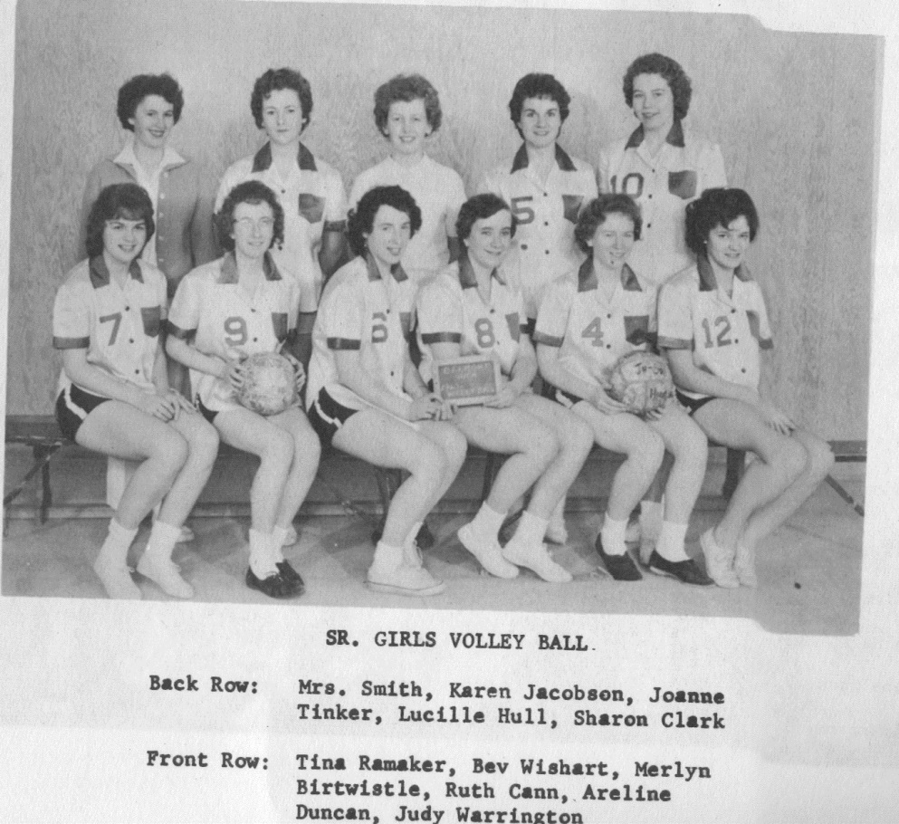
Senior Girls Volleyball

Slide 7
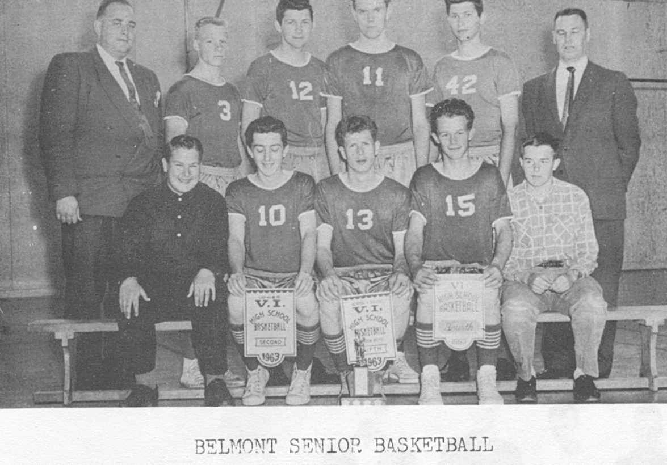
Senior Boys Basketball
1962-63

Slide 8
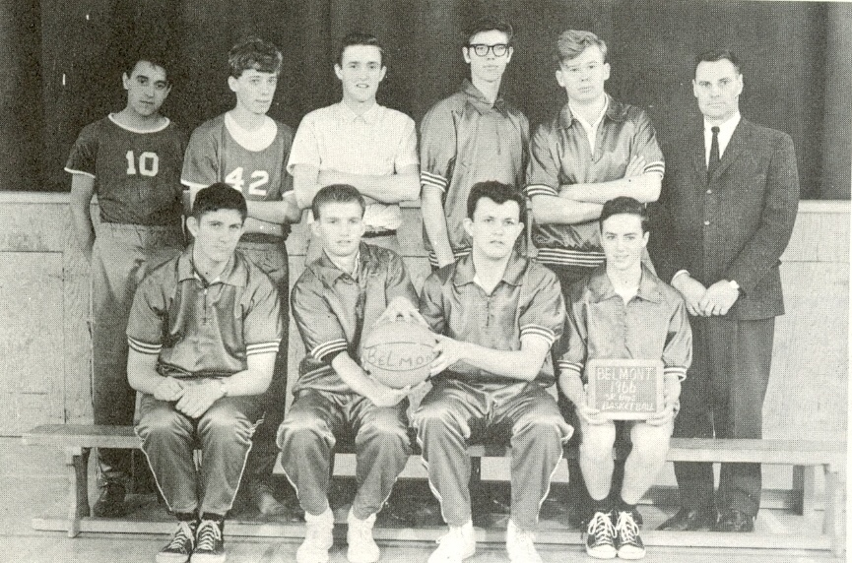
1966 Boys Basketball Team

Slide 9

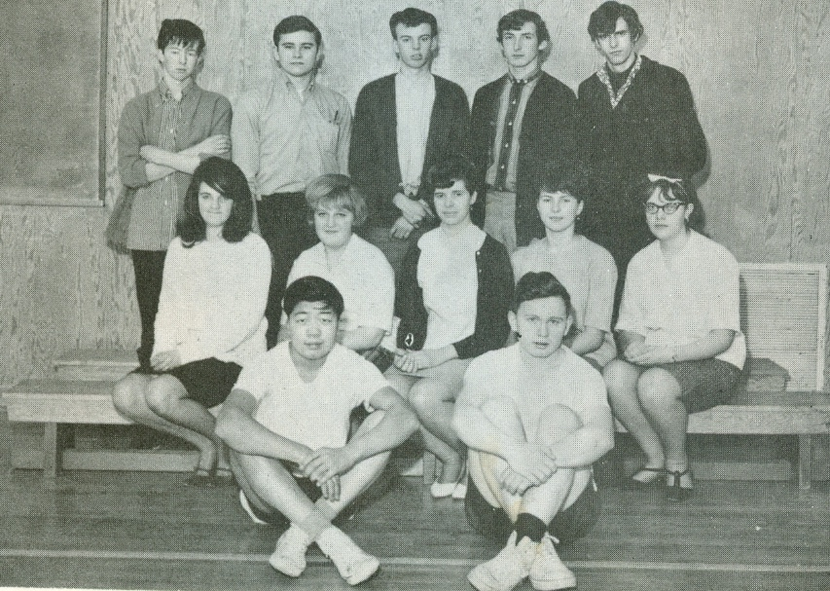
1967 Bowling Team

Slide 10
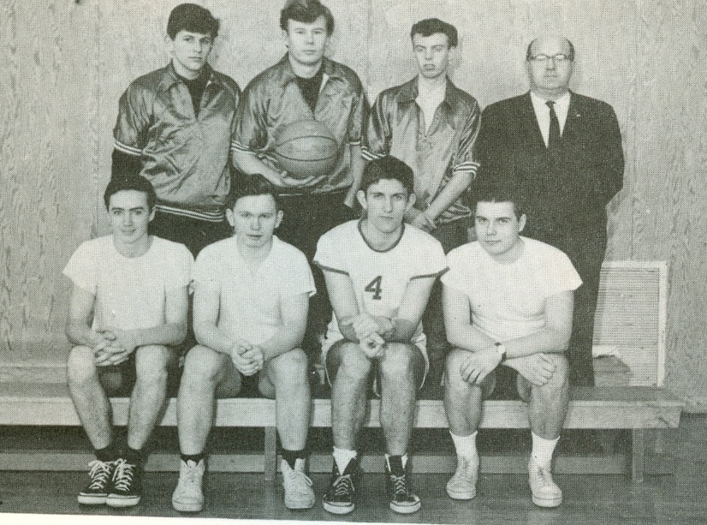
1967 Boys Basketball Team

Slide 11
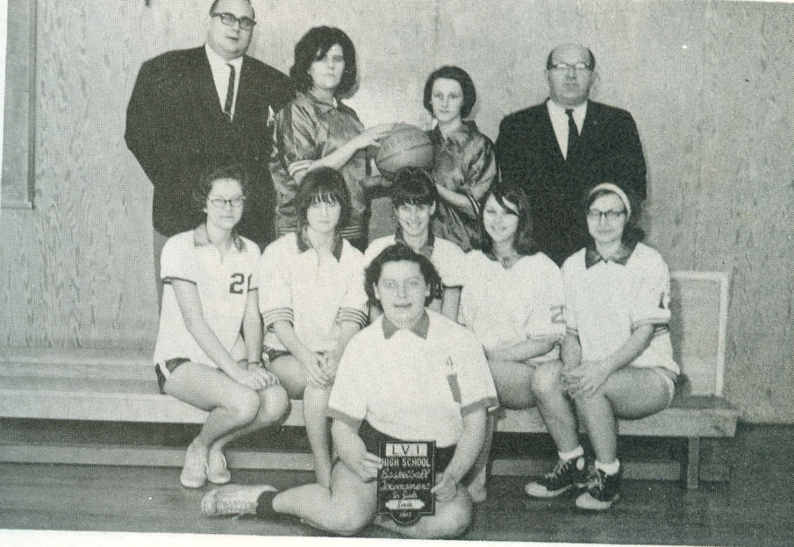
1967 Girls Basketball Team

Slide 12
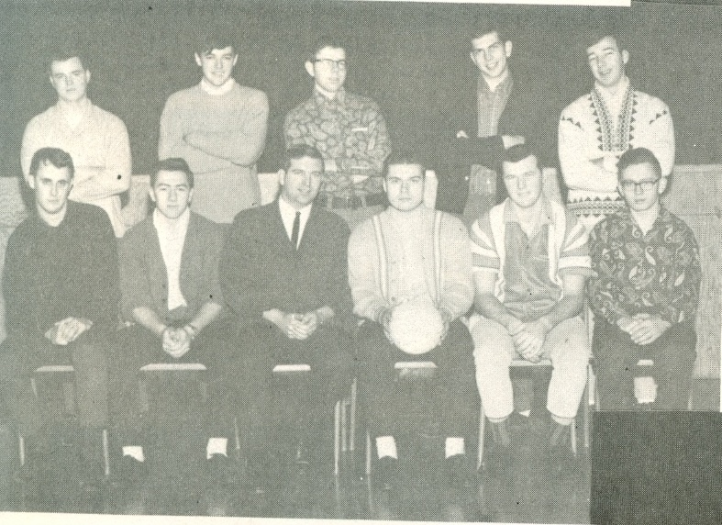
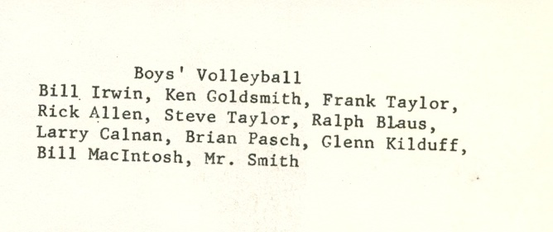
1968 Boys Volleyball Team

Slide 13
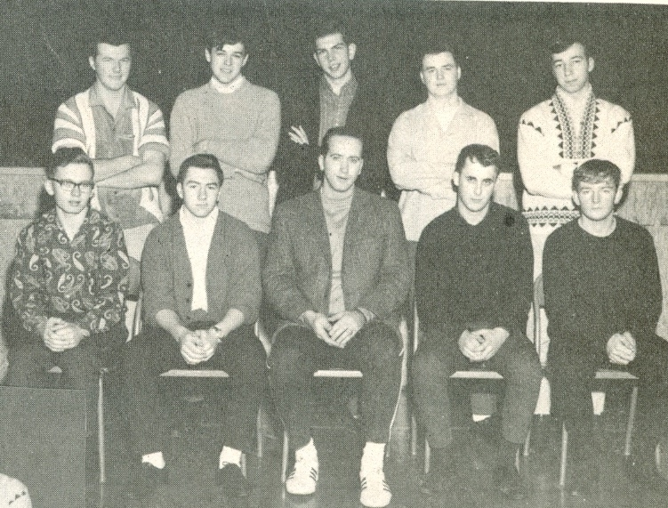
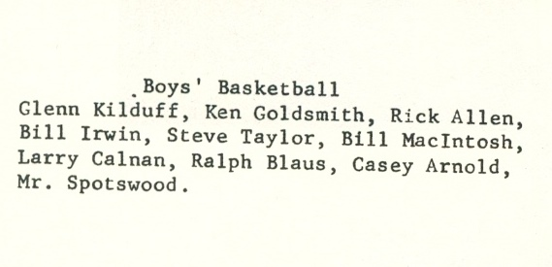
1968 Boys Basketball Team

Slide 14
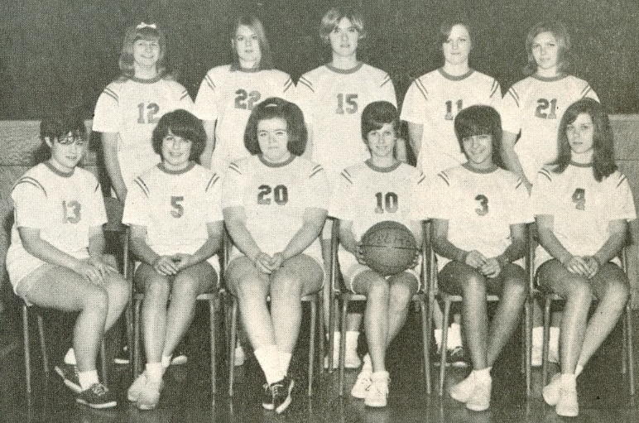
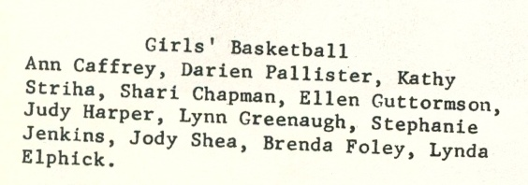
1968 Girls Basketball Team

Slide 15
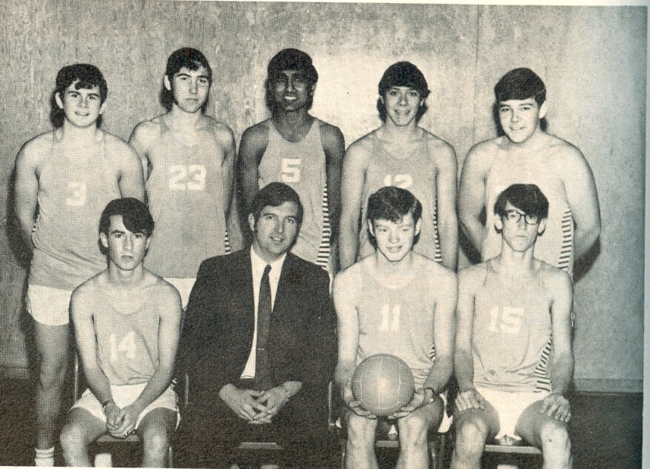

1969-70 Boys Volleyball Team

Slide 16
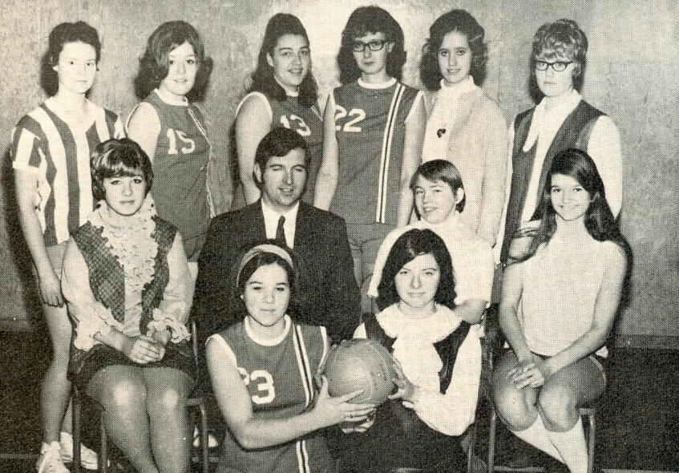
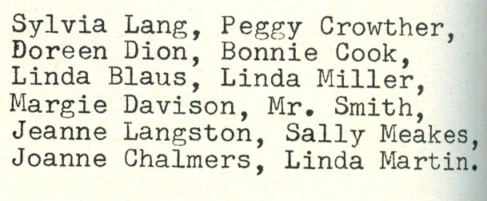
1969-70 Girls Volleyball Team

Slide 17
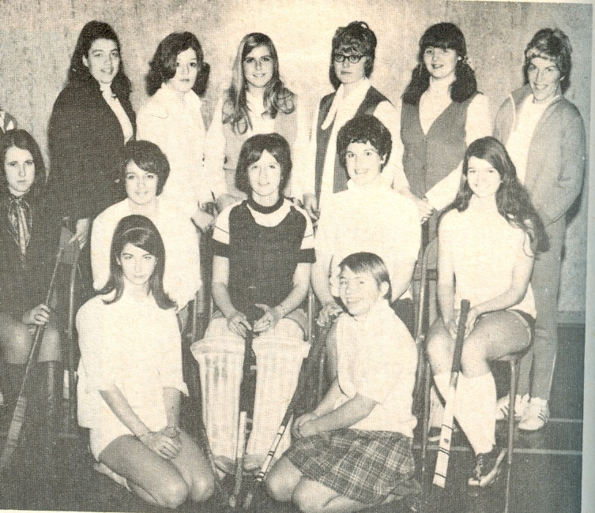
1969-70 Girl’s Field Hockey Team

