Slide 1
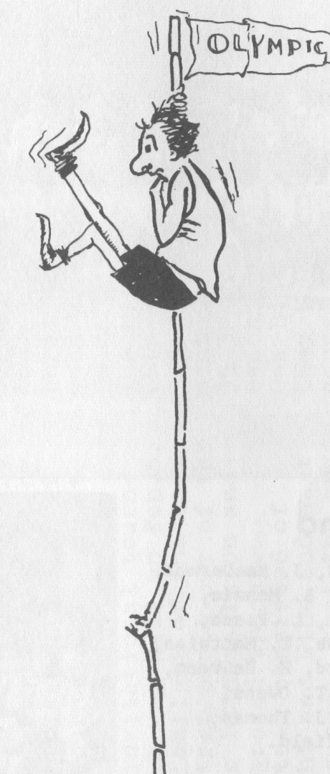
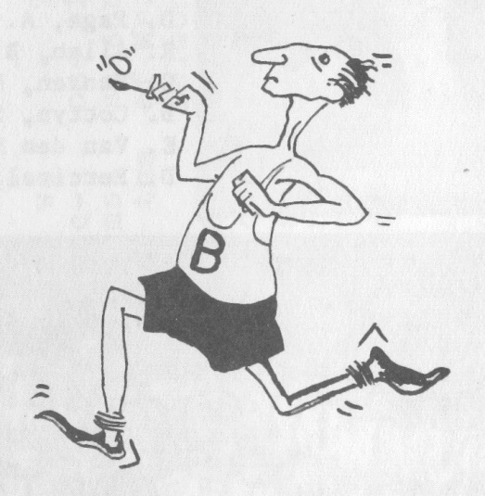
Belmont Sports Photos From the 1970’s

Slide 2
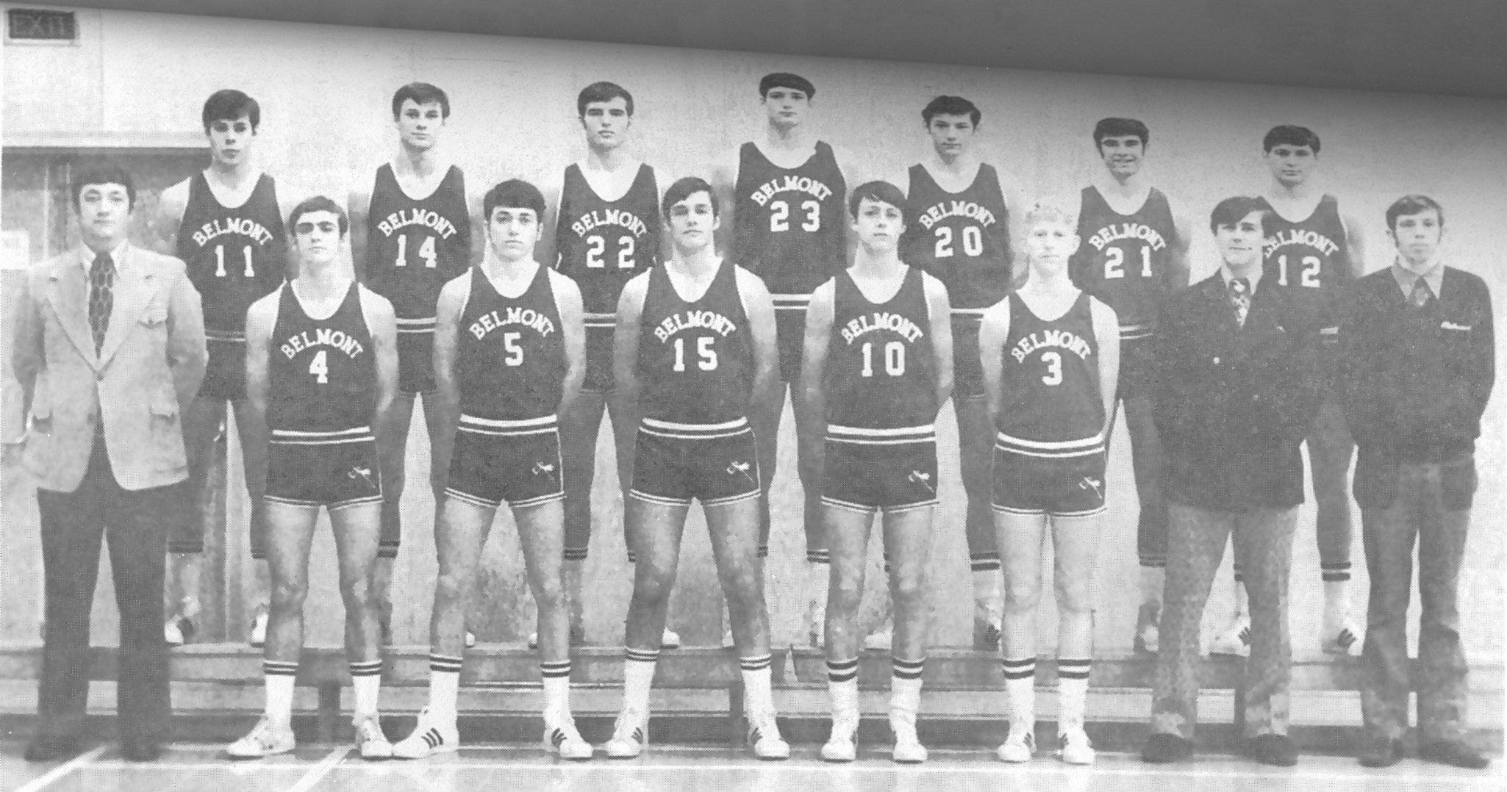
1971 Boys’ Basketball Team

Slide 3
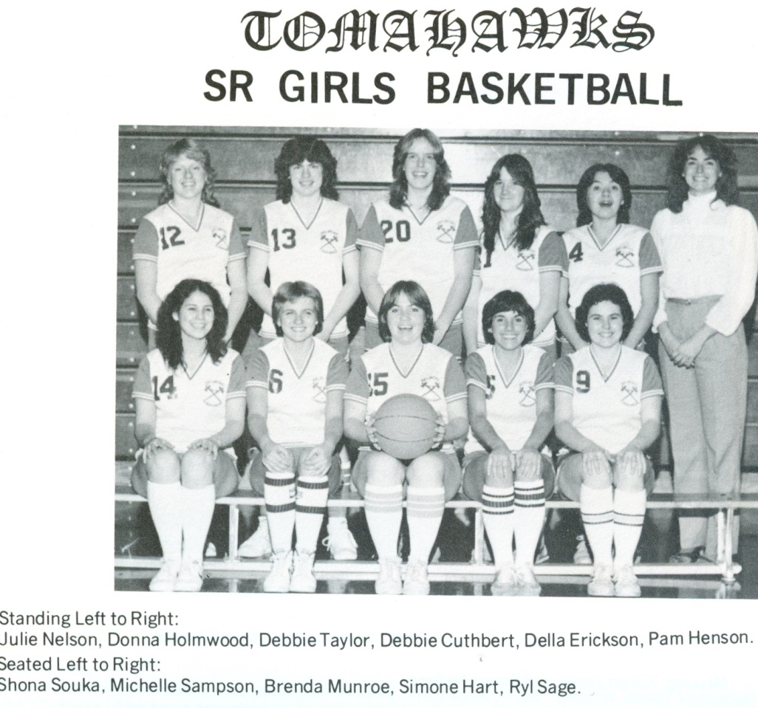

Slide 5
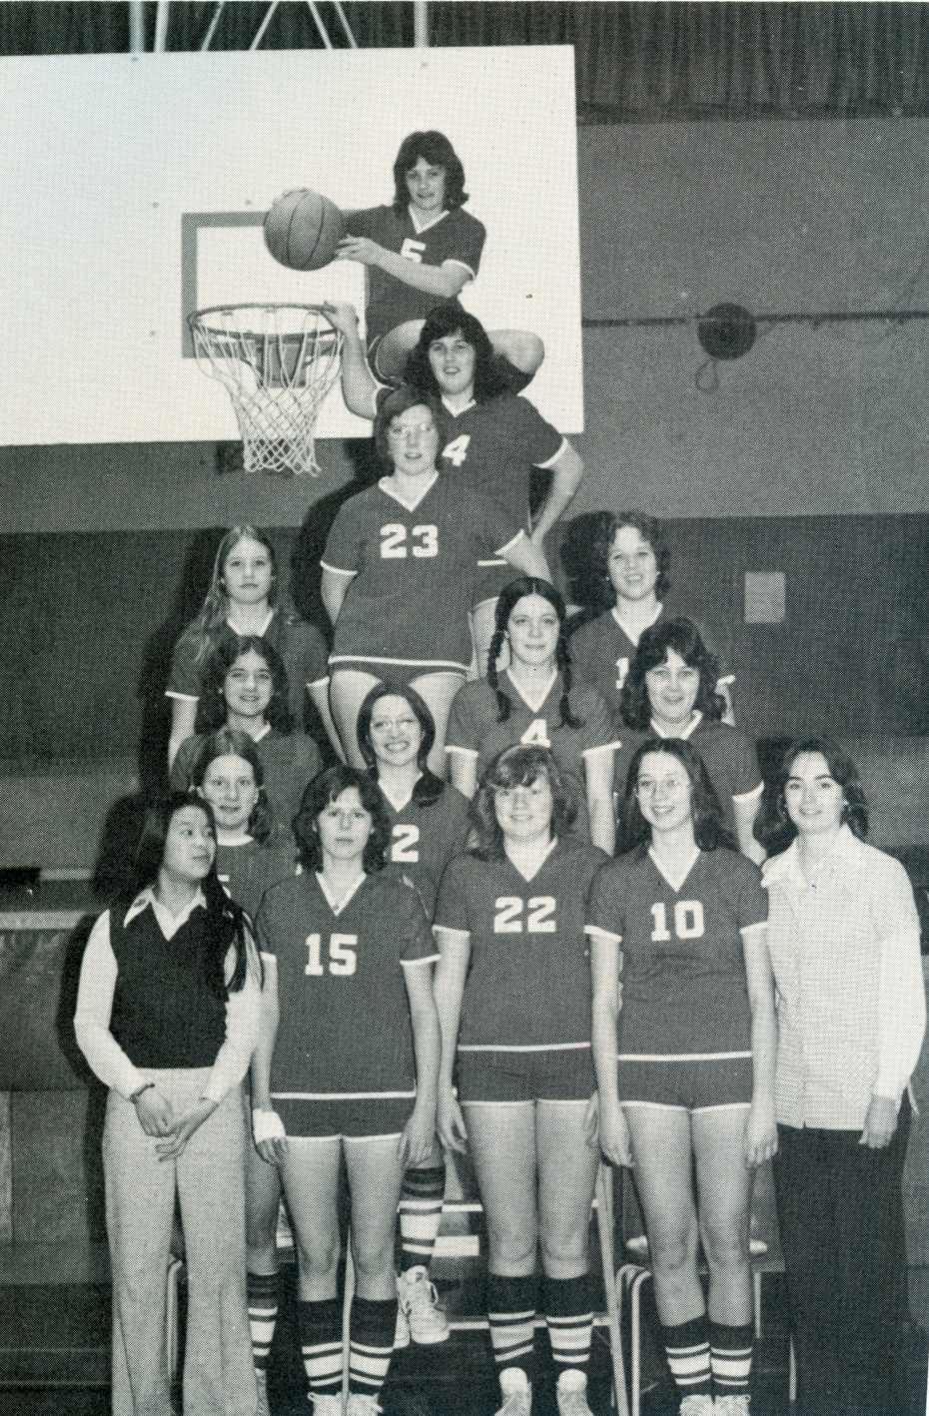
1974-75 Senior Girls’ Basketball

Slide 6
1975-76 Swim Team

Slide 7
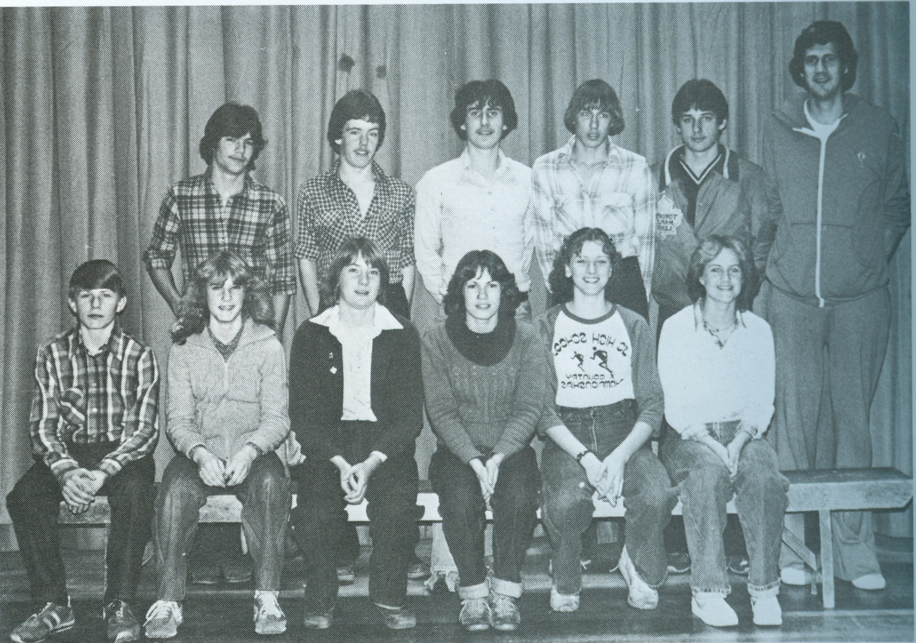
1979-80 Cross Country

Slide 8
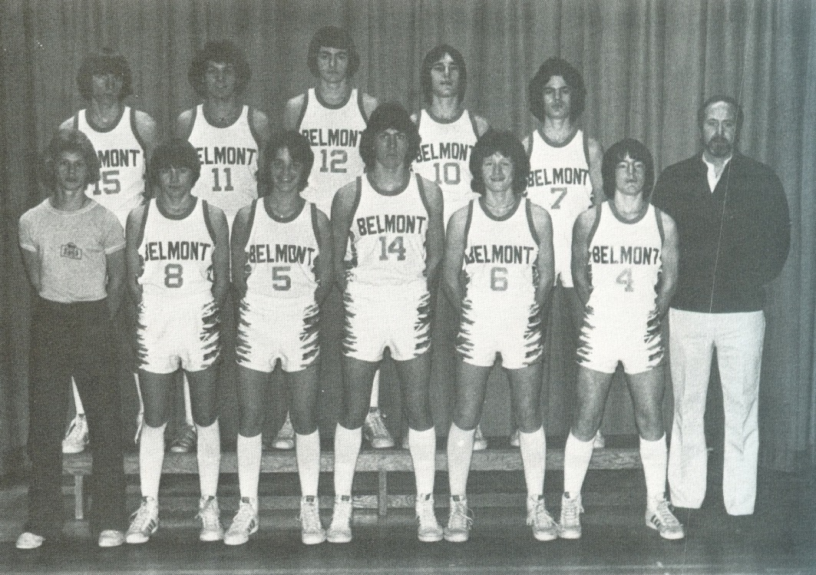
1979-80 Junior Boys’ Baskektball

Slide 9
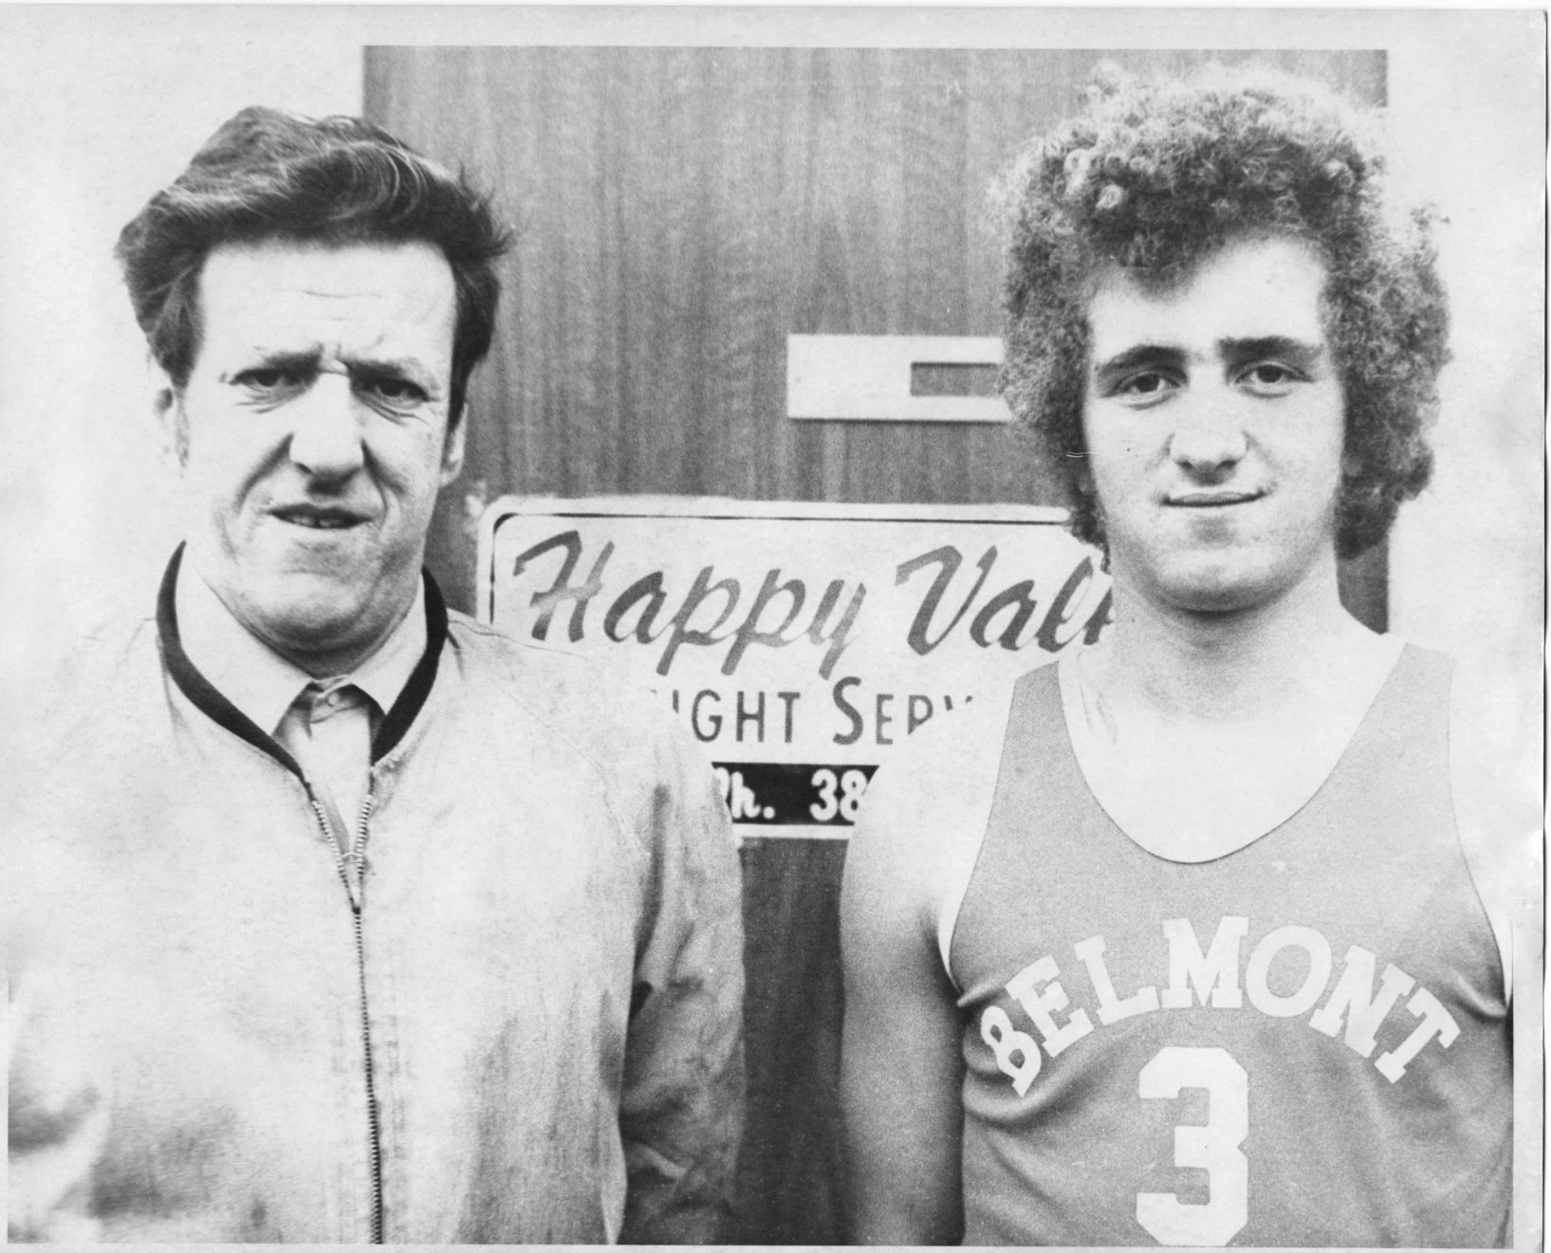
Brian Foley

Slide 10
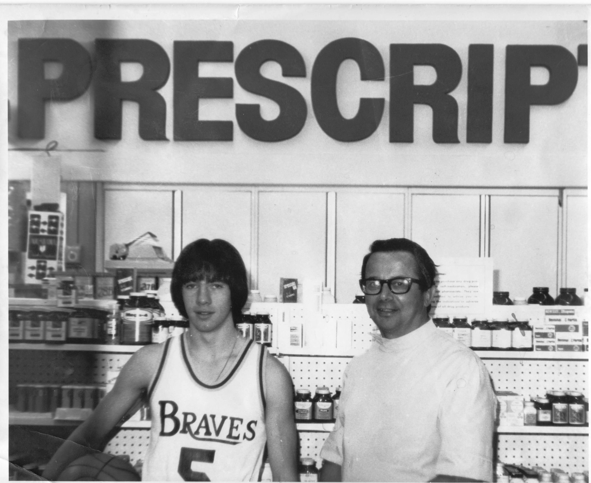
Chris Calnan

Slide 11
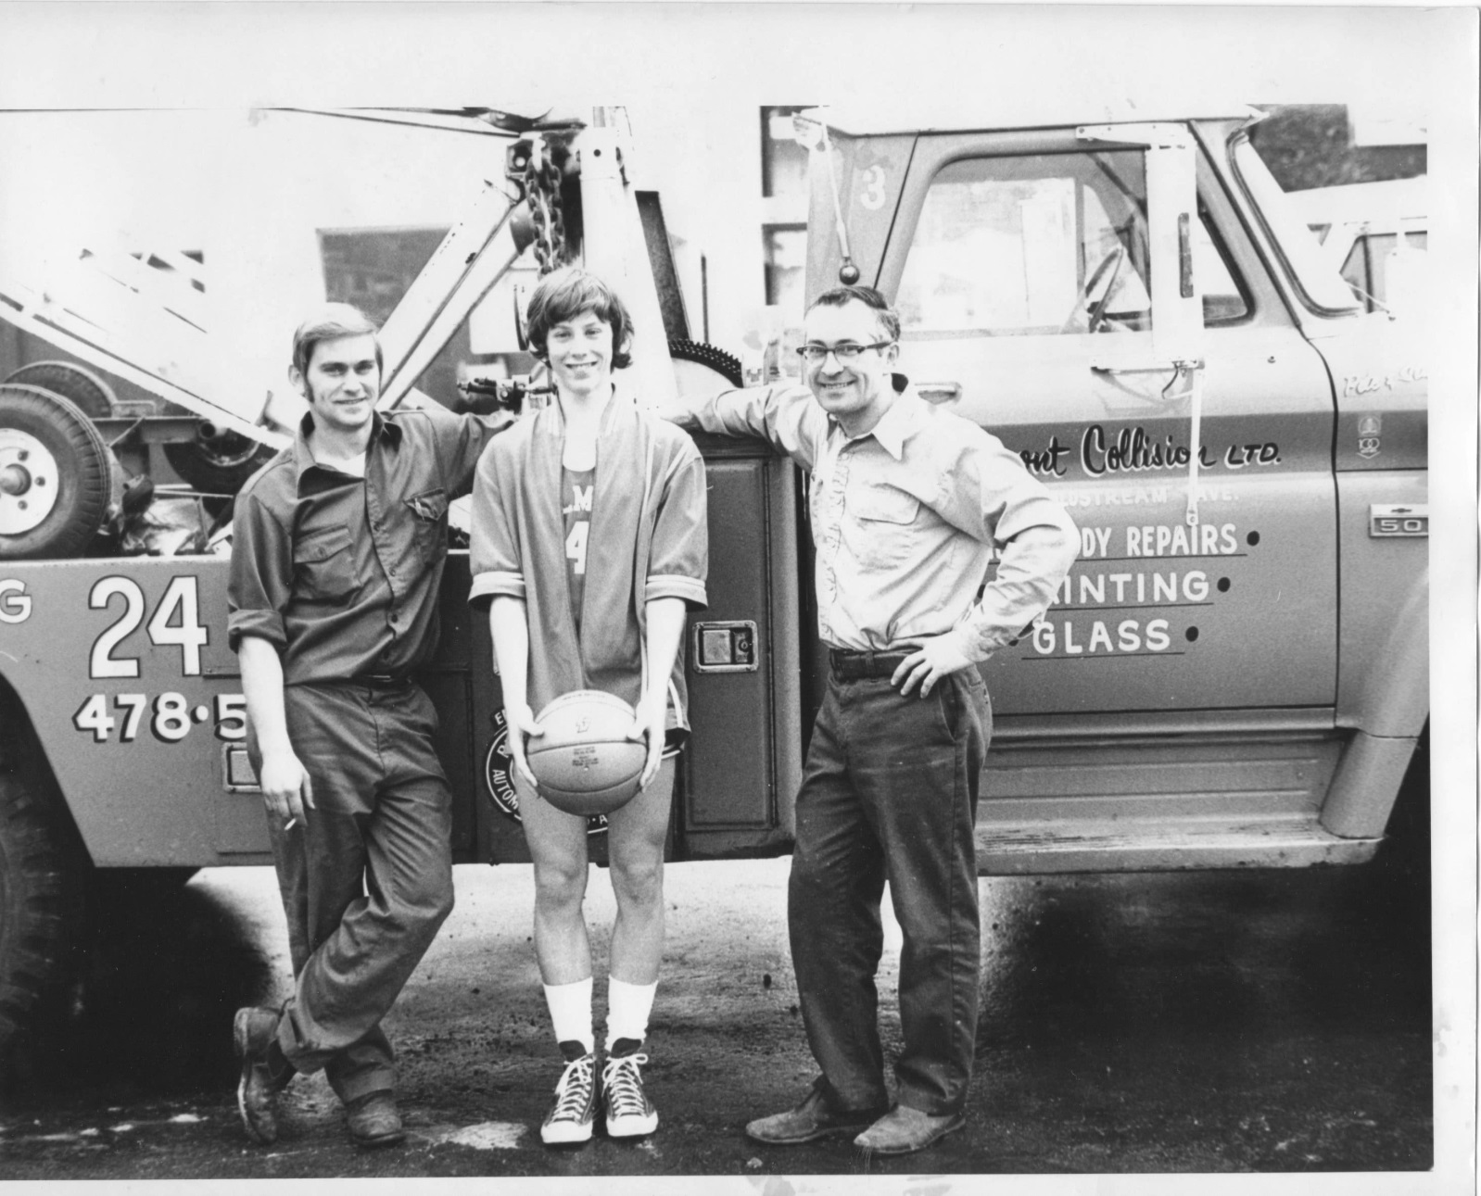
Jim Cochran with sponsor Belmont Collision

Slide 12
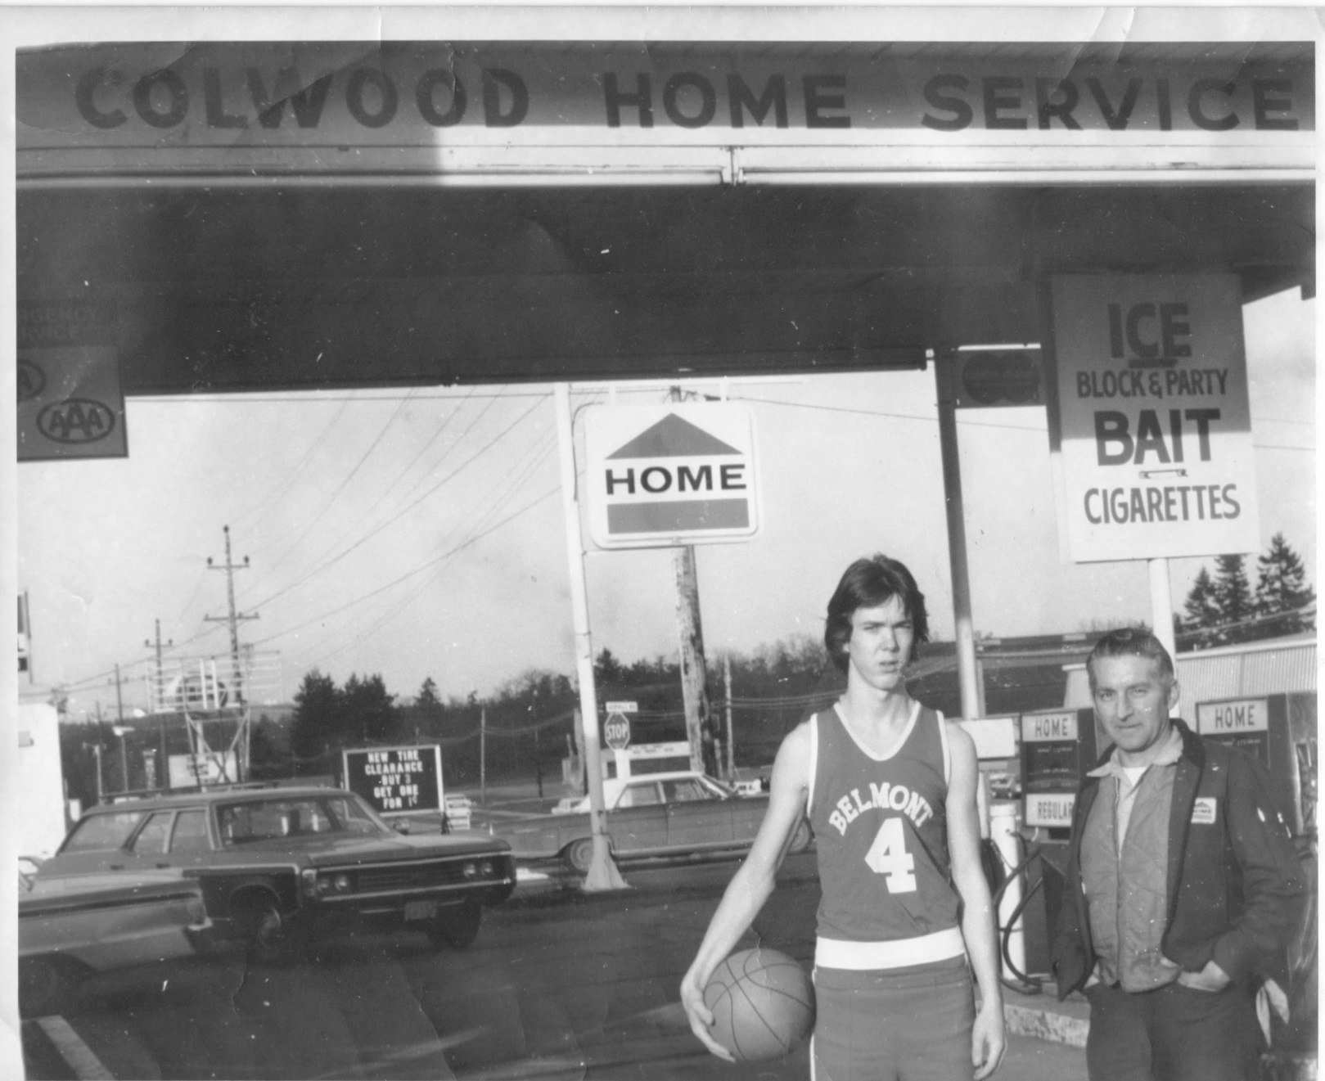
Len Jenson with sponsor Colwood Home Service

Slide 13
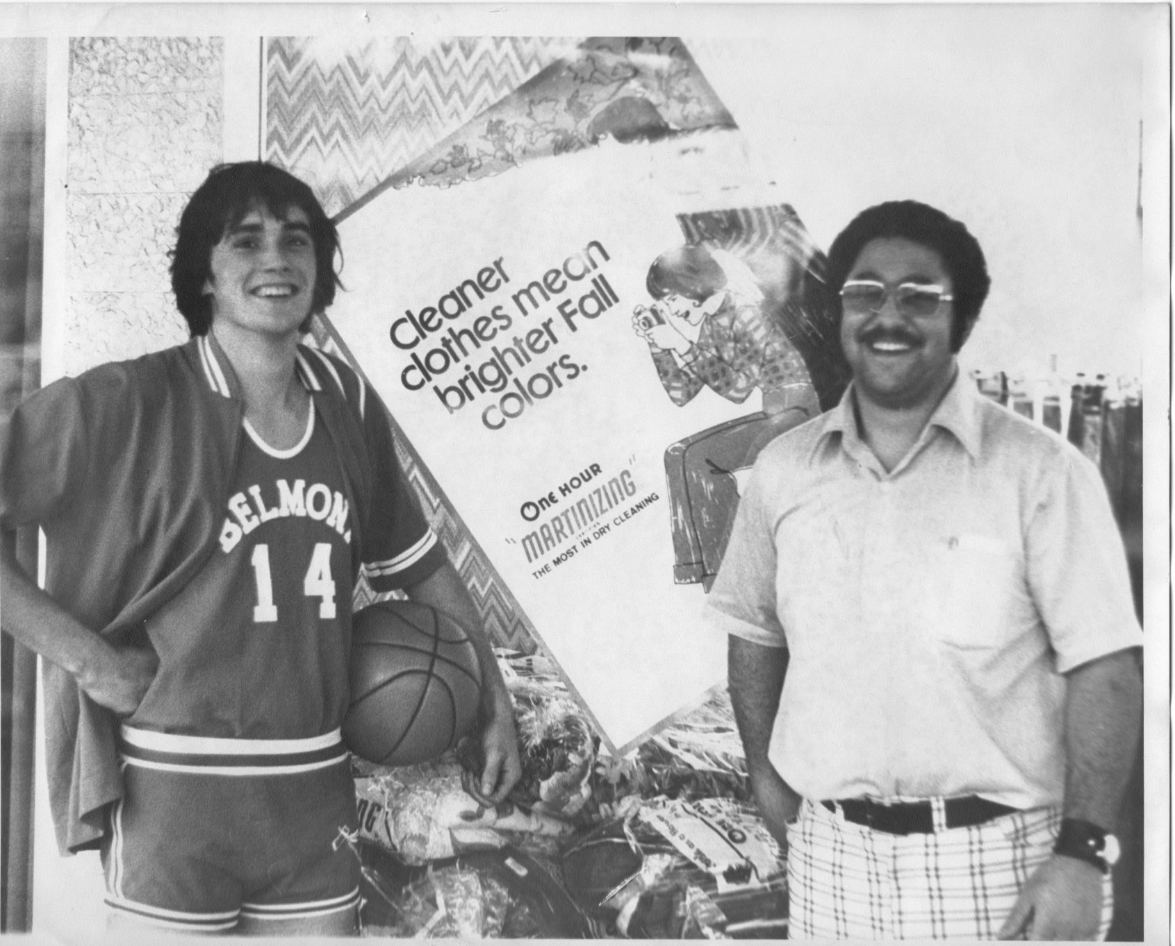
Malcolm Moscrop with sponsor One Hour Martinizing

Slide 14
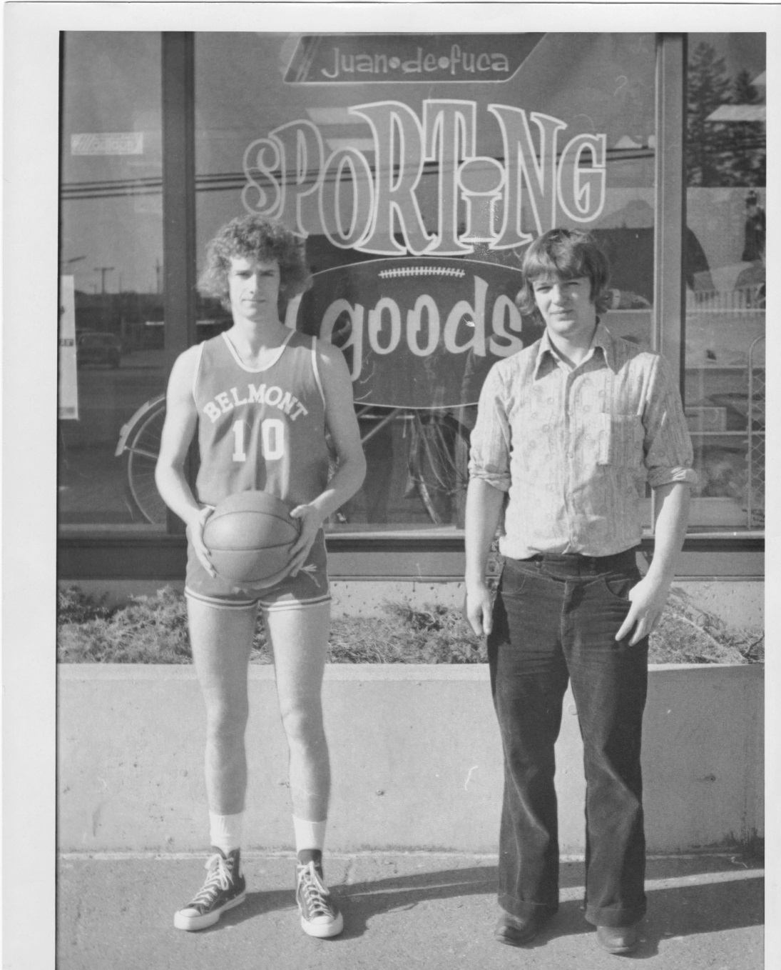
Ryan Thibadeau with sponsor Juan de Fuca Sporting Goods

Slide 15
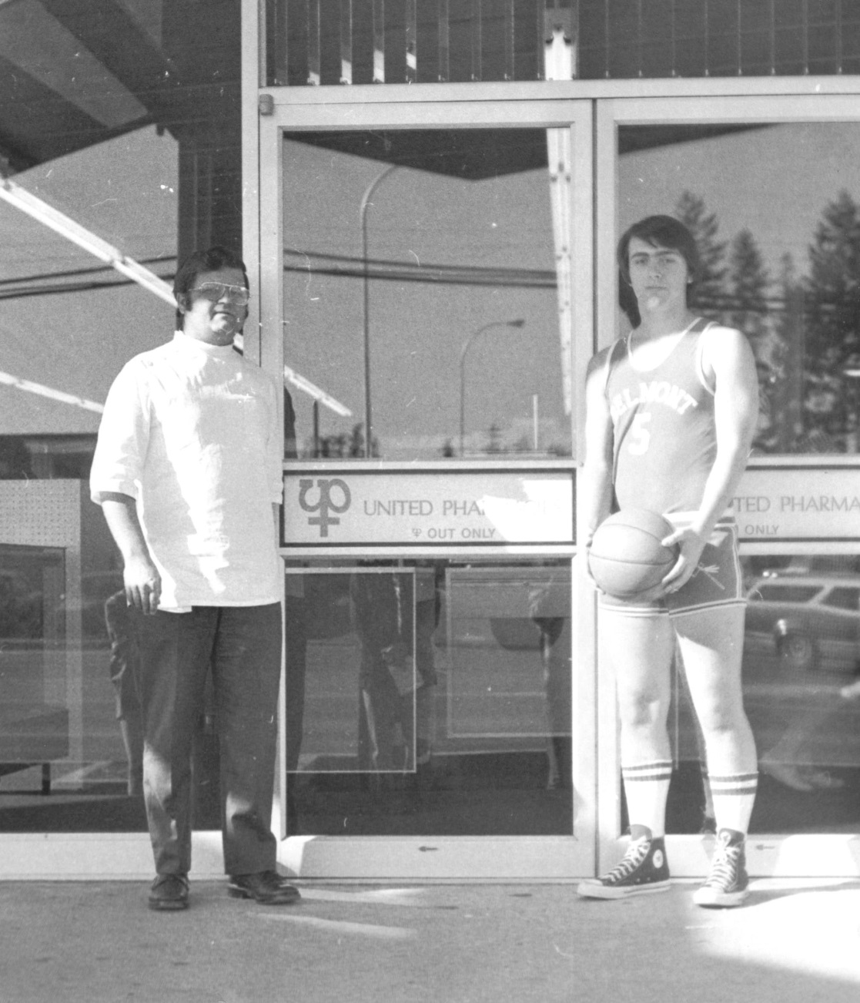
Terry Armstrong

