Slide 1



BELMONT SPORTS
OF THE 1980’S

Slide 2
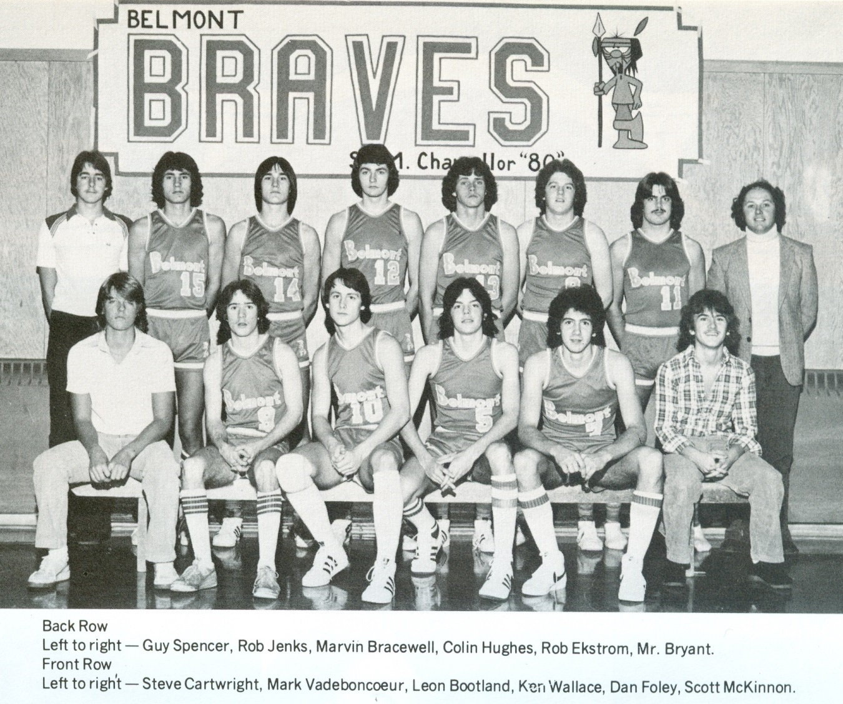
Braves Boys Basketball

Slide 3
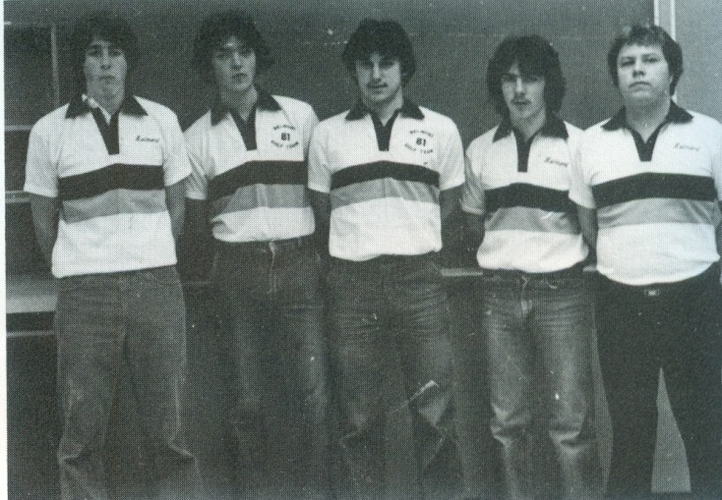
1981 Golf Team

Slide 4
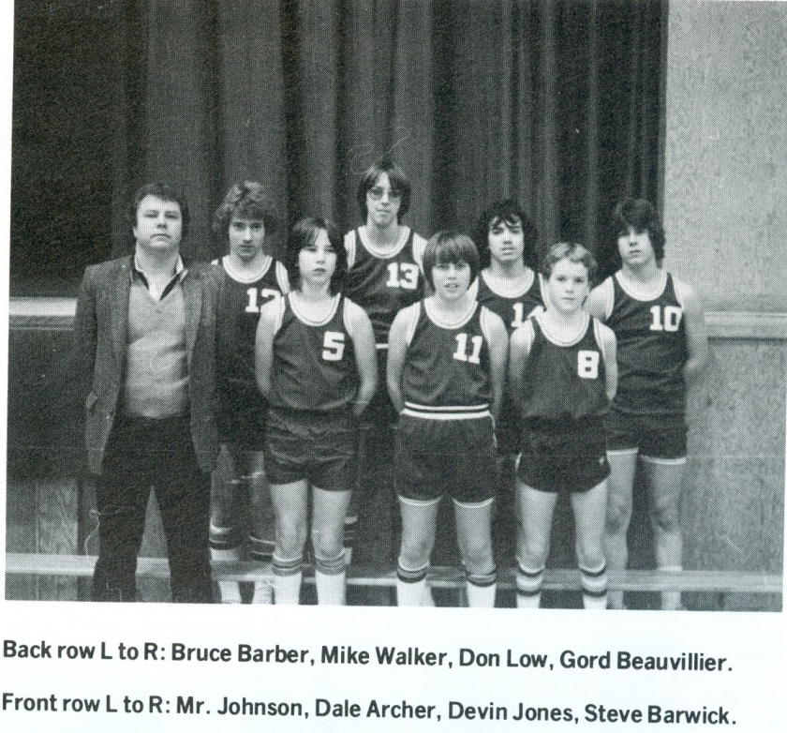
1983 Boys Basketball Team

Slide 5
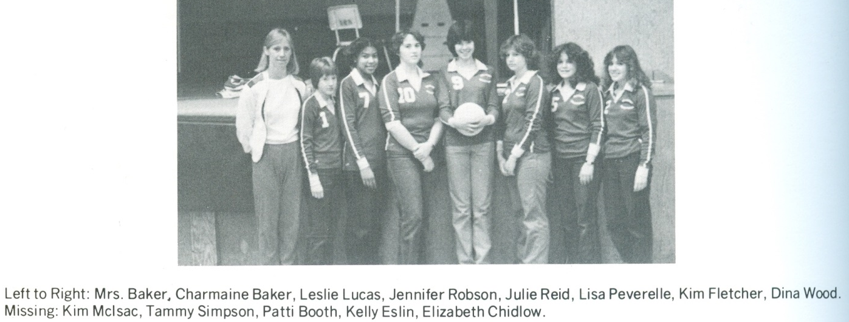
1983 Junior Volleyball

Slide 6
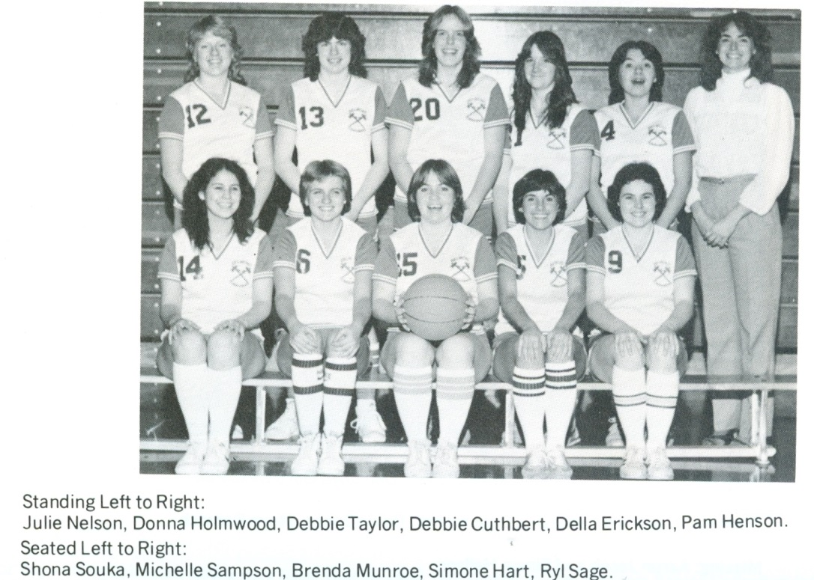
1983 Tomahawks Basketball

Slide 7
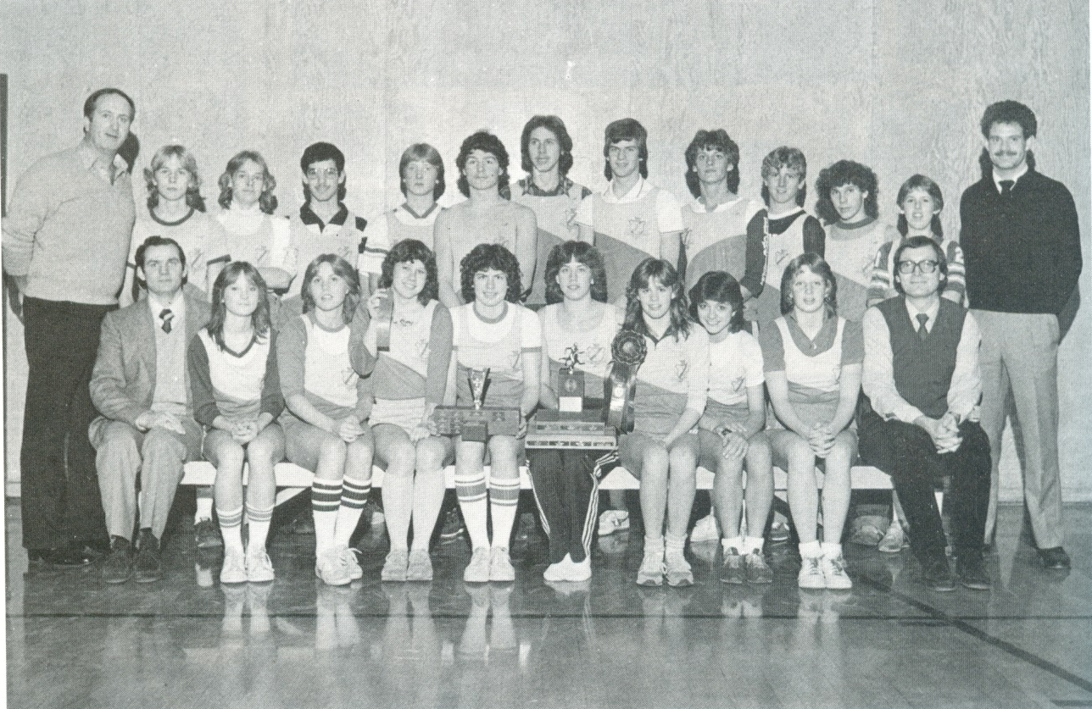

1984 cross country

Slide 8
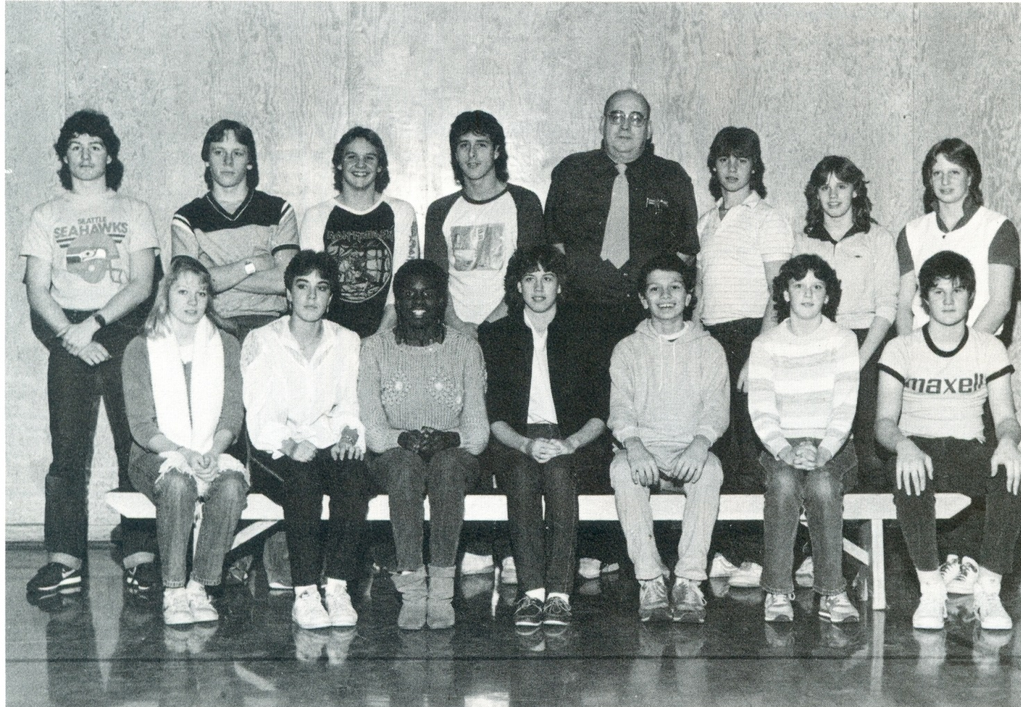

1984 swim team

Slide 9
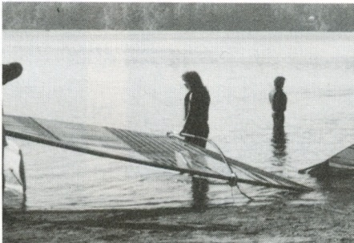
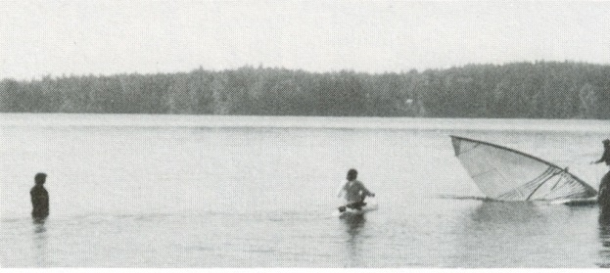
1987 Wind Surfing

Slide 10
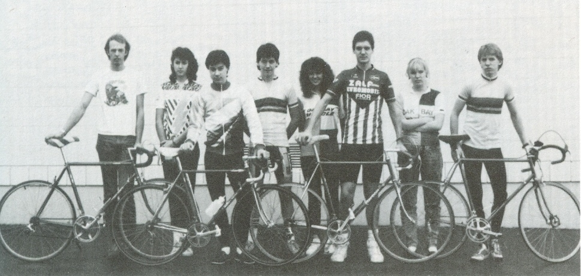
1987 Cycling Team

