Slide 1
Belmont Sports Photos Of The 2000’s

Slide 2
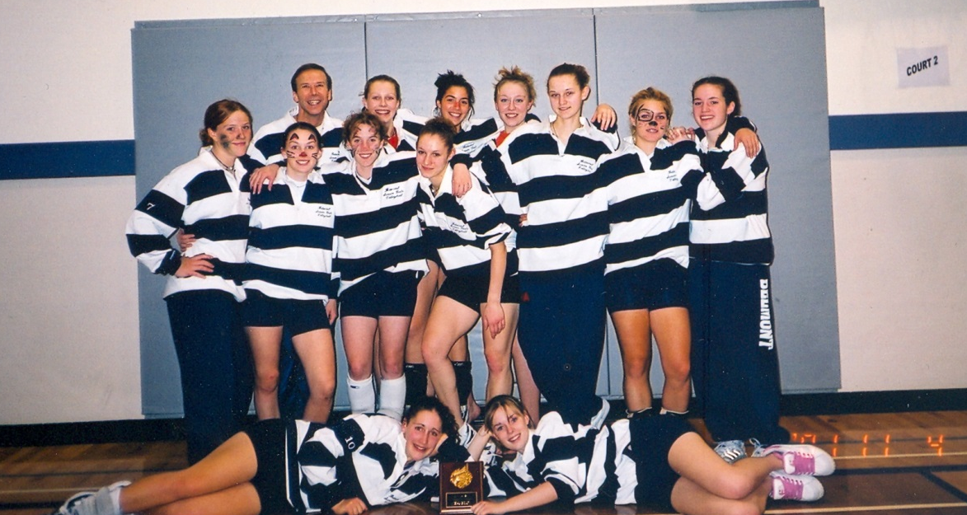
Girls Volleyball 2002

Slide 3
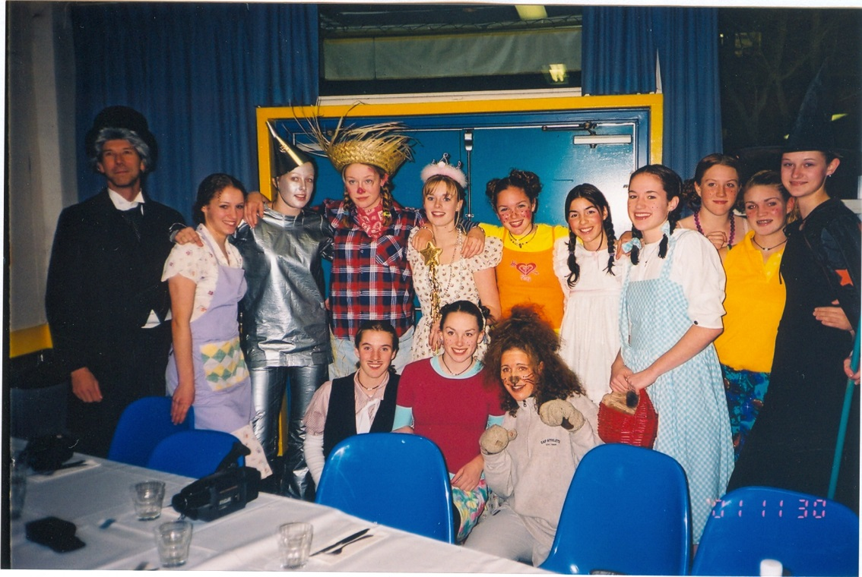
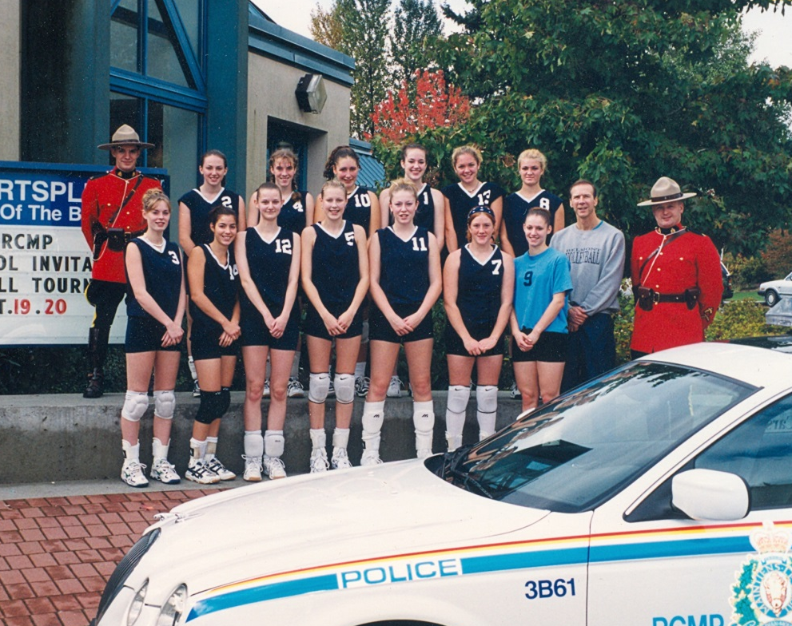
Volleyball team dressed as the Wizard Of Oz cast.
2001-2002
Volleyball team with the Mounties.

Slide 4
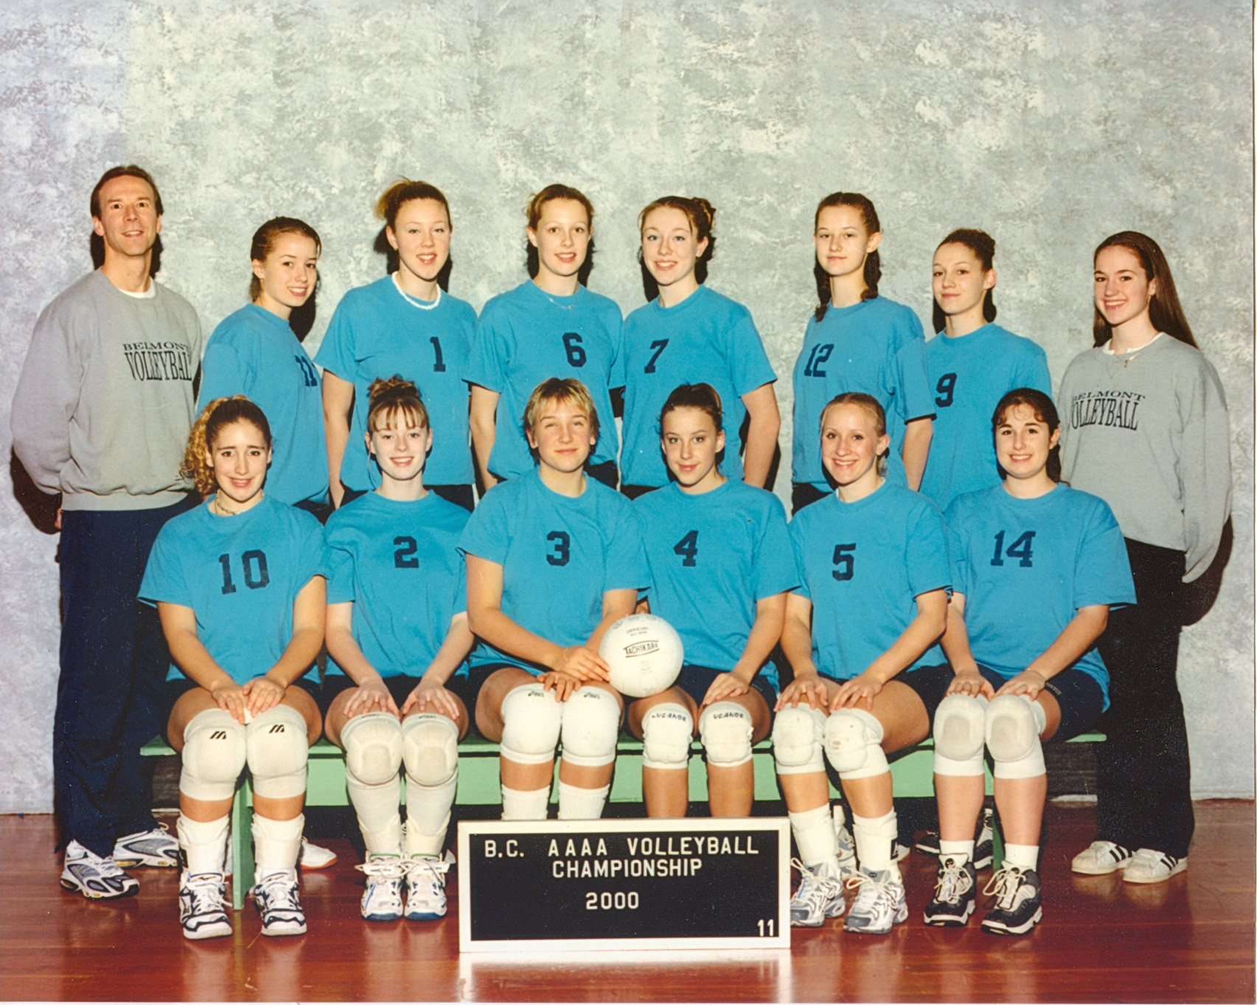

Slide 5
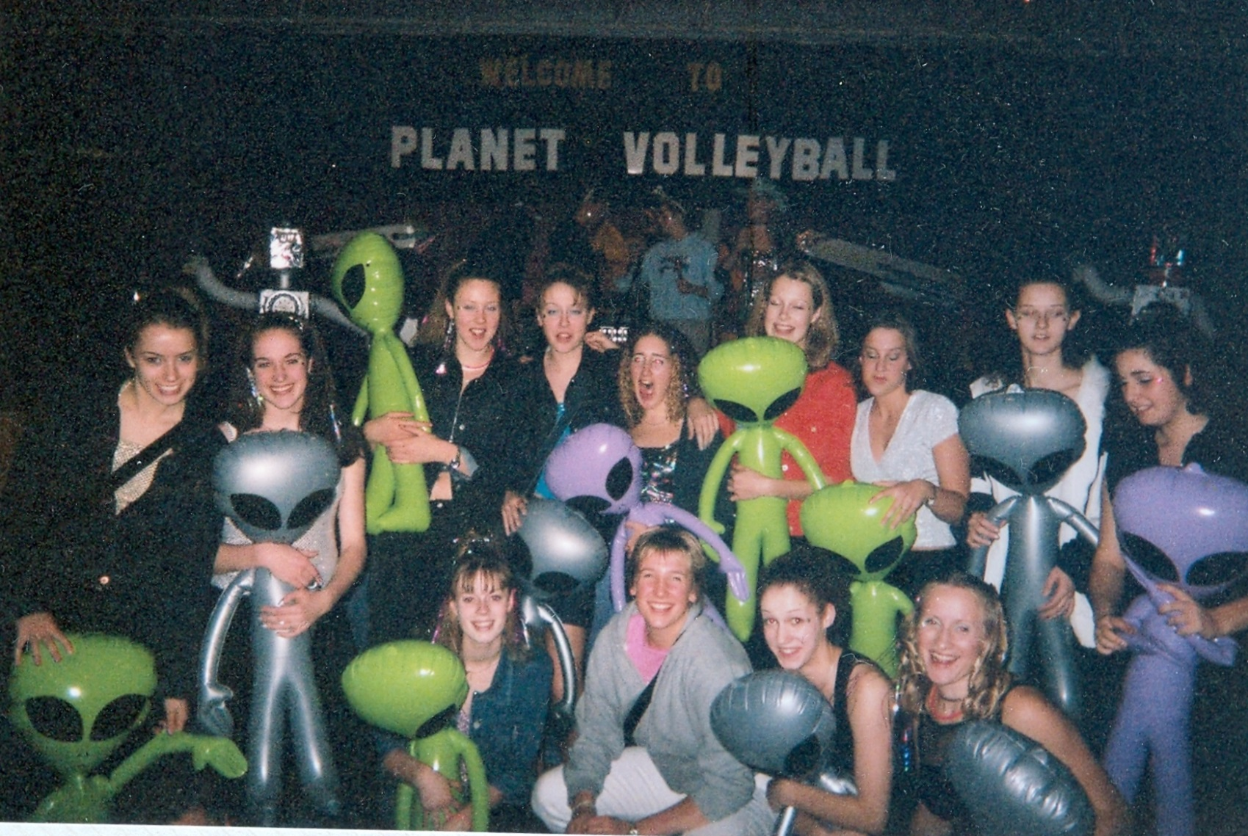
2001 Girls Volleyball team

Slide 6
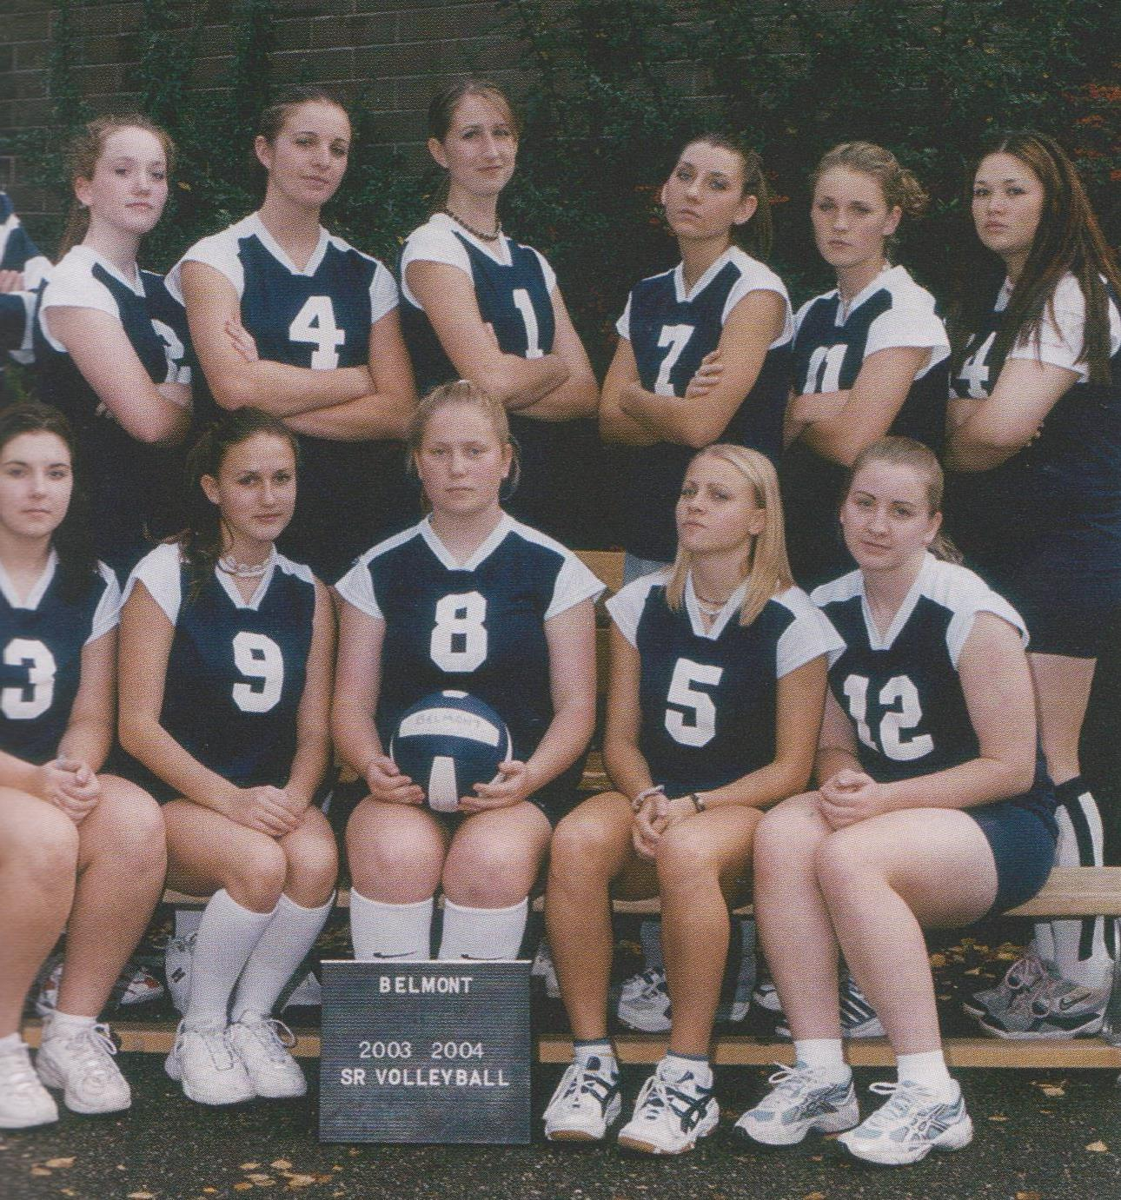
2004 Girls Volleyball Team

Slide 7
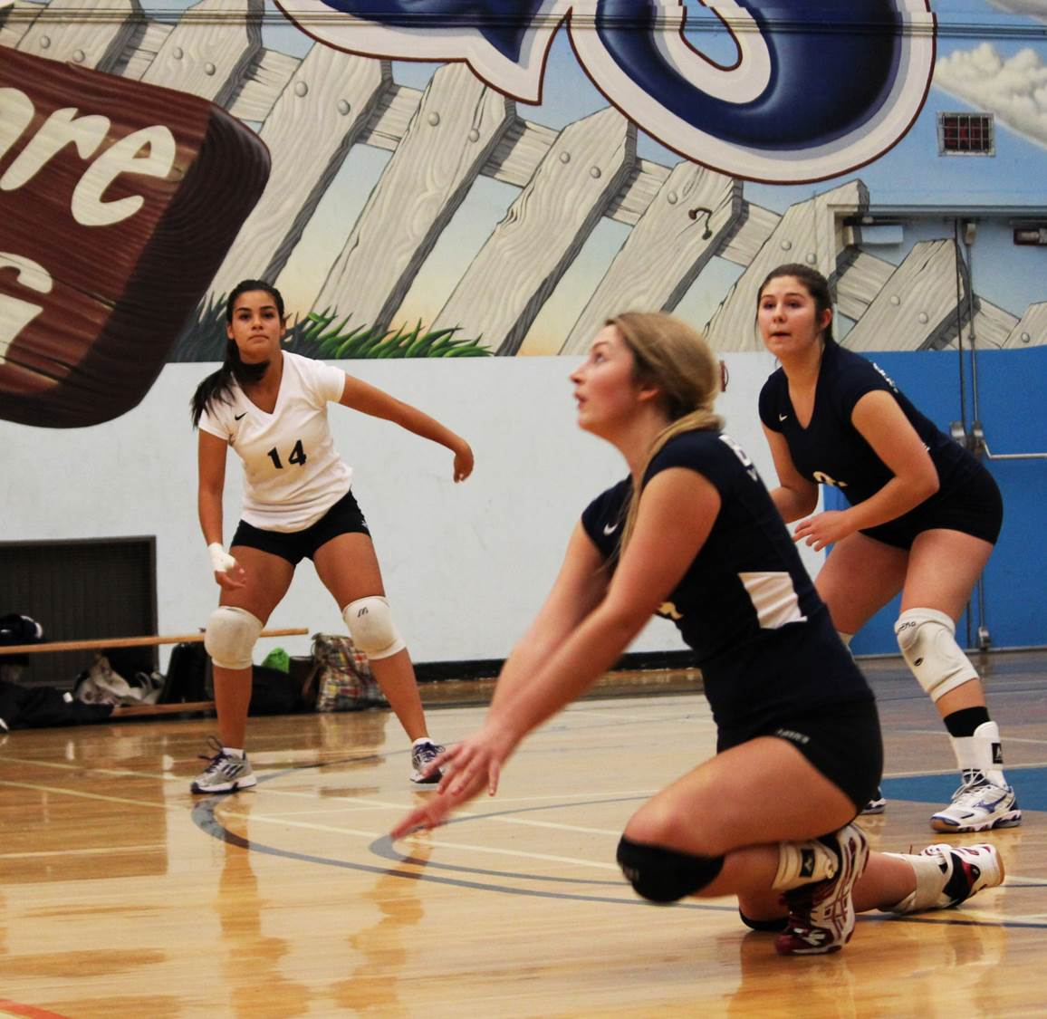
2012 : Nicole Bracewell Junior girls volleyball

Slide 8
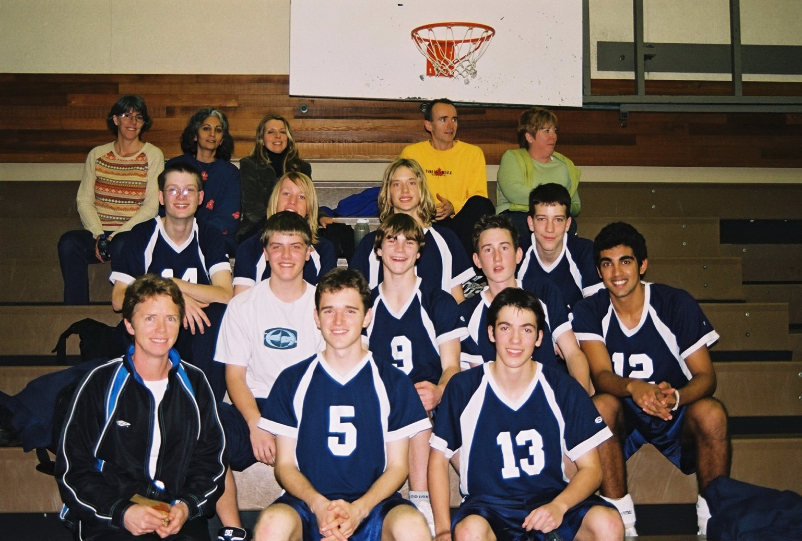
2005 Junior boys volleyball team

Slide 9
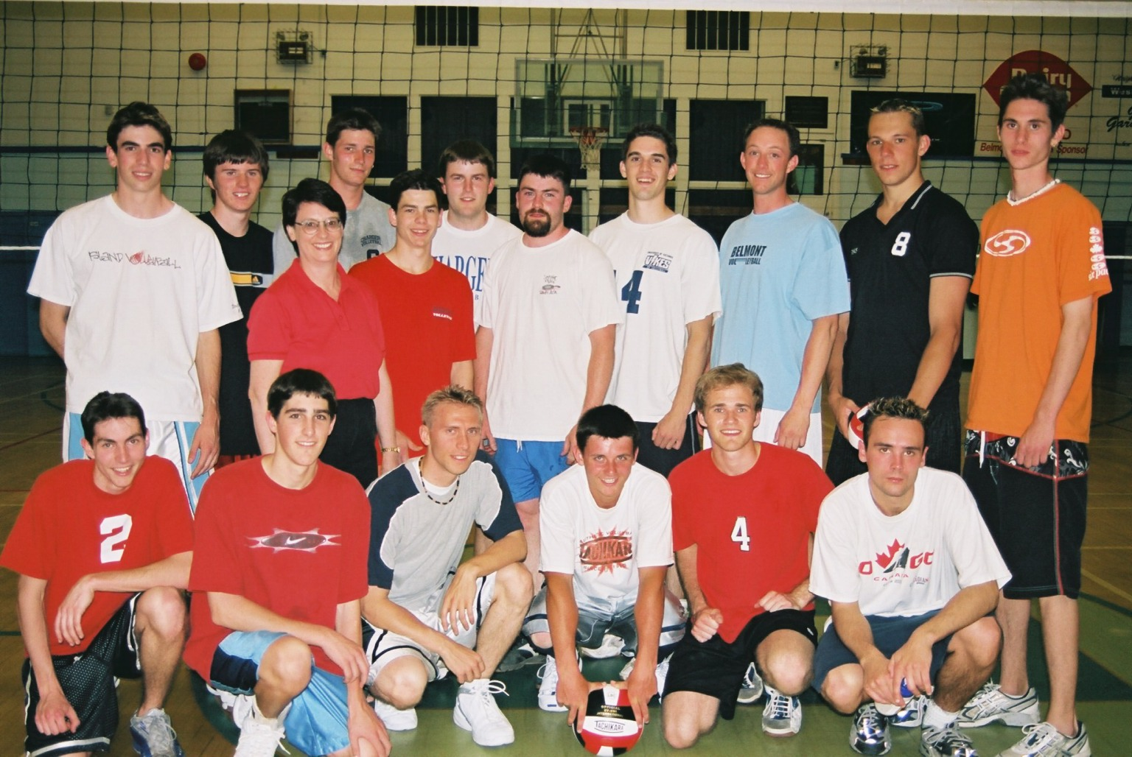

Slide 10
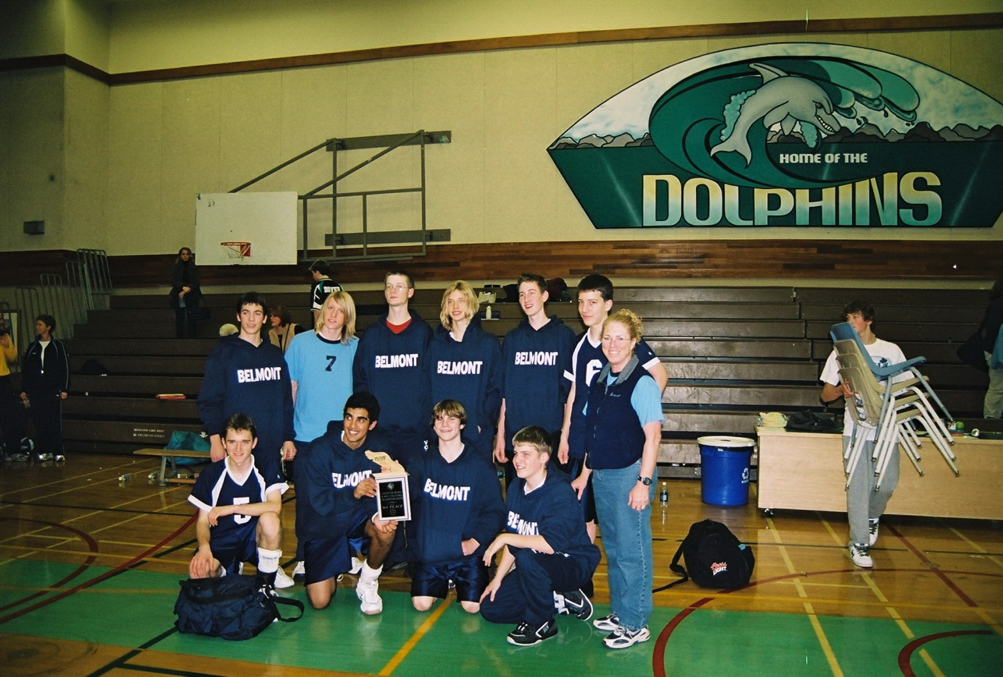
Boys’ Volleyball

Slide 11
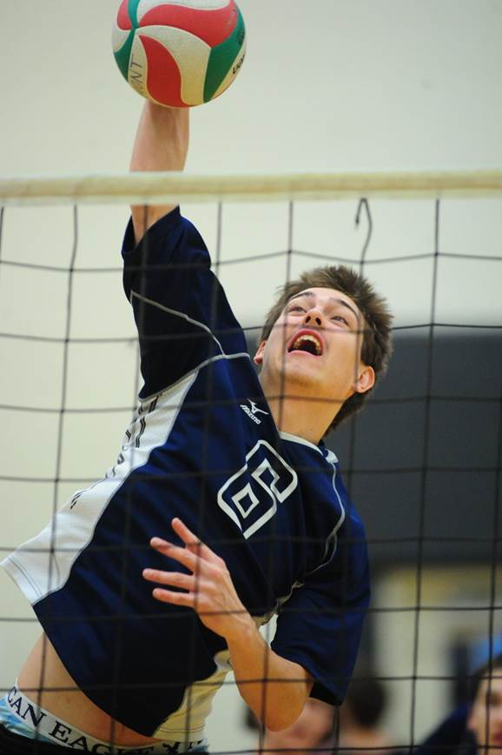
Taran Silas
2013

Slide 12
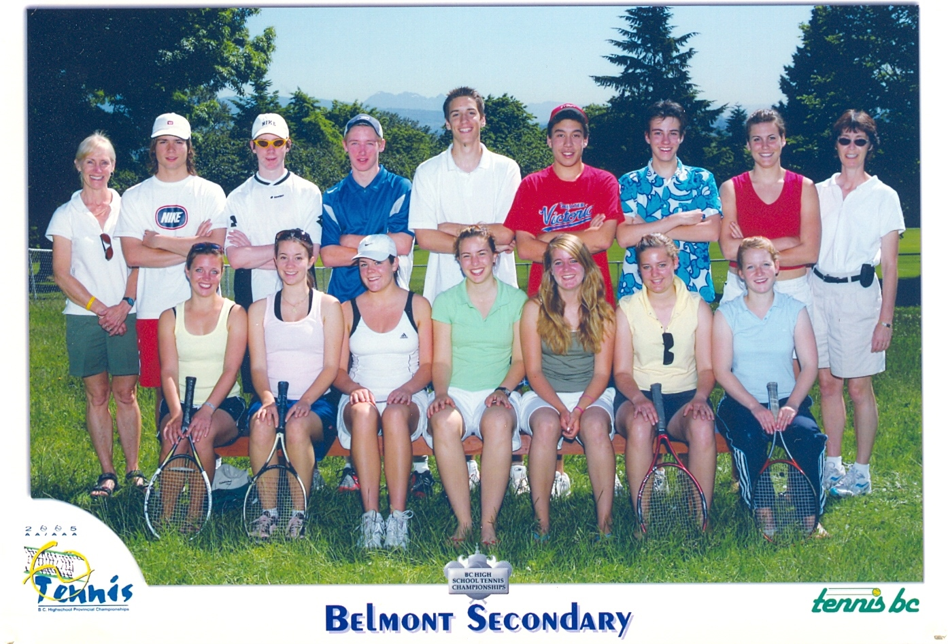
TENNIS TEAM 2005

Slide 13
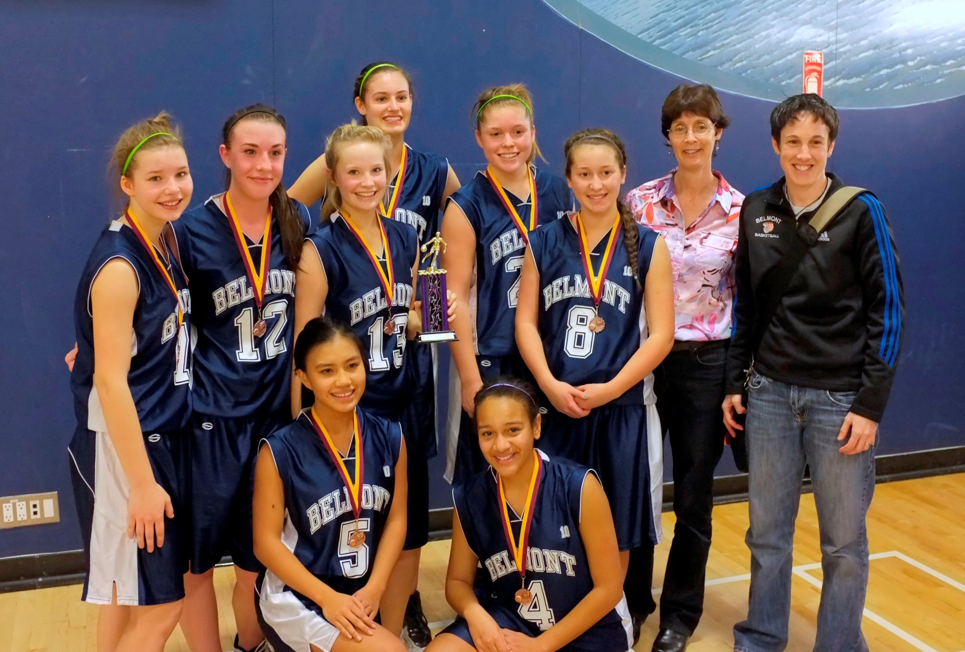
2012-13 Junior Girls Basketball

Slide 14
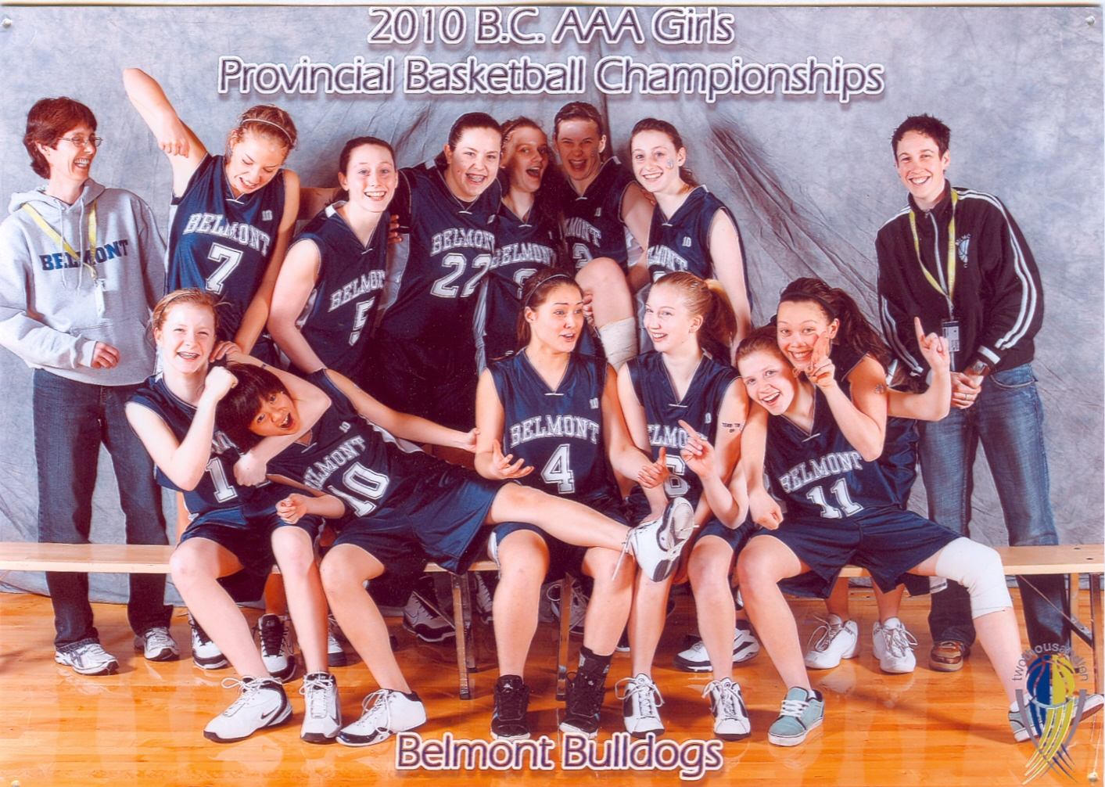
2010 Girls Basketball

Slide 15
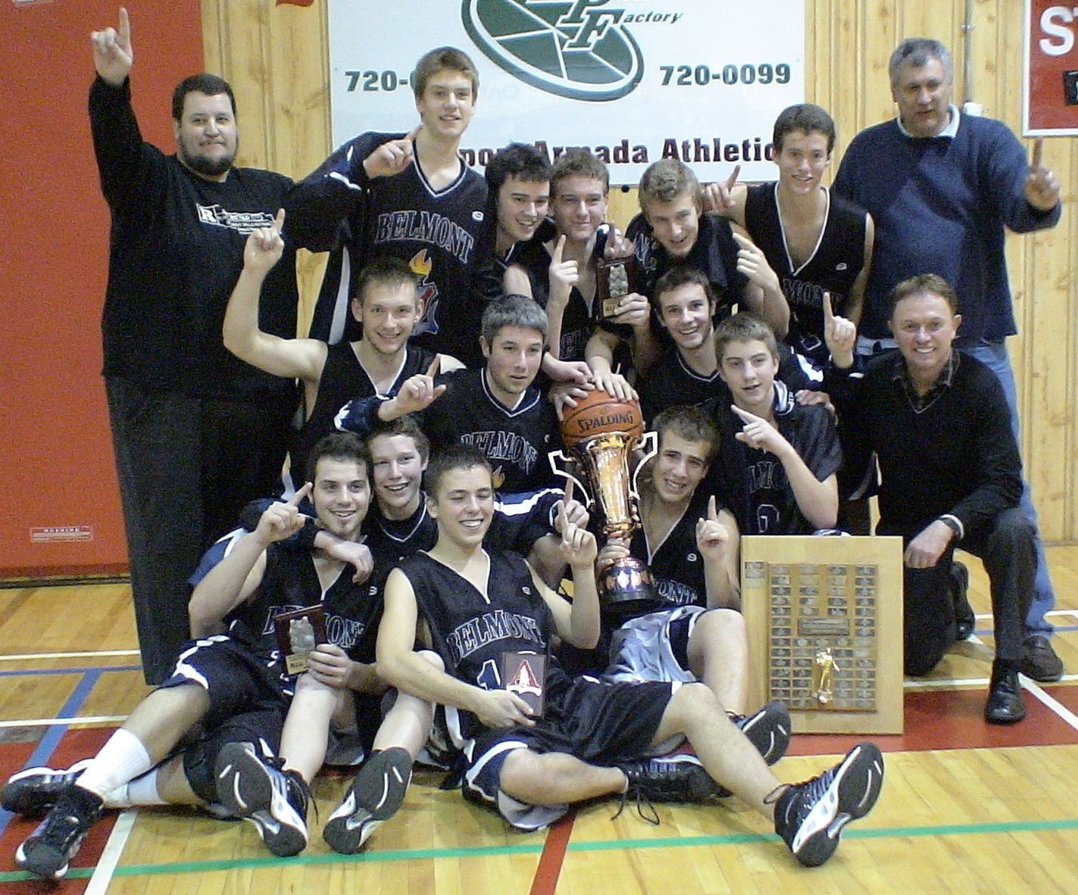
2008 Senior Boys Island Champs

Slide 16
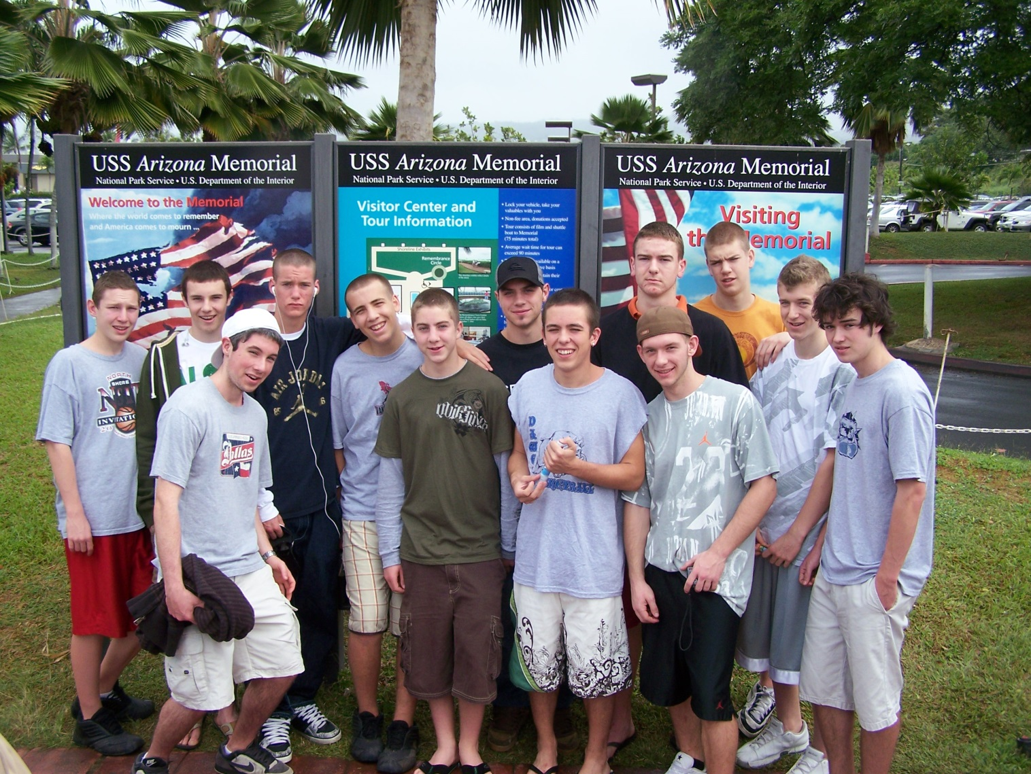
2008 Boys Basketball team in Hawaii

Slide 17
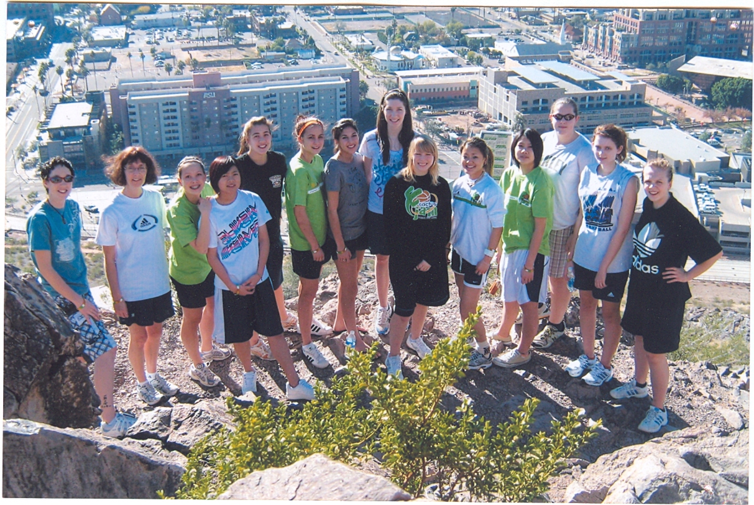
2009 Arizona Basketball Trip

Slide 18
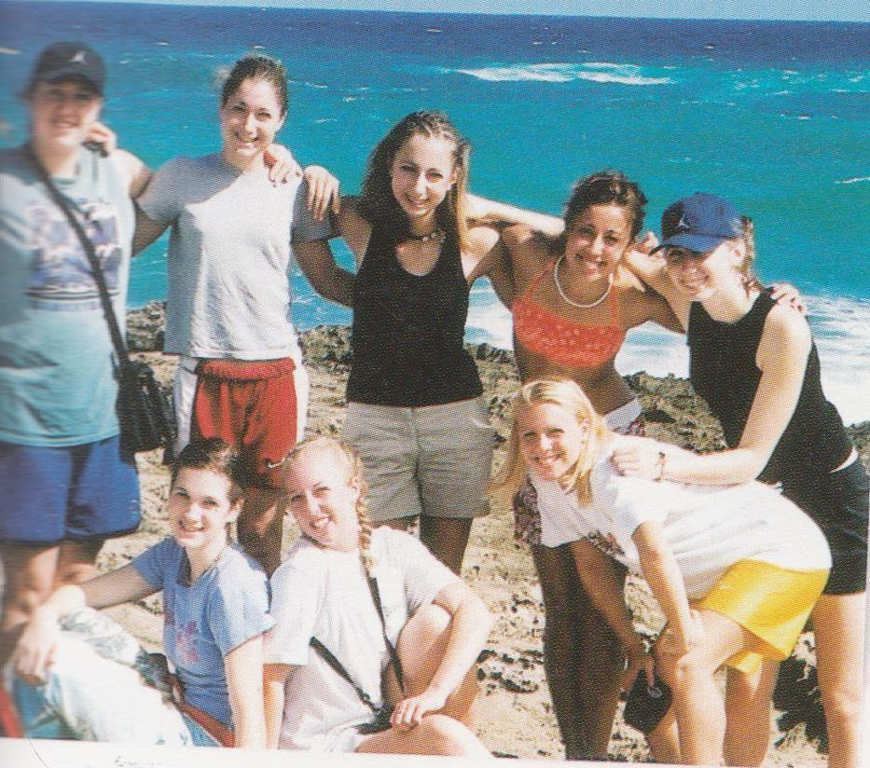
2003 Girls Basketball Team in Hawaii

Slide 19
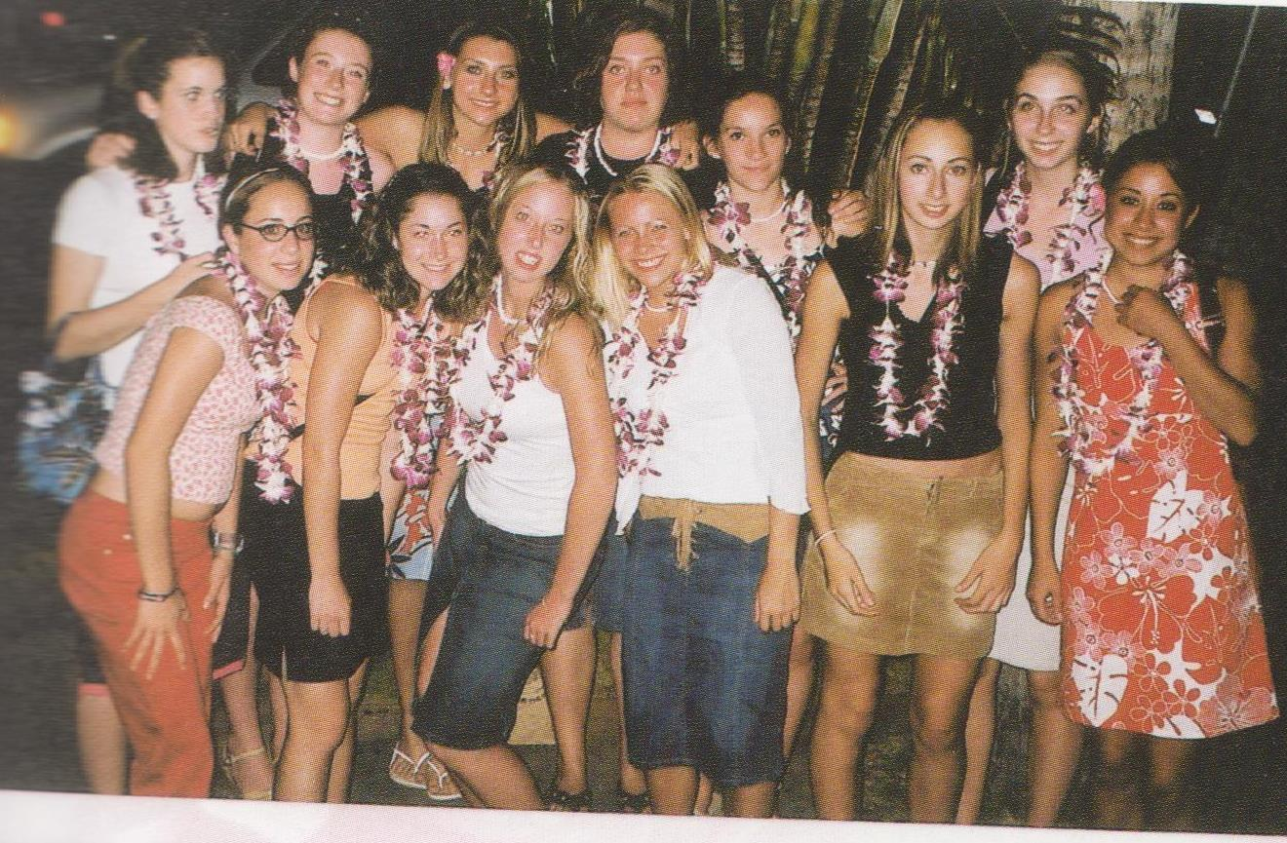
2003 Girls Basketball Team in Hawaii

Slide 20
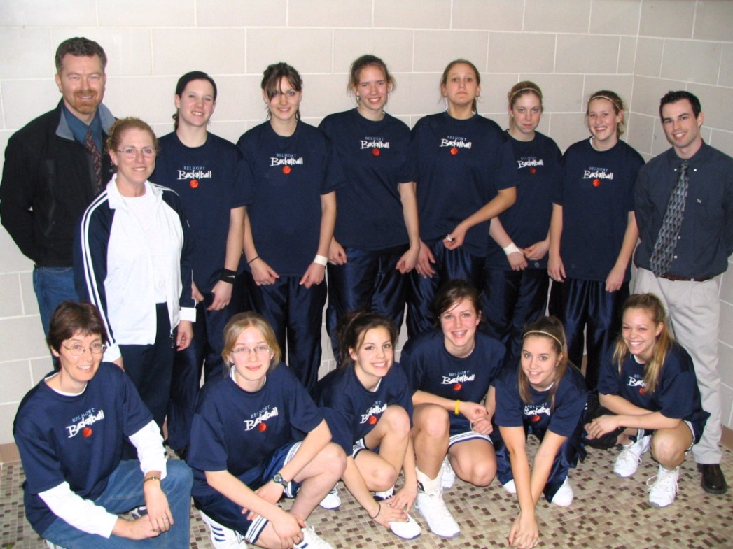
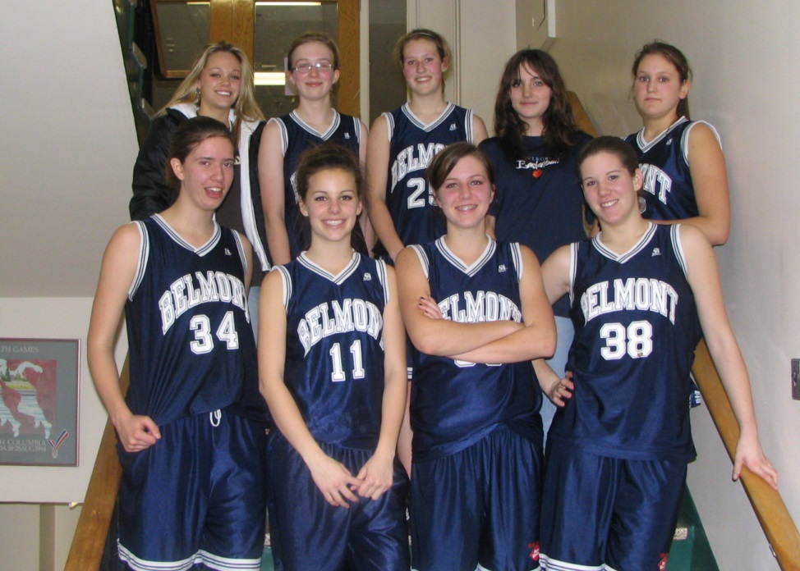
2004-2005
Junior team, city champs

Slide 21
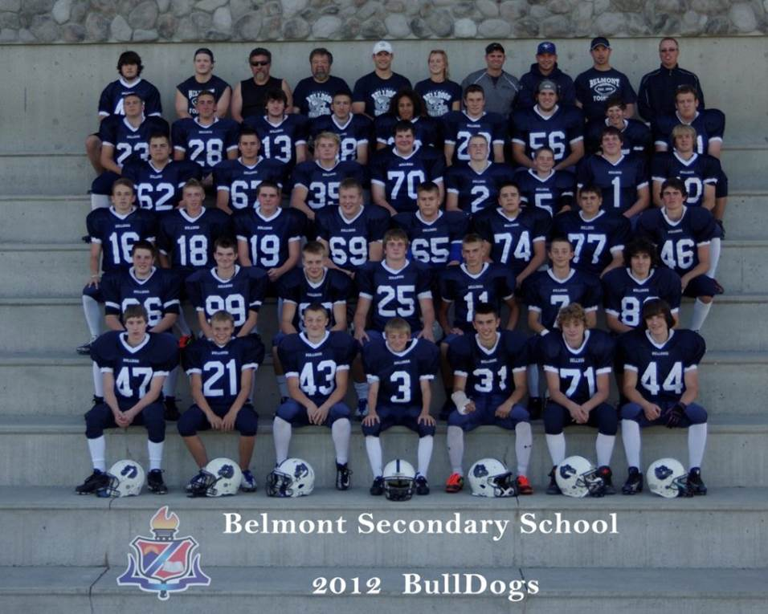
Belmont Football
2012

Slide 22
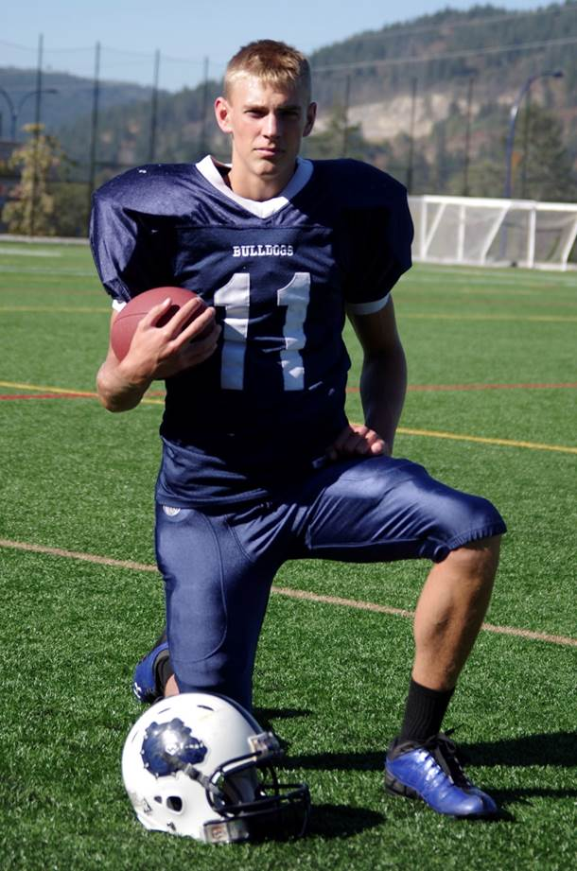
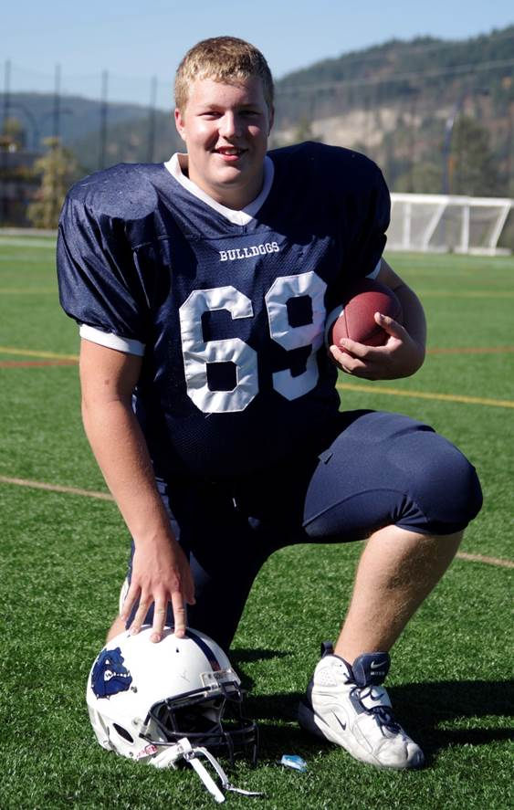
Football
Court Boice
Tristen Forish

Slide 23
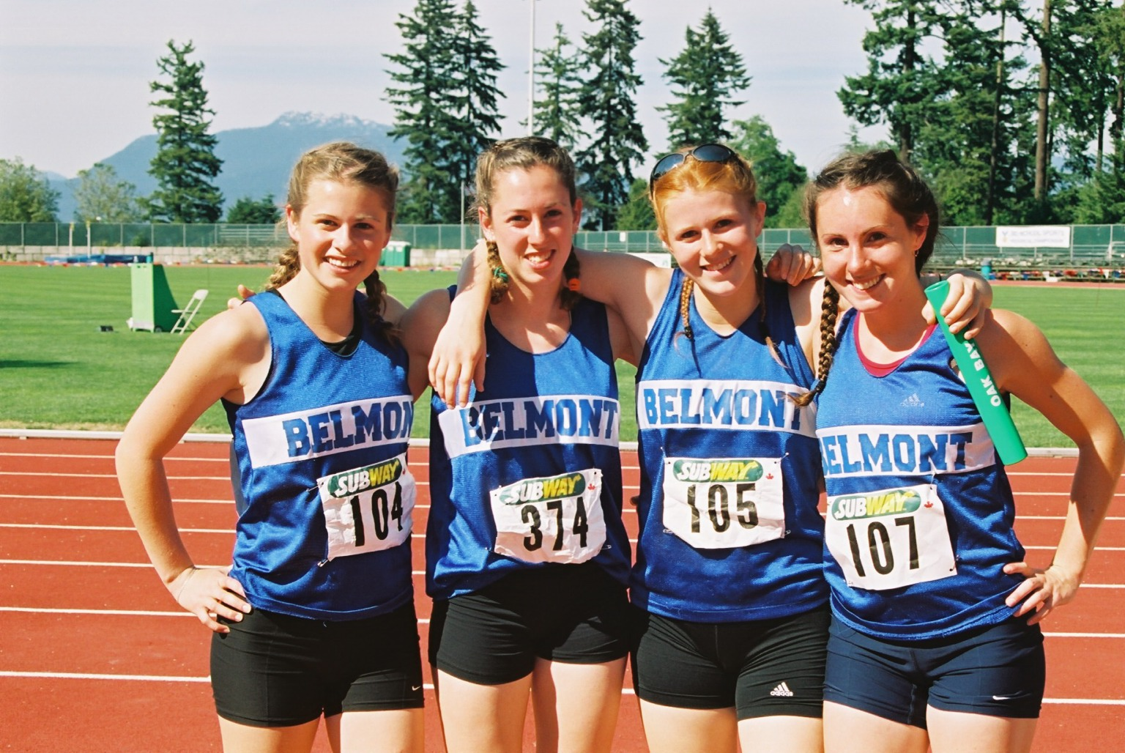
BELMONT’S TRACK AND FIELD TEAM

Slide 24
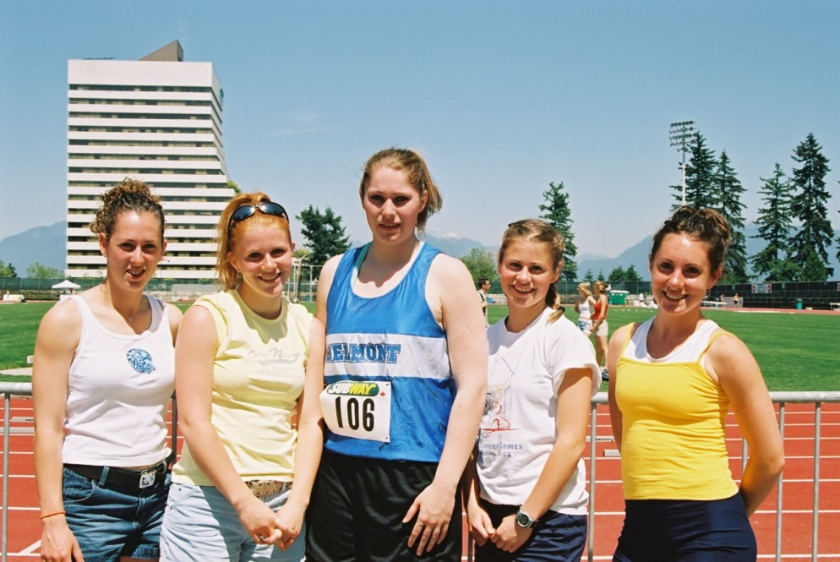
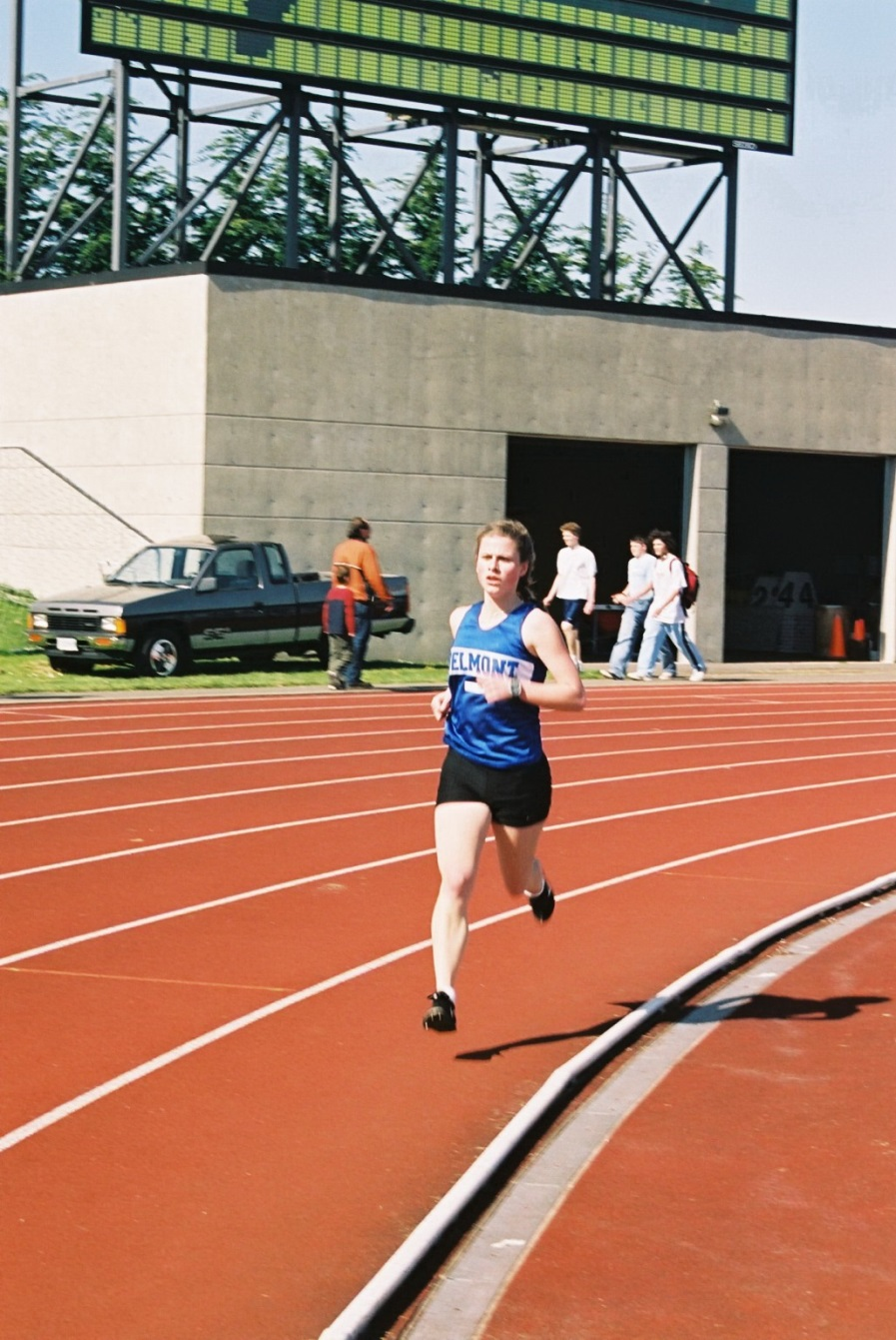
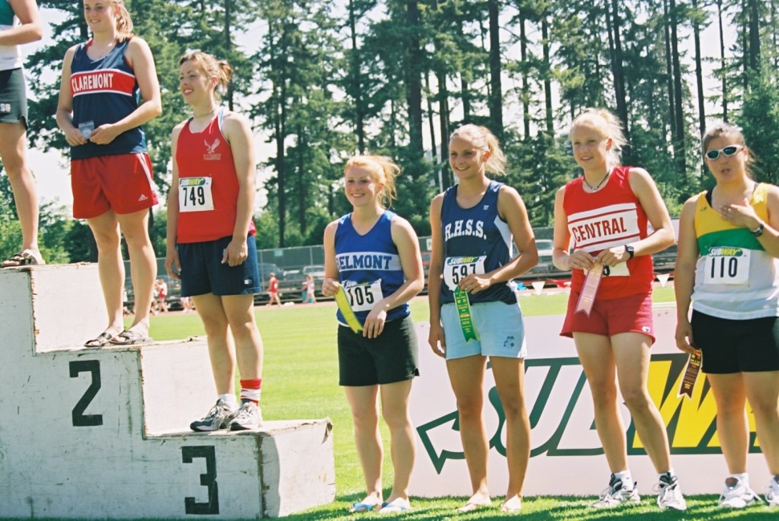

Slide 25
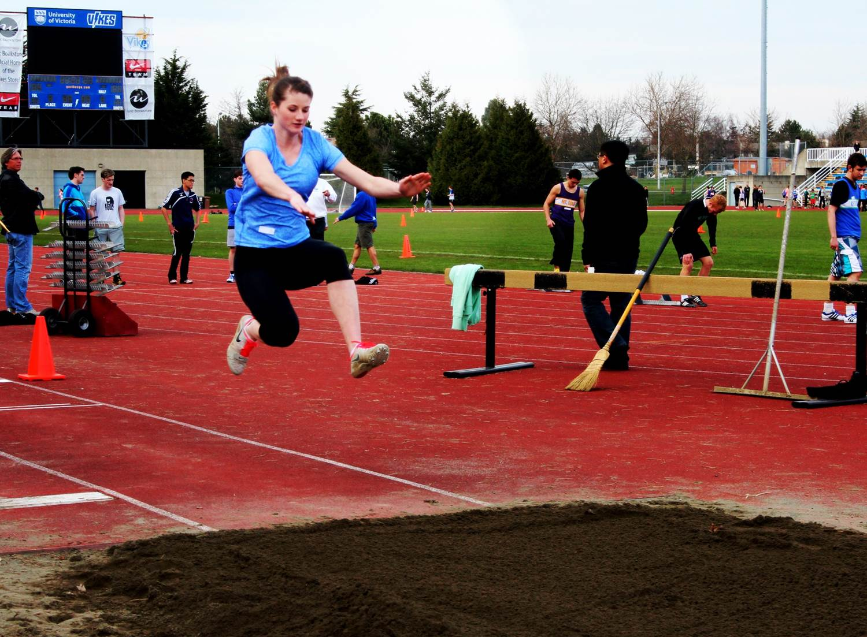
Megan Koblum triple jump 2013

Slide 26
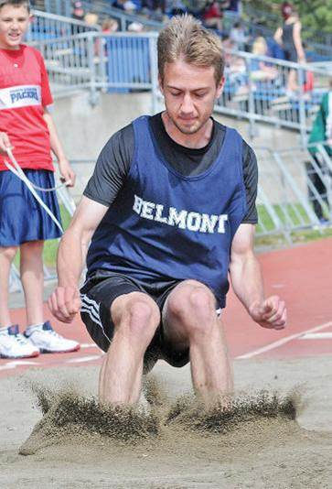
Cody Manson
Long Jump
2013

Slide 27
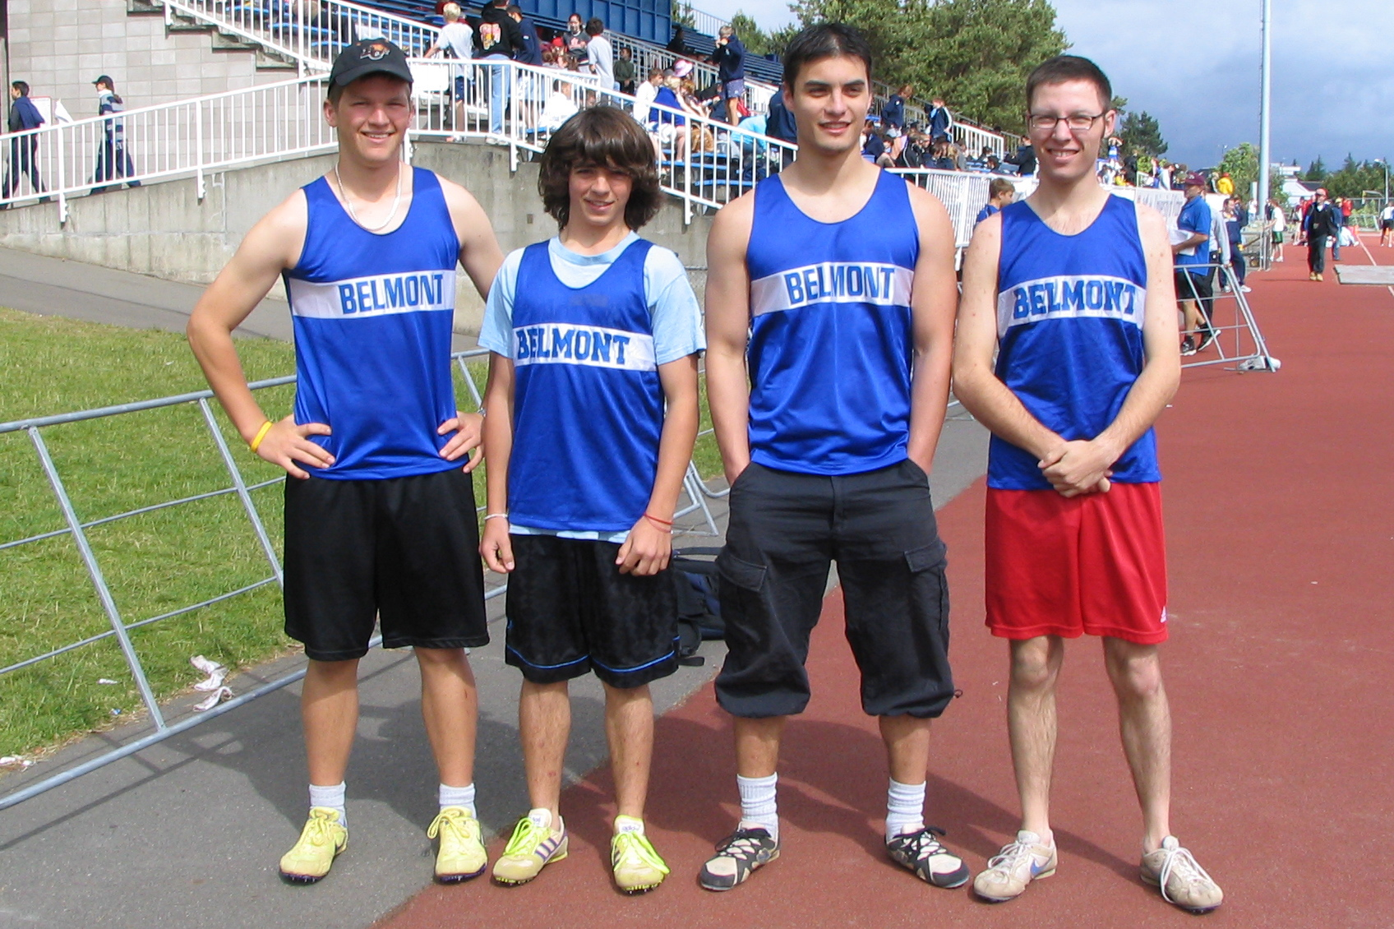
2004-05 Relay Team

Slide 28
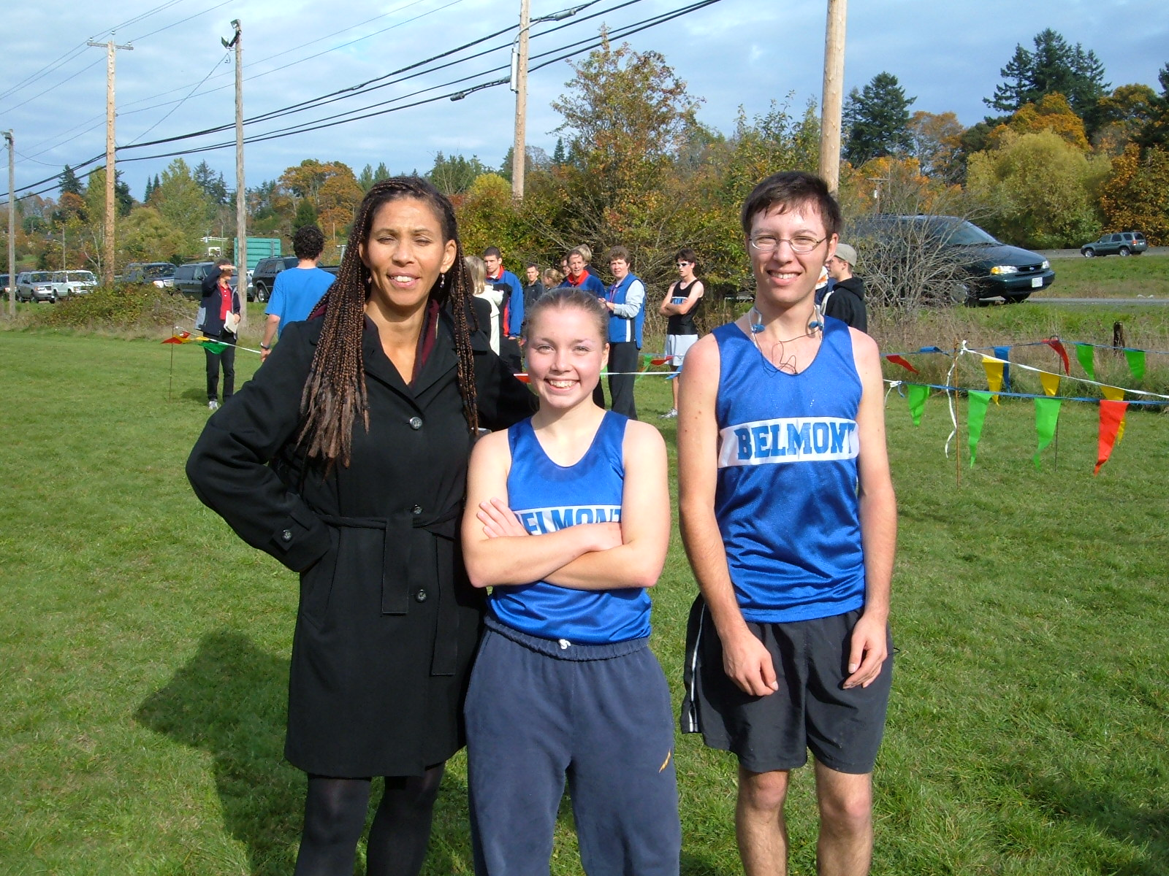
Shirley McComb, Angela Pushka, Brad Tikk 2004

Slide 29
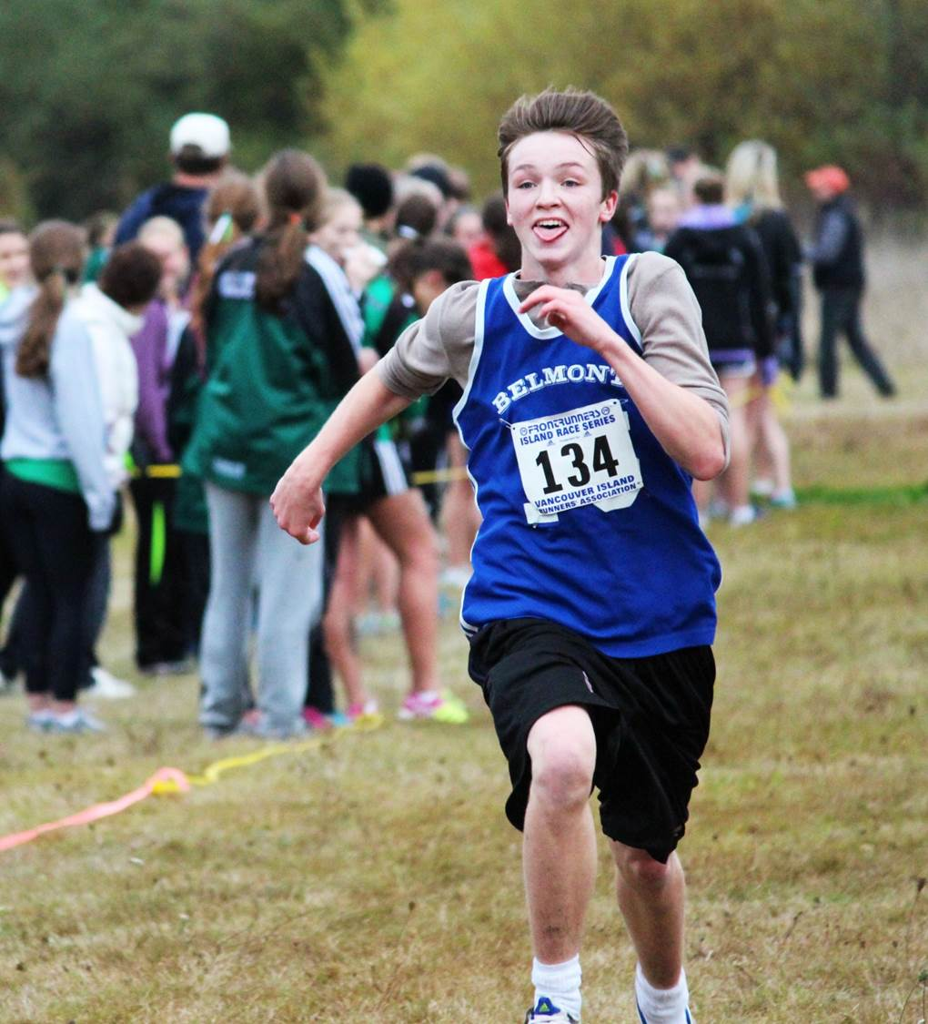
Owen Vaags 2012

Slide 30
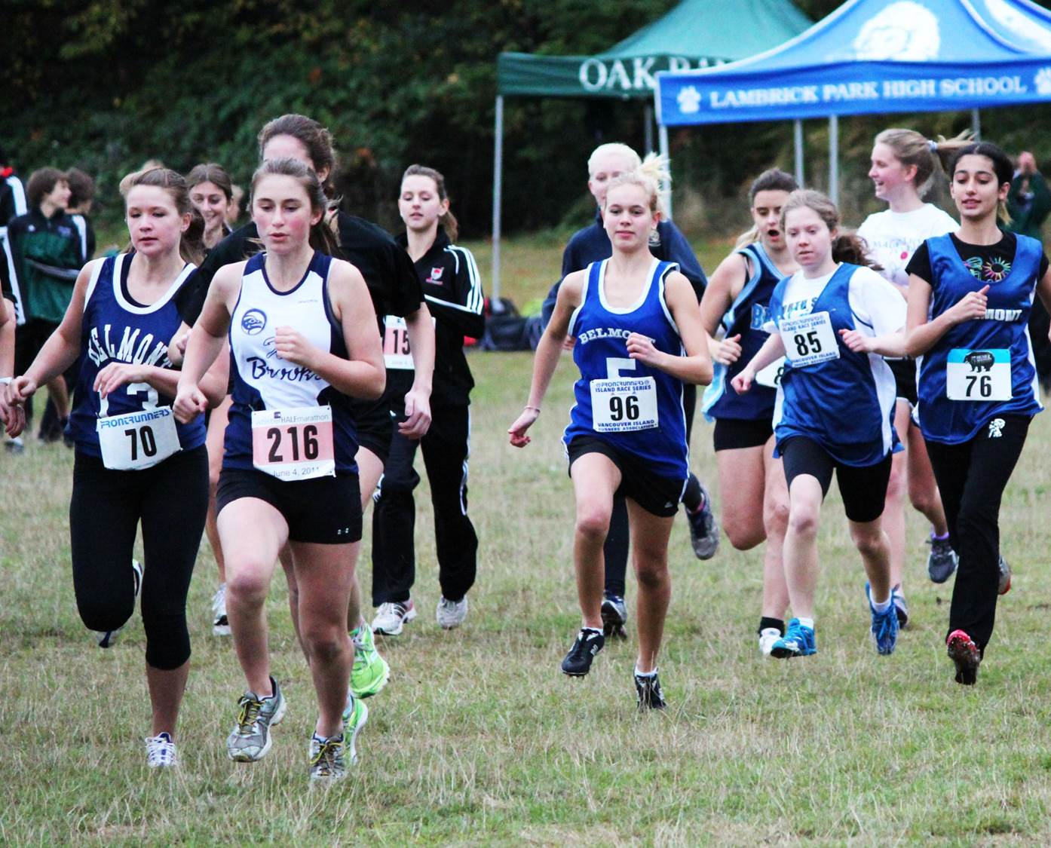
2012 Cross country

Slide 31
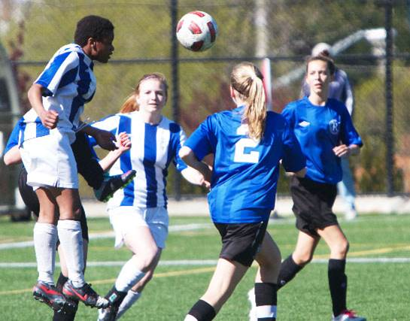
Kathy Forbes 2013

Slide 32
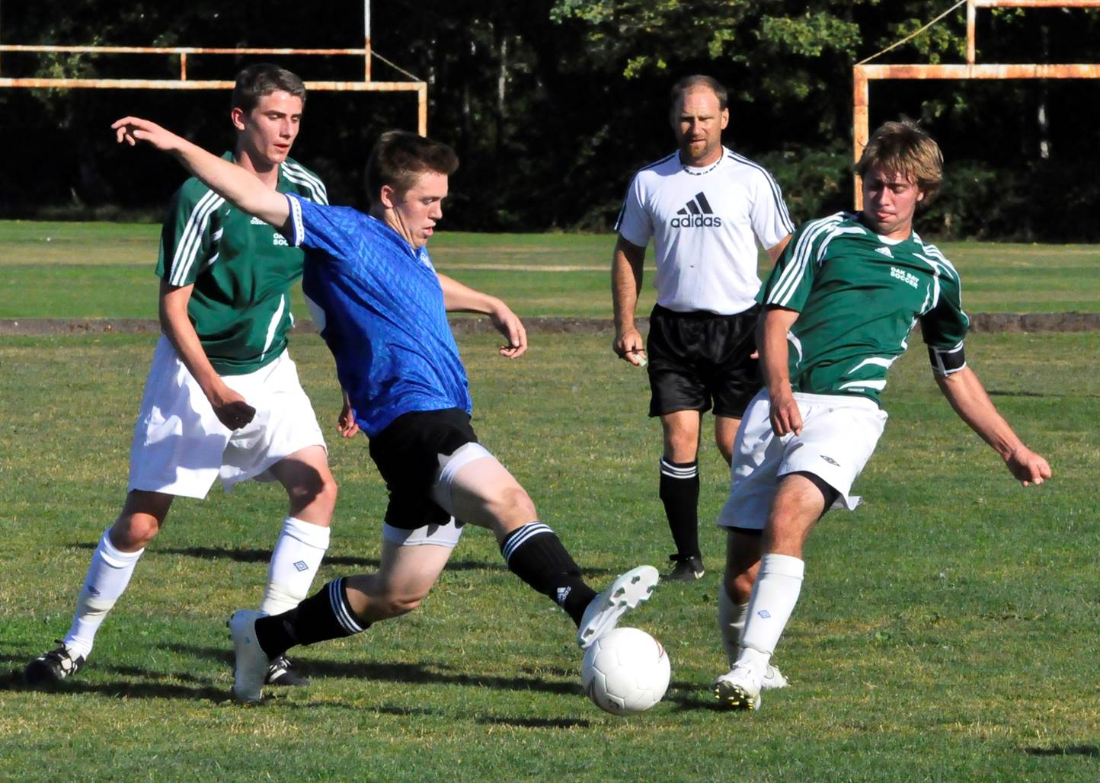
Kane Johnston 2012

Slide 33
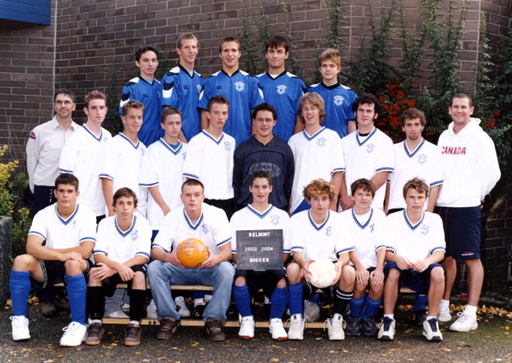
2003-04 Boys Soccer

Slide 34
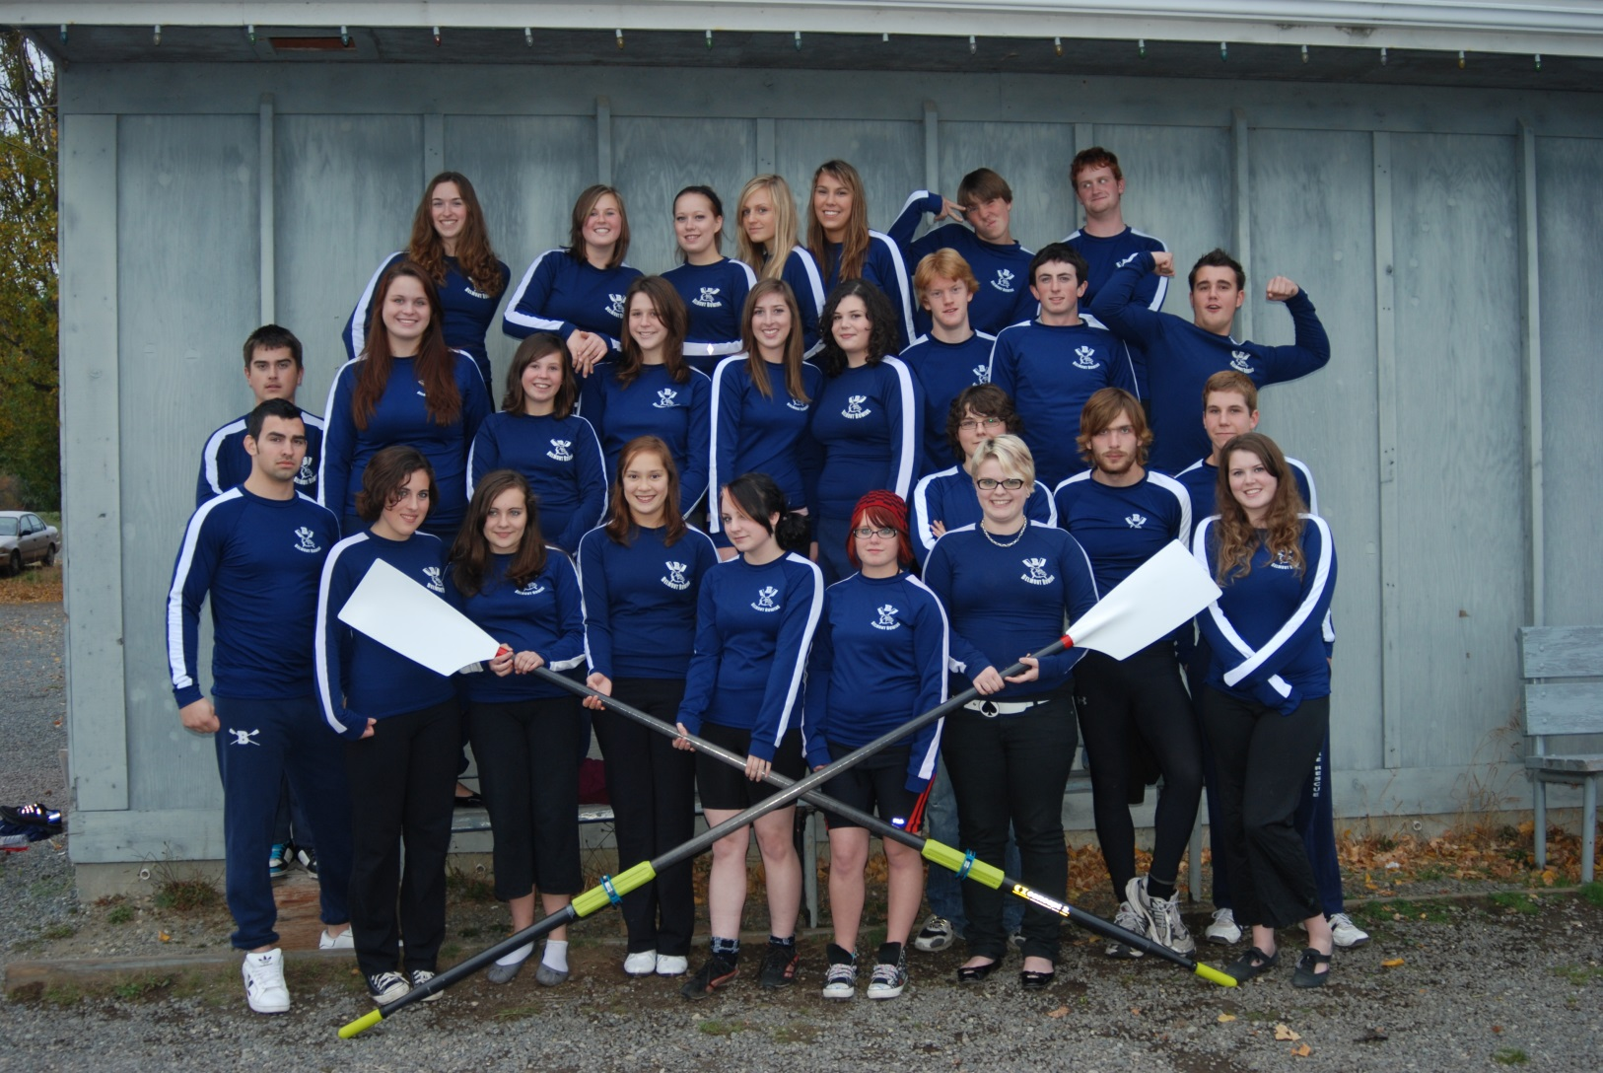
2008 ROWING TEAM

Slide 35
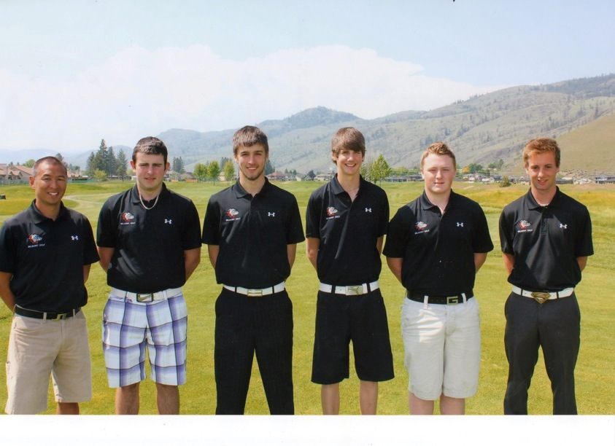
2011 Golf Team
2nd in British Columbia

