Slide 1
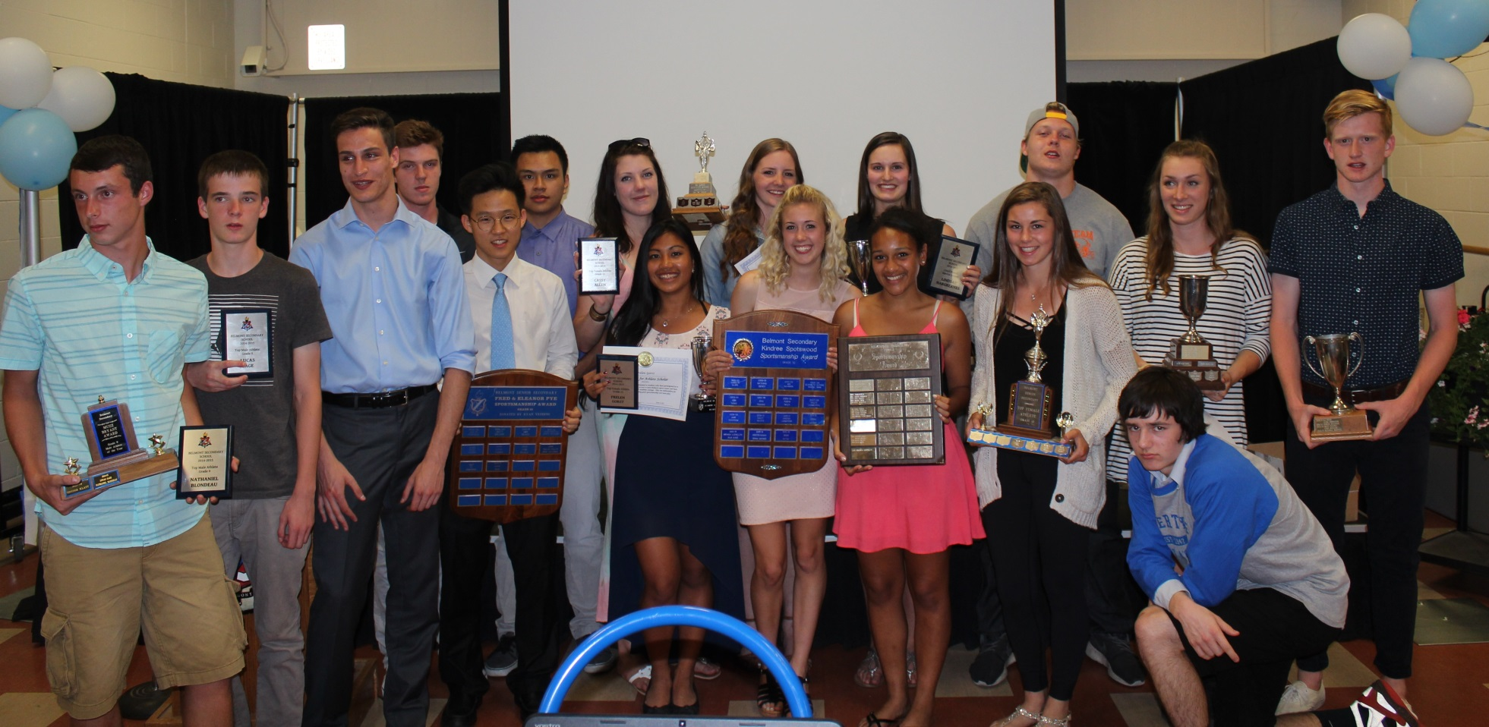
Belmont Athletic Award Winners 2014-15

Slide 2
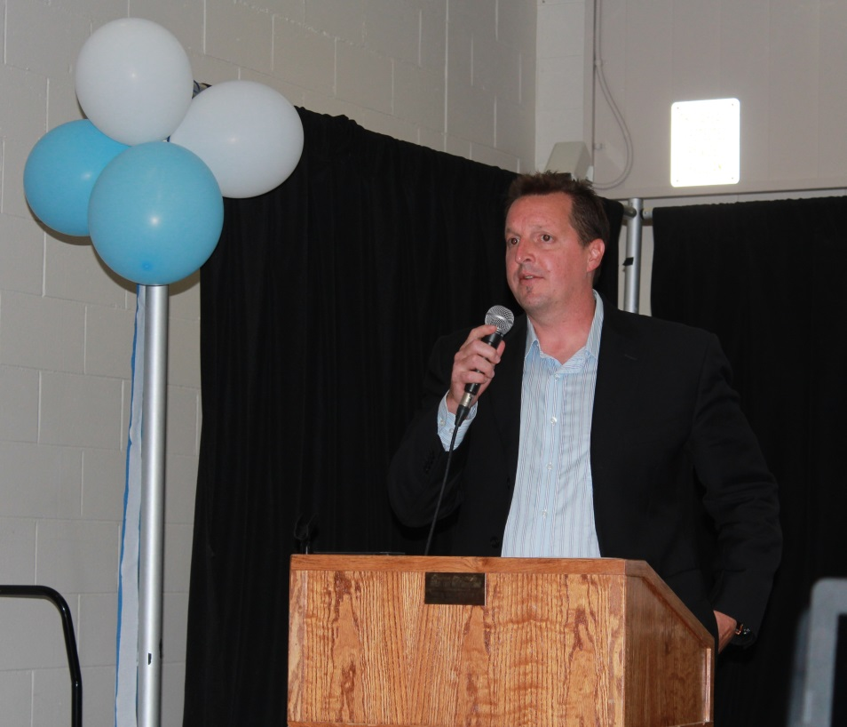
Keynote Speaker: Rob Dyke
Rob Dyke is a Belmont grad and Hall of Fame athlete. He told the
students about some of his amazing athletic accomplishments,
including becoming the only person to swim around Vancouver
Island! He also showed a short inspirational video that highlighted
his historic swim.

Slide 3
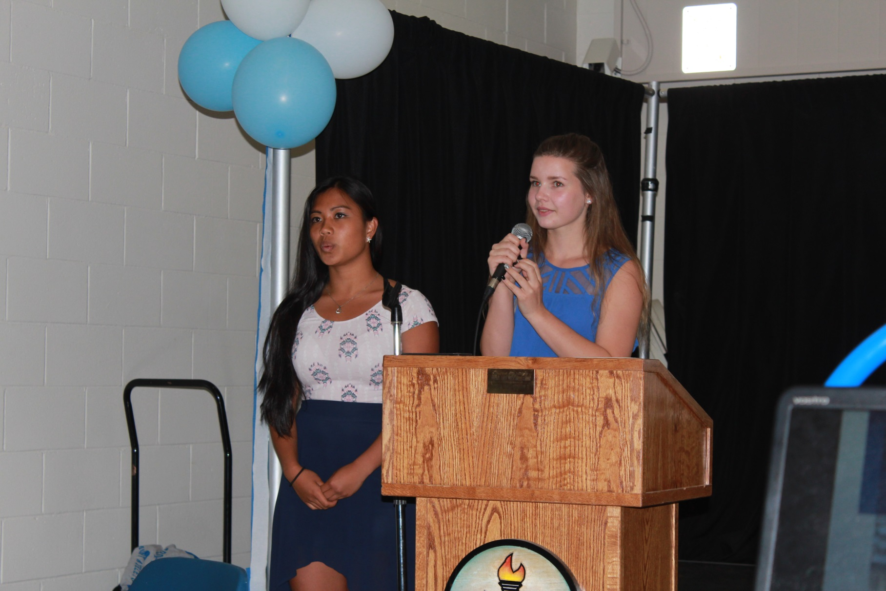
MC’s Frelen Gorst and Nicole Weldam

Slide 4
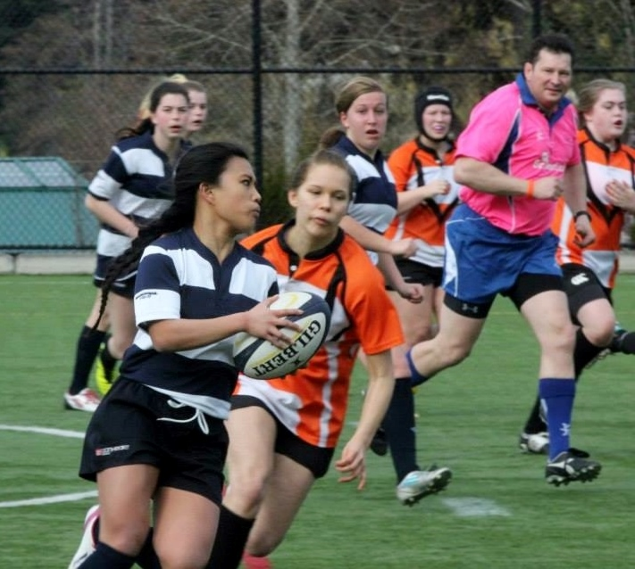
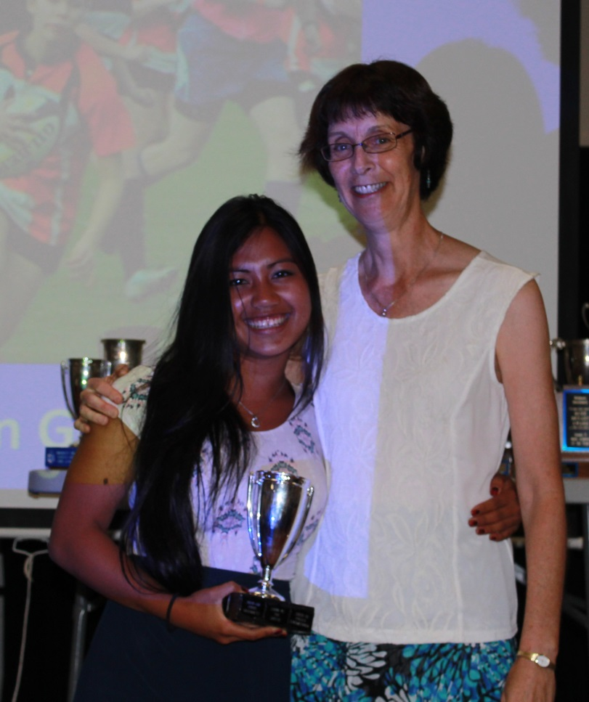
Top Scholar Athlete
Frelen Gorst with coach Cindy Cullen

Slide 5
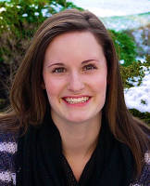
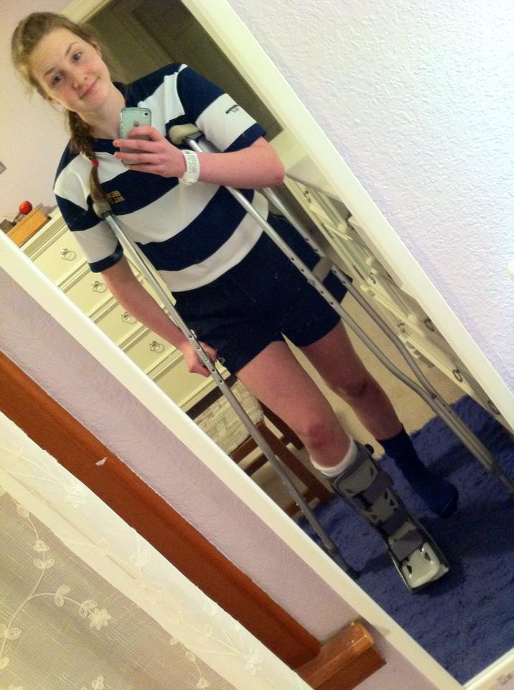
Lloyd Powell Athletic Service Award
Lindsay Hargreaves
Claire Church

Slide 6
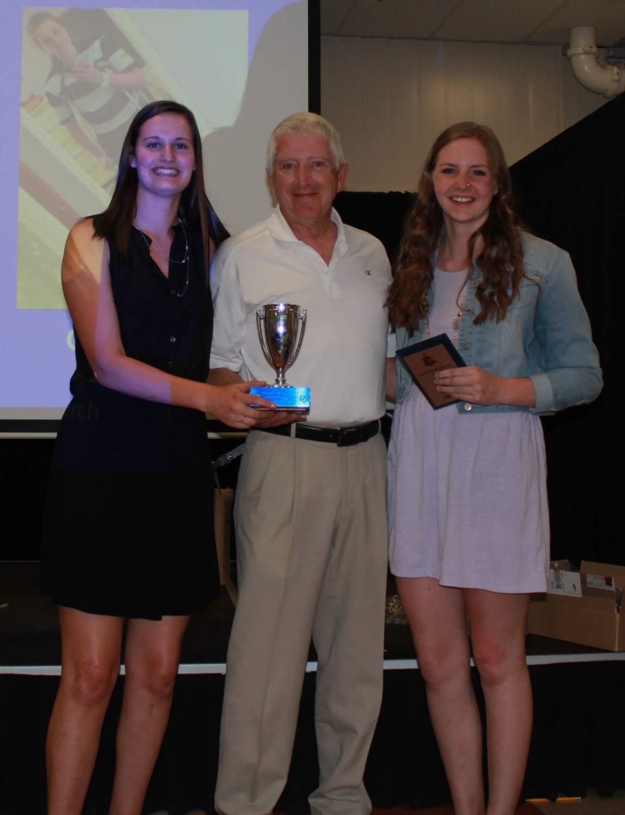
Lindsay and Claire
receive their award
from Lloyd Powell

Slide 7
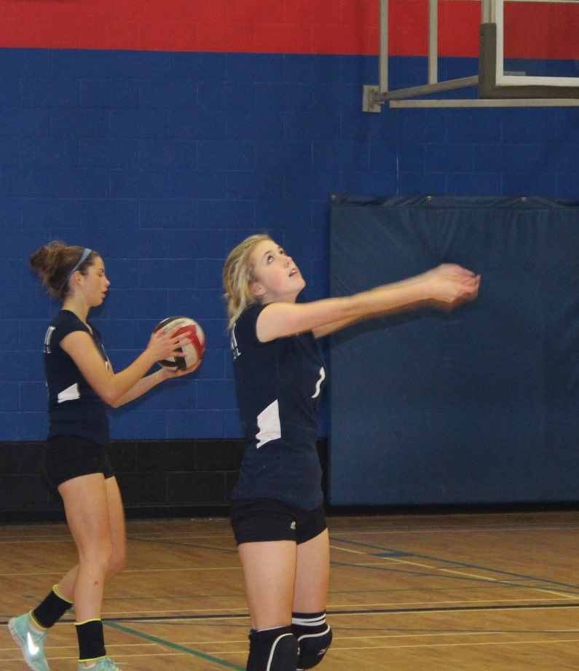
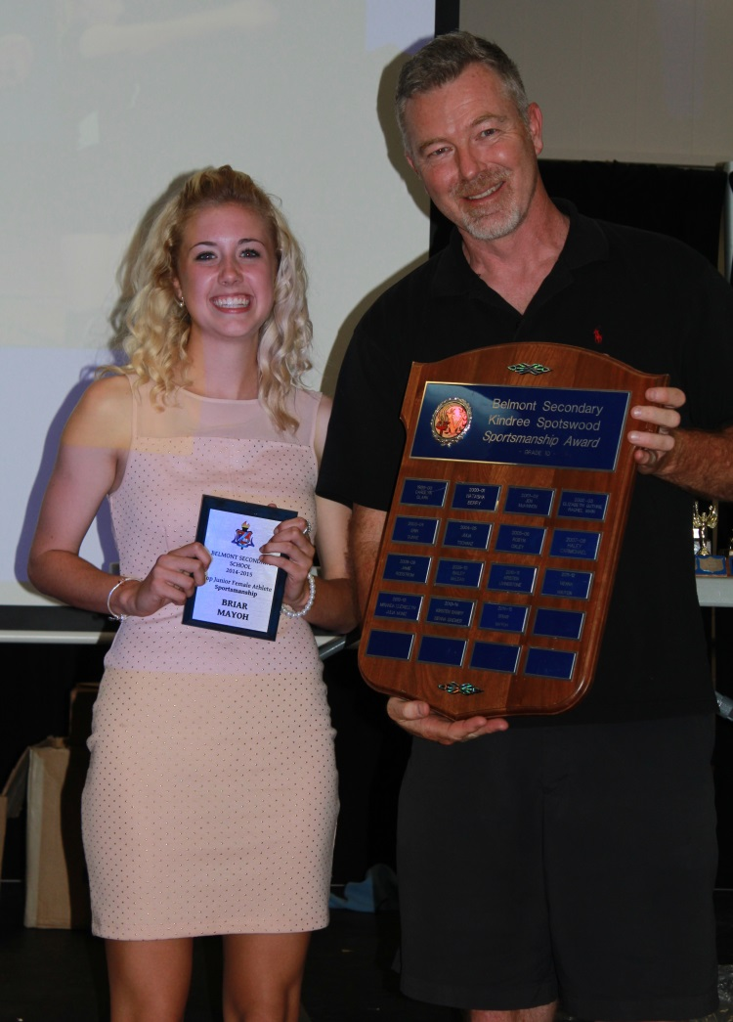
Junior Girls’ Sportsmanship
Briar Mayoh with coach Lee Phillips

Slide 8
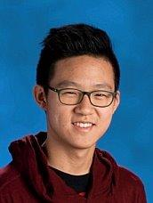
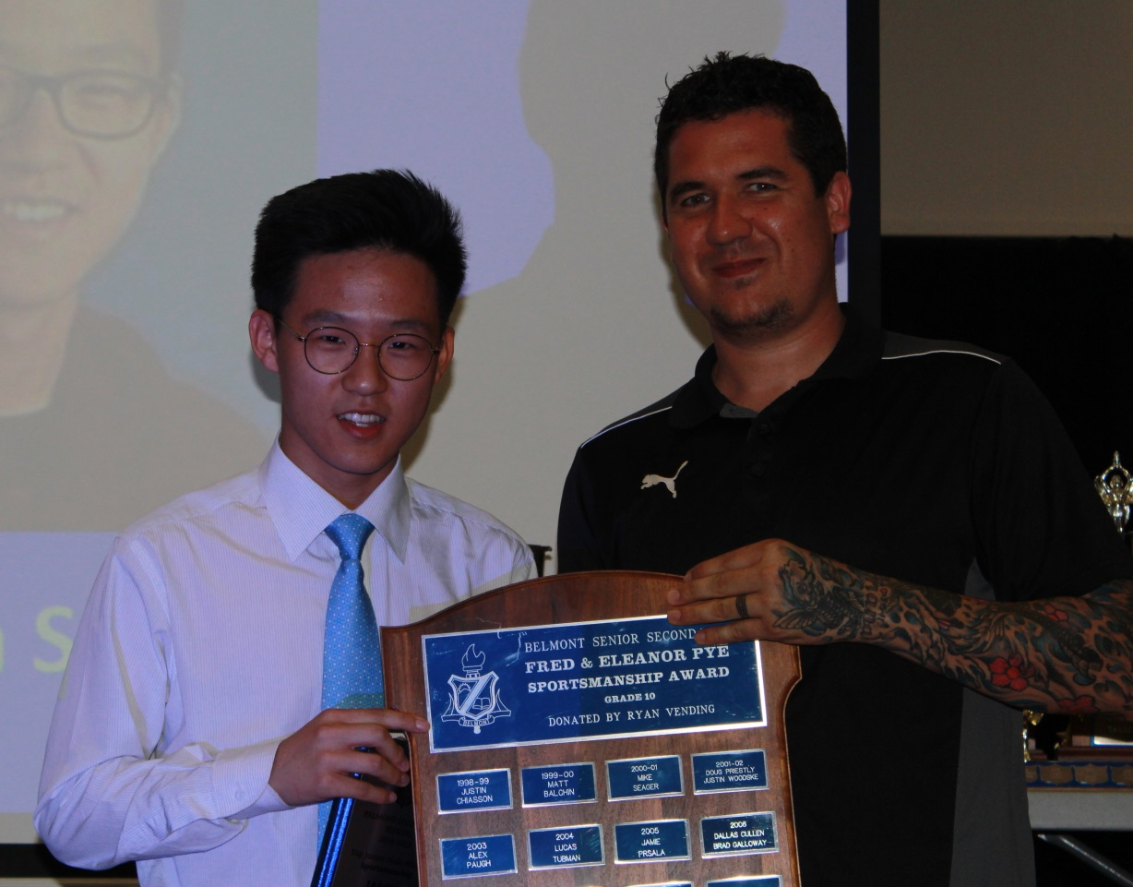
Junior Boys’ Sportsmanship
Jason Song with coach Kevin Brown

Slide 9
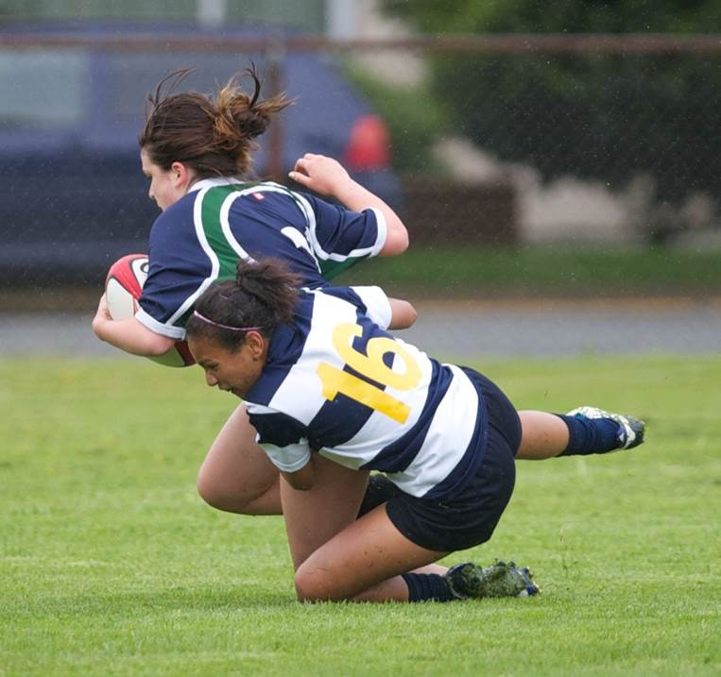
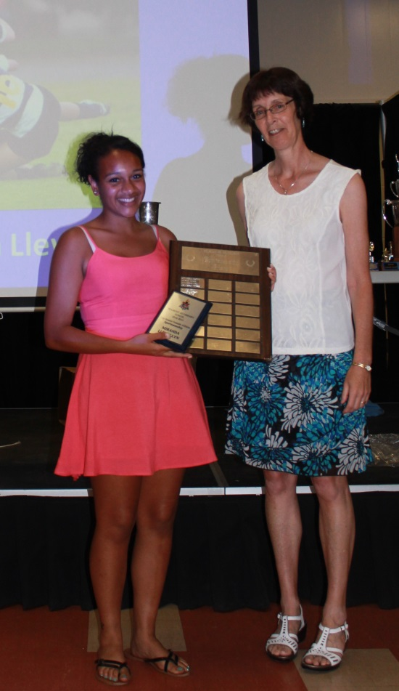
Senior Girls’ Sportsmanship
Miranda Llewellyn

Slide 10
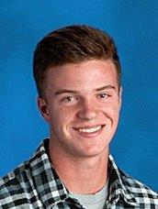
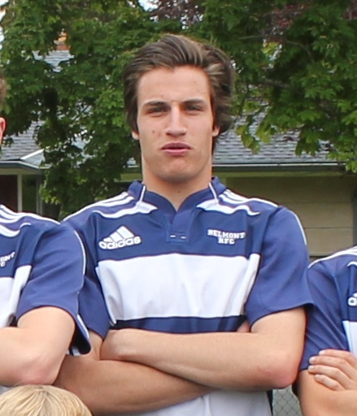
Senior Boys’ Sportsmanship
Ryan Backhouse
Keaton Clarke

Slide 11
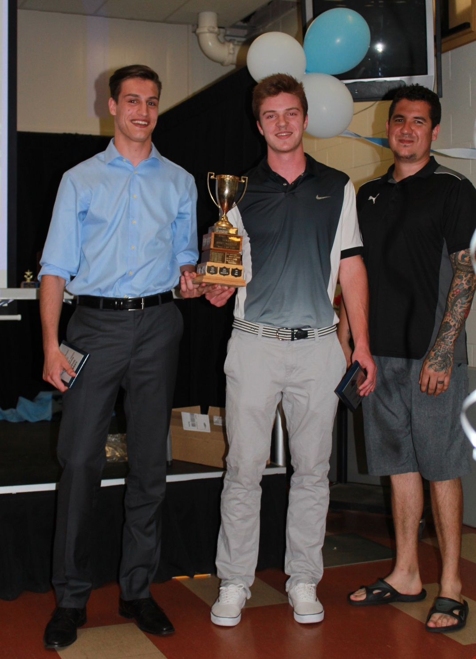
Keaton Clarke and Ryan
Backhouse with coach
Kevin Brown

Slide 12
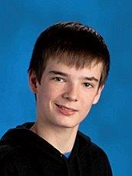
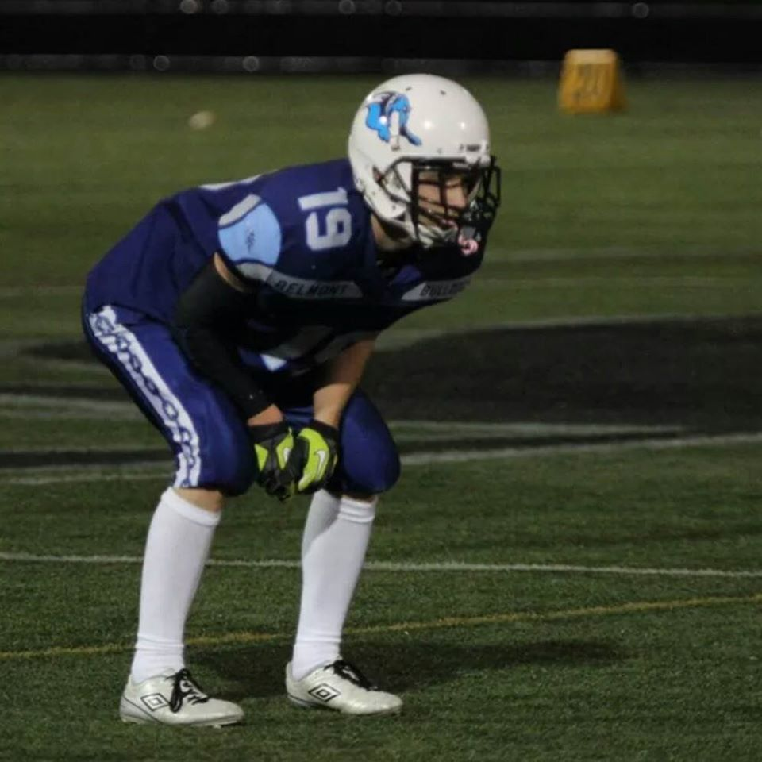
Top Grade 9 Male Athlete
Lucas Gage
Nathaniel Blondeau

Slide 13
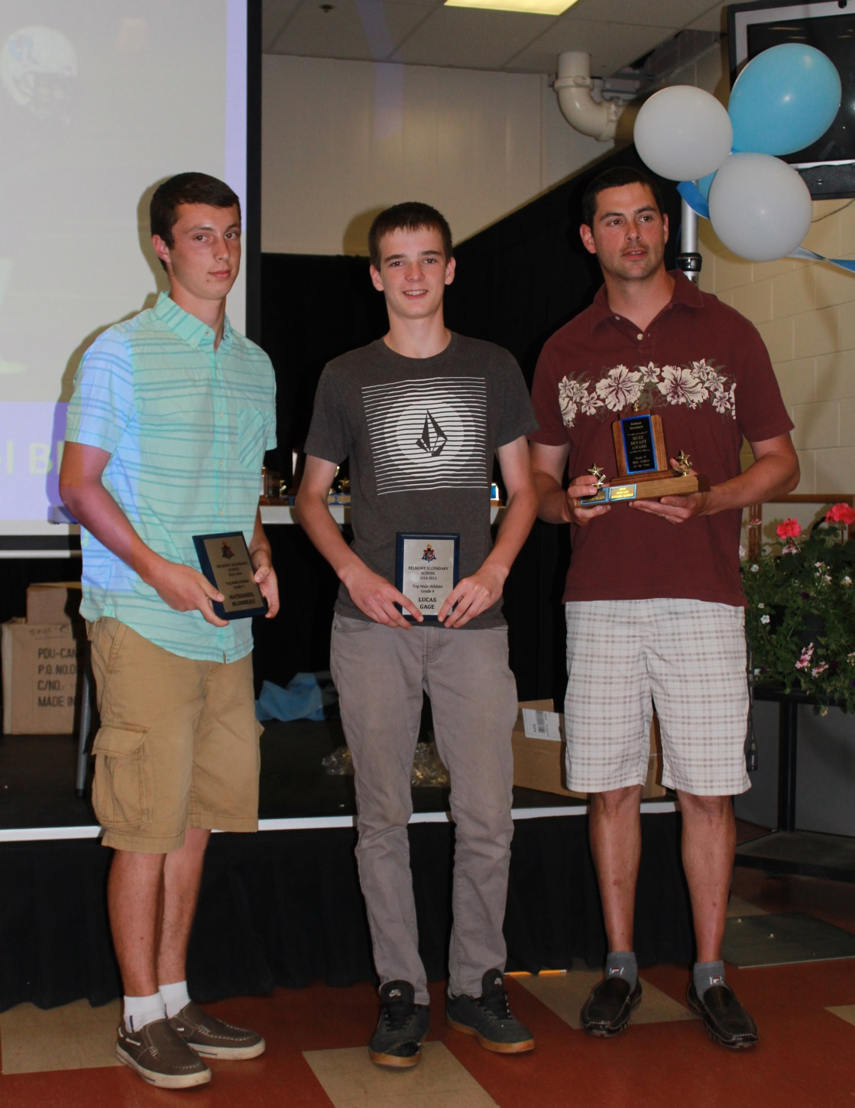
Nathaniel Blondeau
and Lucas Gage with
coach Alexis Sanschagrin

Slide 14
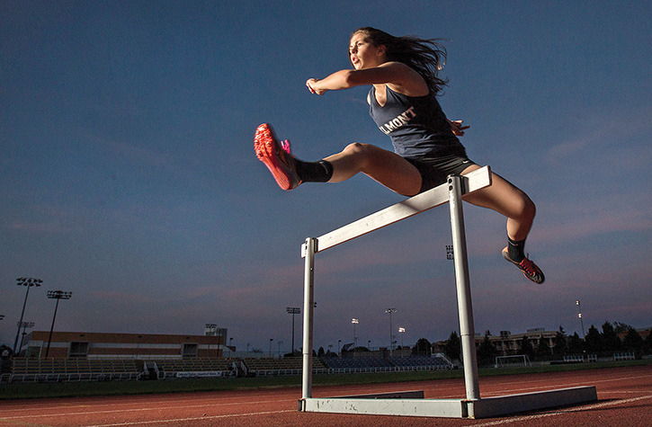
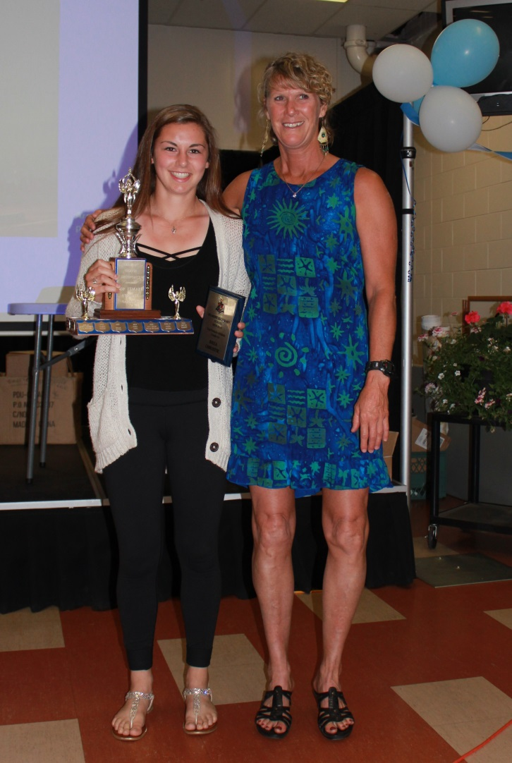
Top Grade 10 Female Athlete
Arnold Lim photo
Brea Christie with coach Dian McKinnon

Slide 15
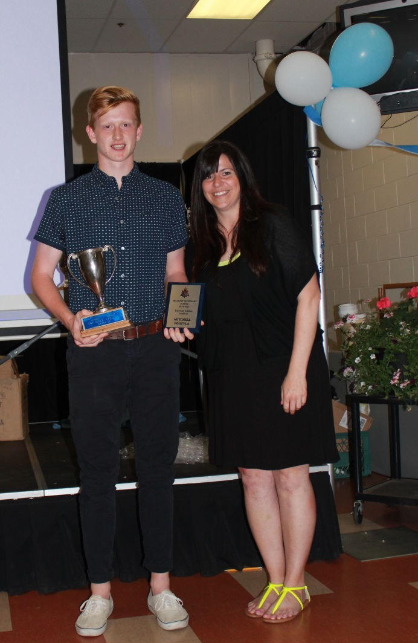
Top Grade 10 Male Athlete
Mitchell Whittla with coach Kris Johnson

Slide 16
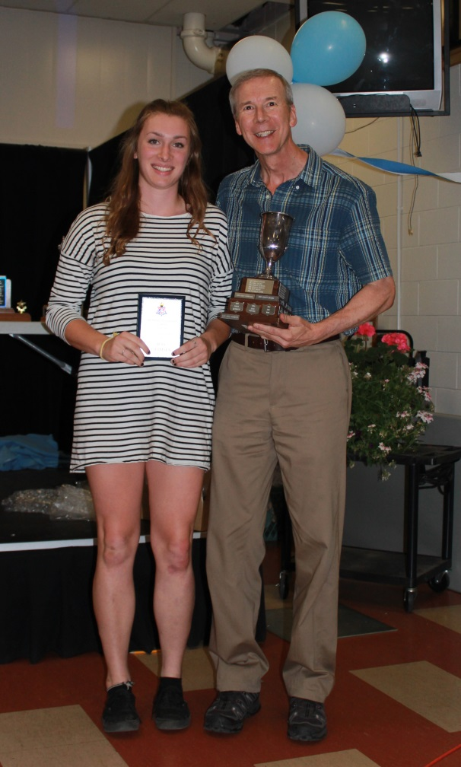
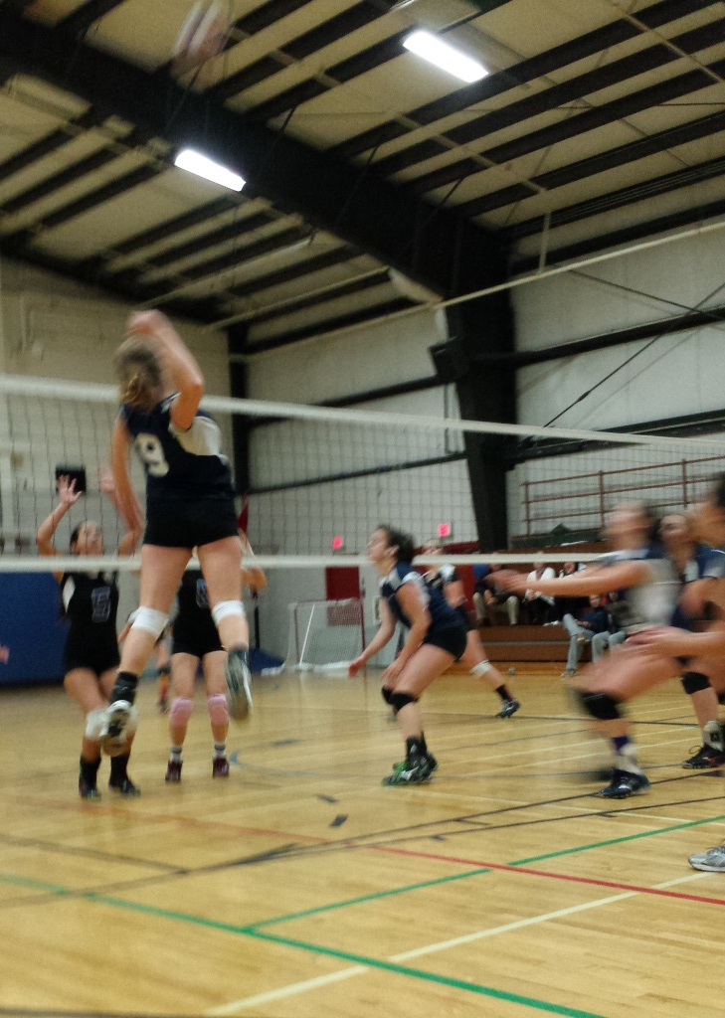
Top Grade 11 Female Athlete
Jess Thomsen with coach Mike Toakley

Slide 17
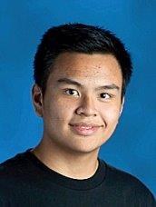
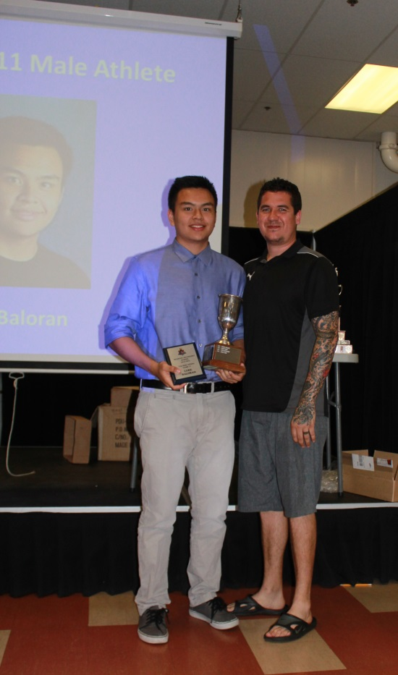
Top Grade 11 Male Athlete
Luke Baloran with coach Kevin Brown

Slide 18
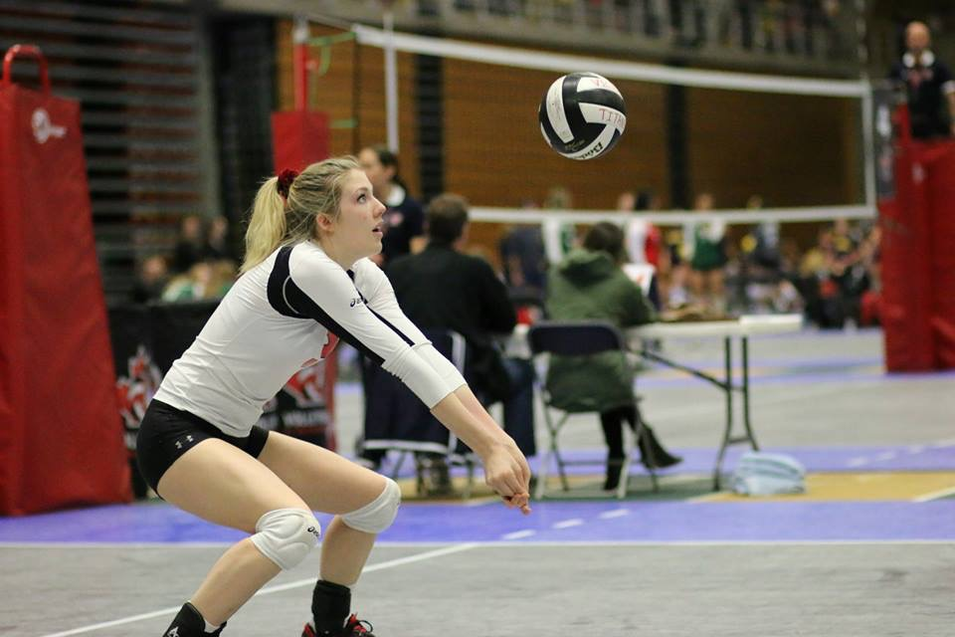
Top Grade 12 Female Athlete
Cassy Allen Frelen Gorst

Slide 19
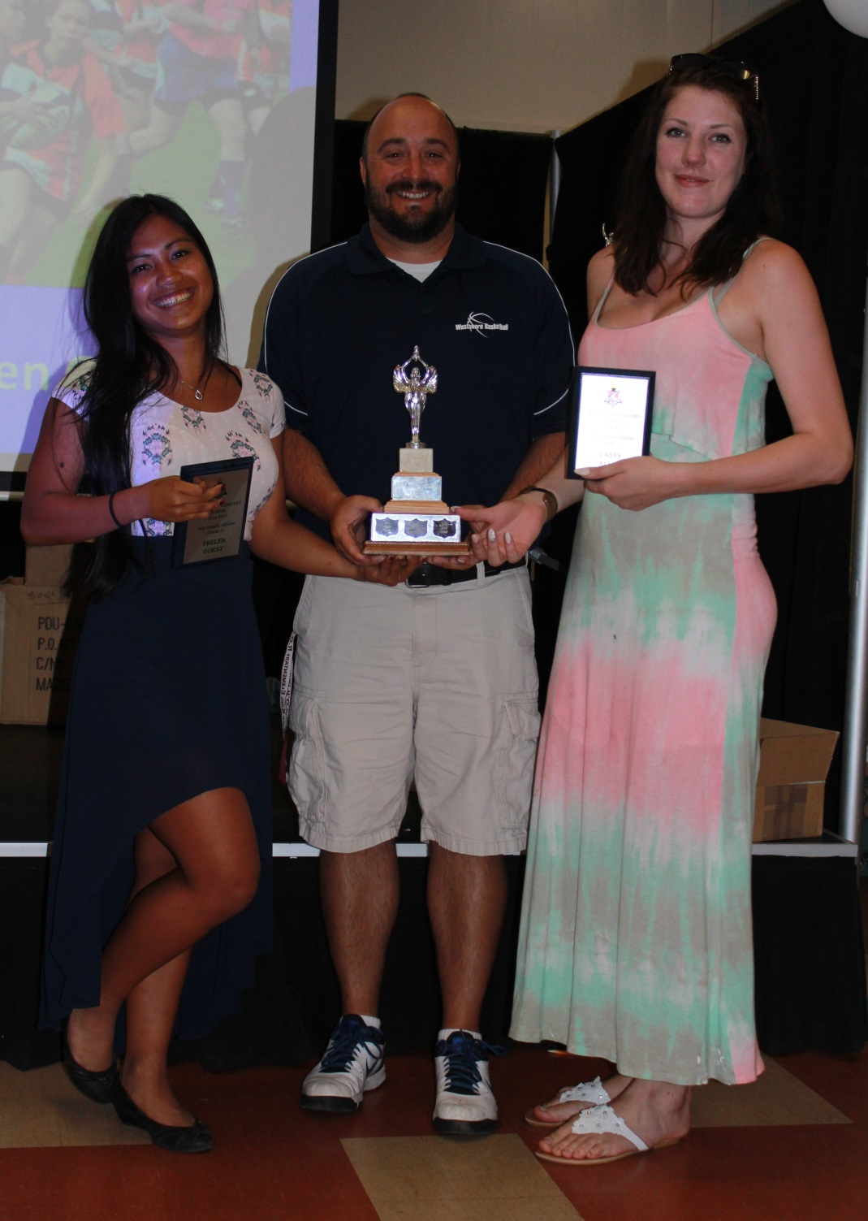
Frelen Gorst and
Cassy Allen with
coach Brad Lidstone

Slide 20
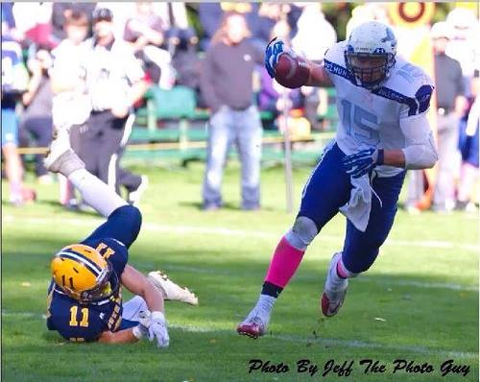
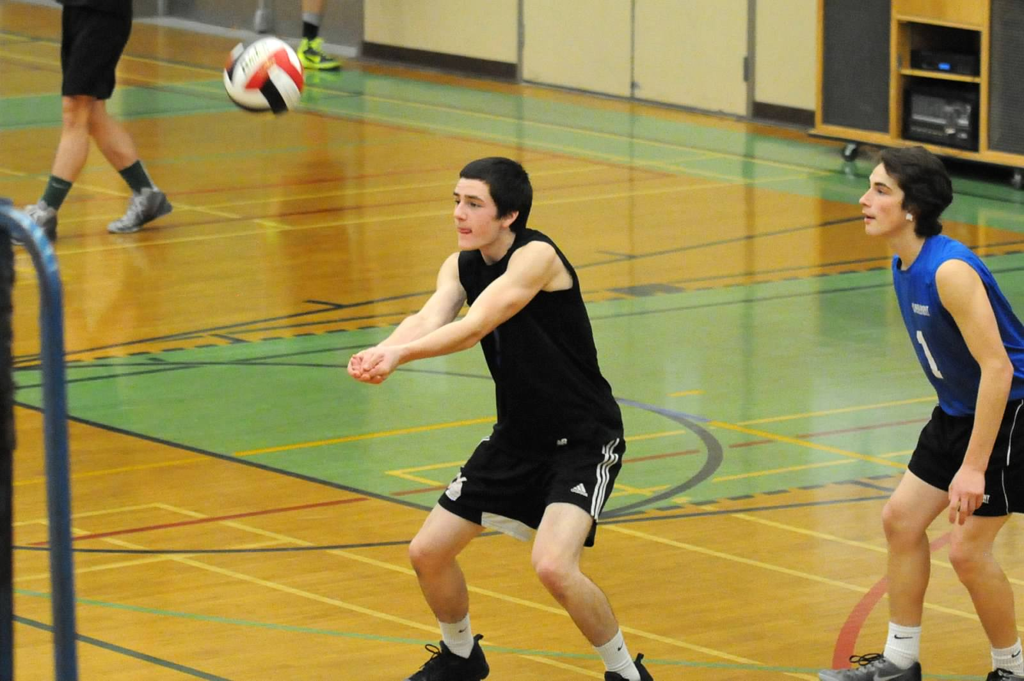
Top Grade 12 Male Athlete
Edgar Nelson
Jack Wenstob

Slide 21
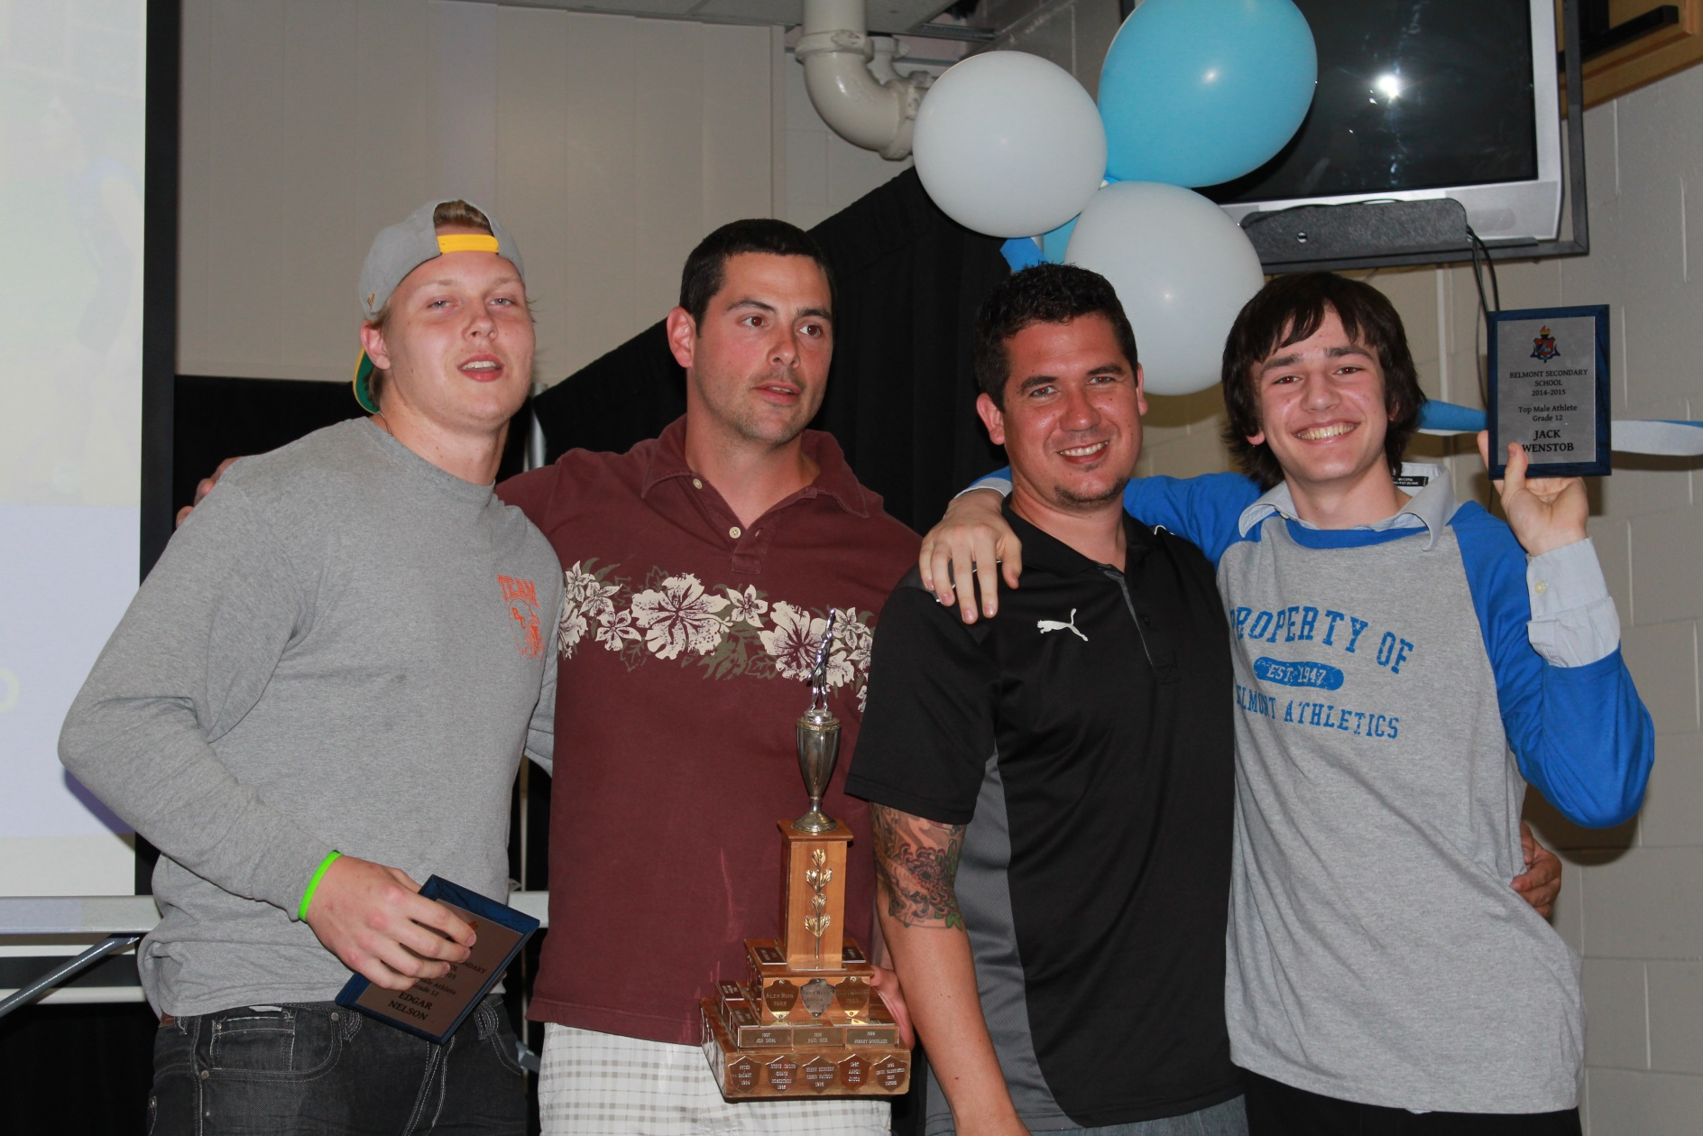
Edgar Nelson and Jack Wenstob with coaches Alexis Sanschagrin and Kevin Brown

Slide 22
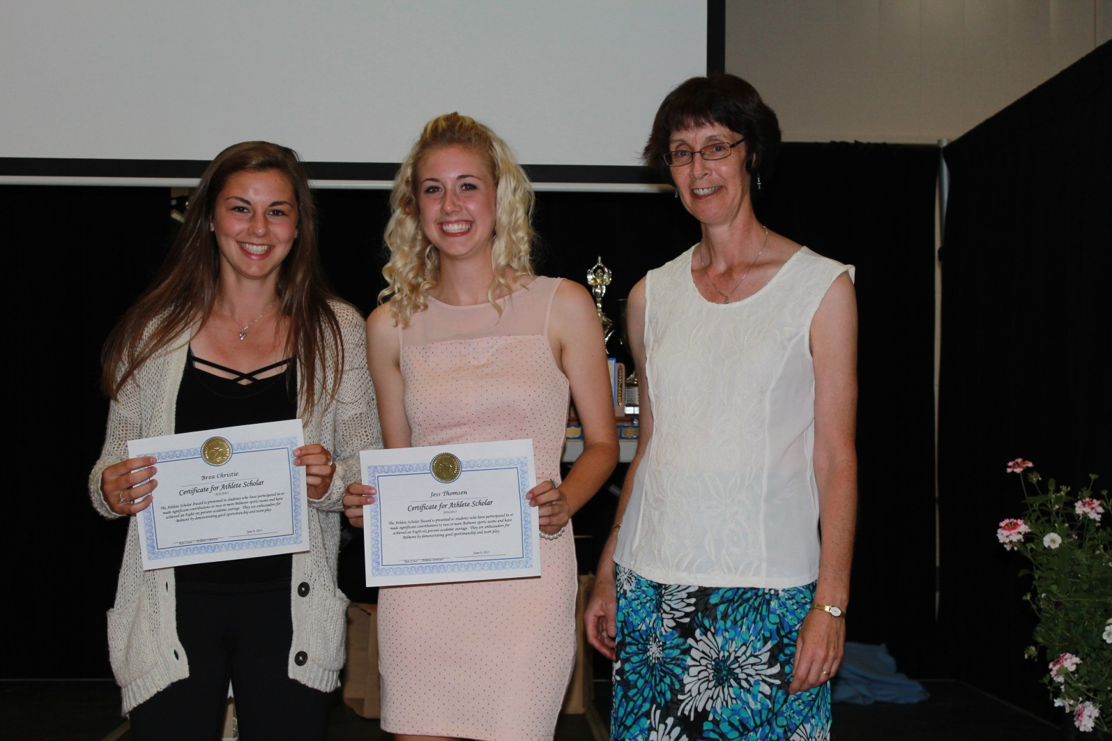
Grade 10 Scholar Athletes
Brea Christie and Briar Mayoh with coach Cindy Cullen

Slide 23
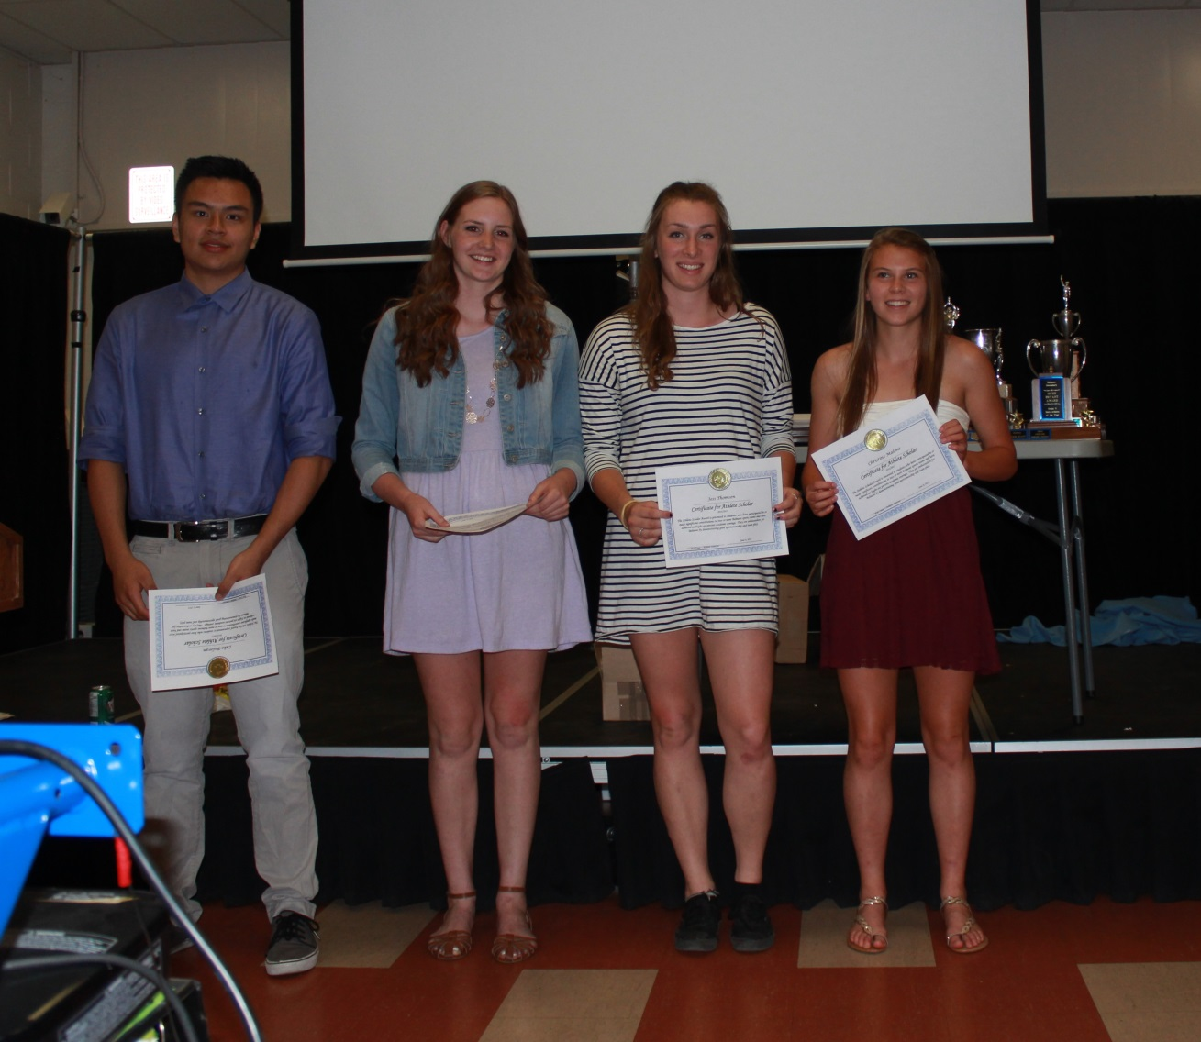
Grade 11 Scholar Athletes
Luke Baloran, Claire Church, Jess Thomsen, Christine Malone

Slide 24
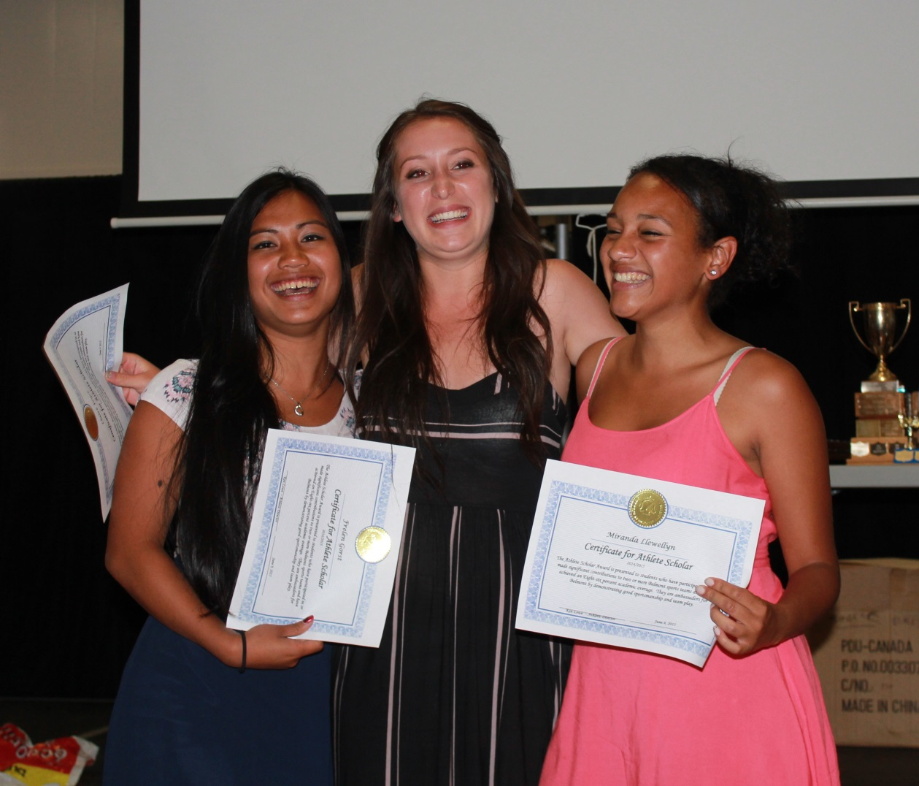
Grade 12 Scholar Athletes
Frelen Gorst, Claire Joyce and Miranda Llewellyn

