Slide 1
Belmont Athletic Award Winners 2015-16

Slide 2
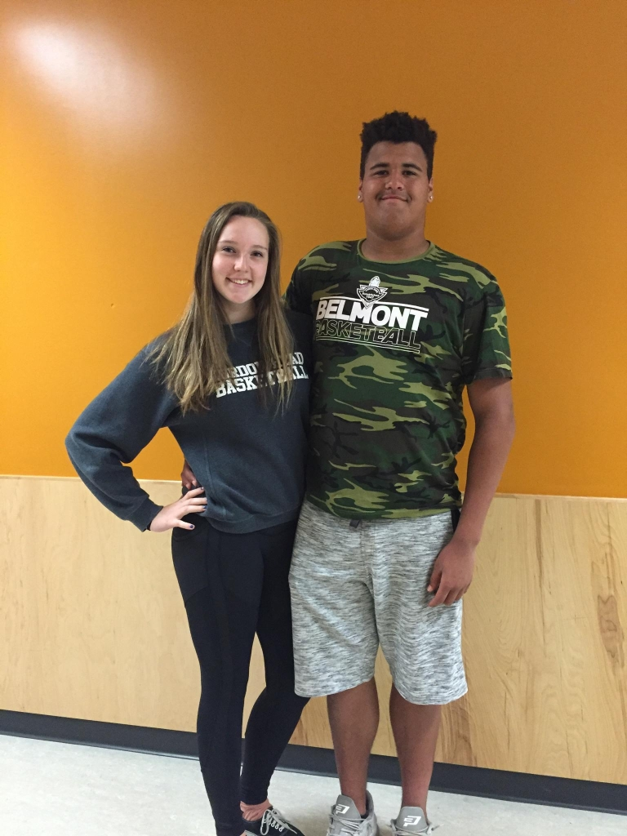
MC’s
Gracie May and Dontae Bull

Slide 3
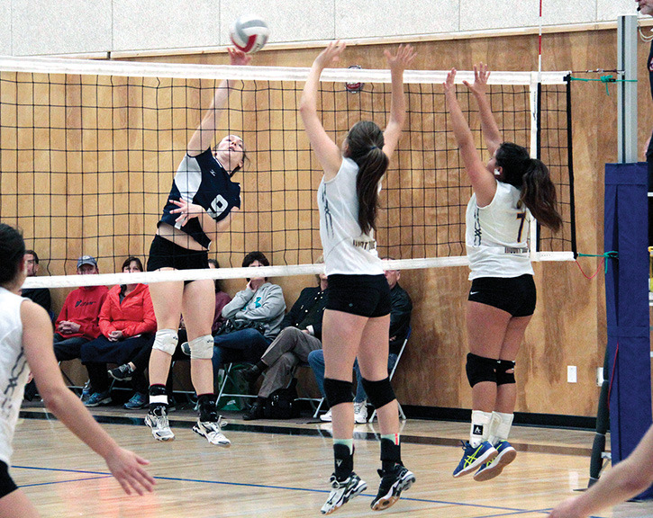
Top Scholar Athlete earned a GPA of at least 90% and made major contributions to one or more Belmont sports teams
Jess Thomsen

Slide 4
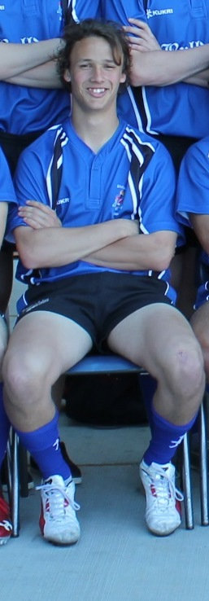
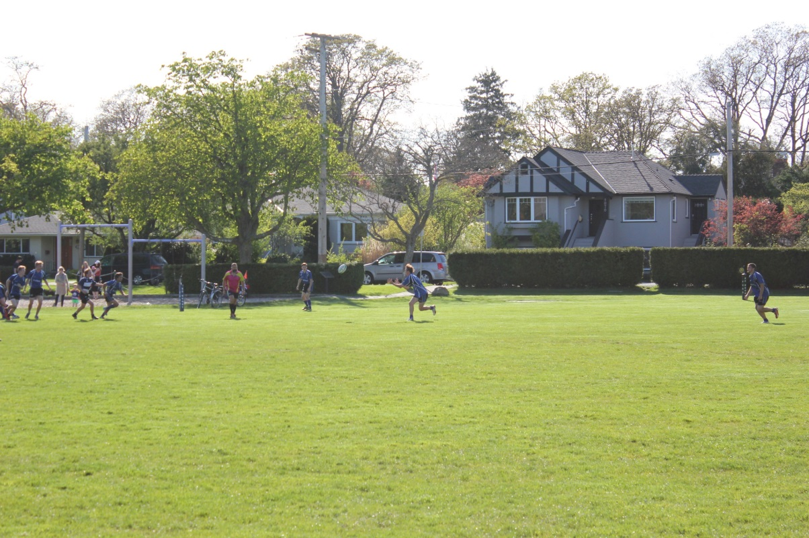
Lloyd Powell Athletic Service Award
Connor Klatt

Slide 5
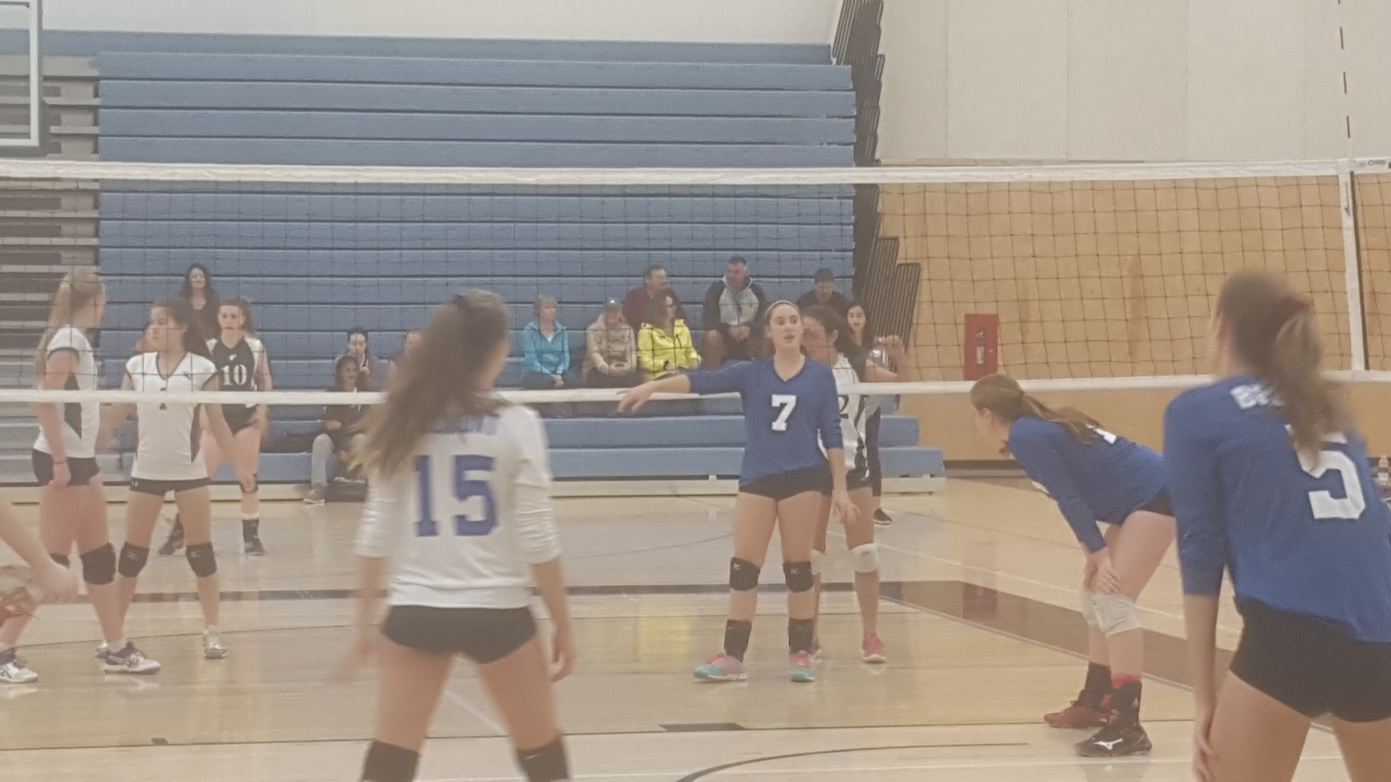
Grade 9 Girls’ Sportsmanship
Taylee Pomponio

Slide 6
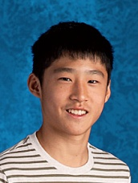
Grade 9 Boys’ Sportsmanship
Danny Song

Slide 7
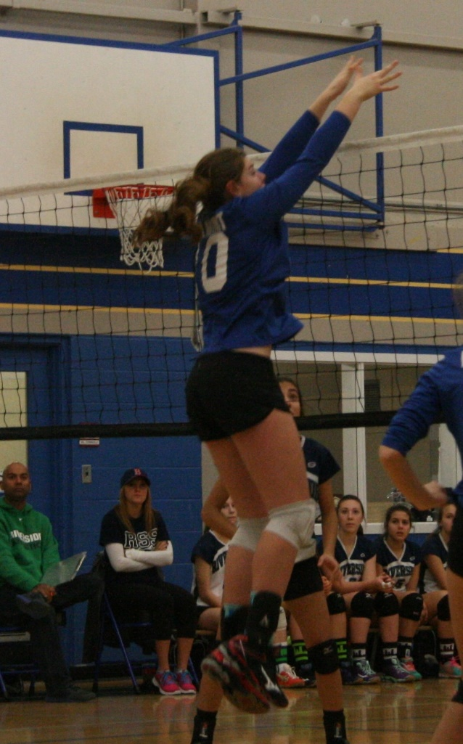
Grade 10 Girls’ Sportsmanship
Sydney Belton

Slide 8
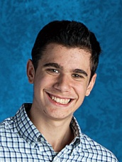
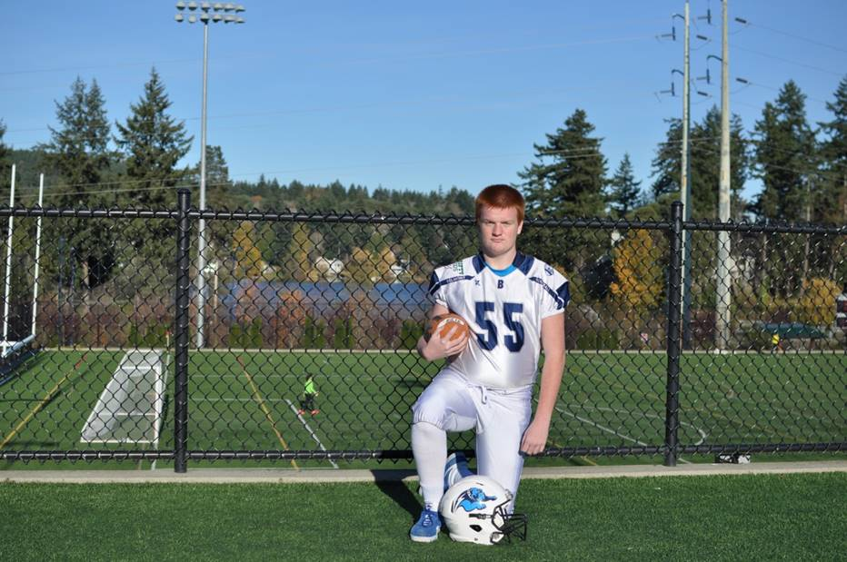
Grade 10 Boys’ Sportsmanship
Nathan Eldridge
Isaac Ickovich

Slide 9
Grade 11 Girls’ Sportsmanship
Aeae Savontand

Slide 10
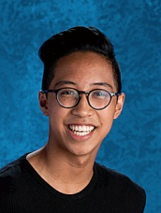
Grade 11 Boys’ Sportsmanship
Perry Panganiban

Slide 11
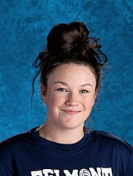
Grade 12 Girls’ Sportsmanship
Jesse Lusk

Slide 12
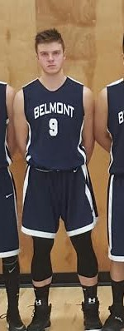
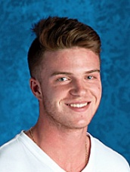
Grade 12 Boys’ Sportsmanship
Ryan Backhouse

Slide 13
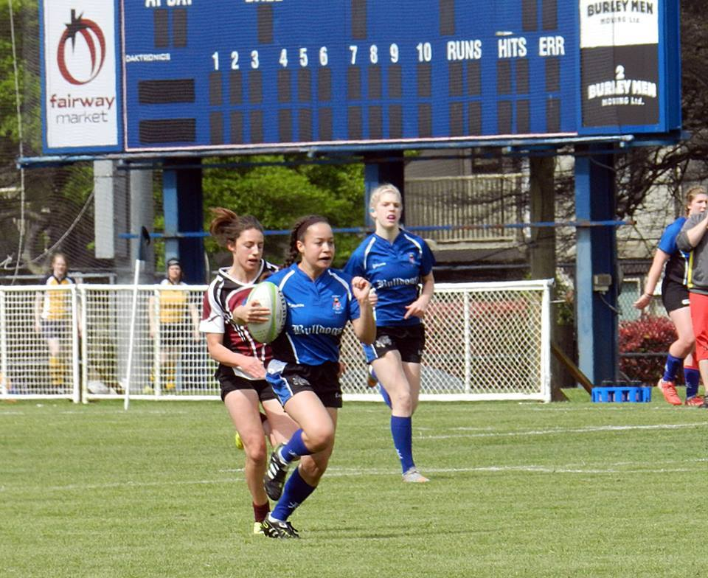
Top Grade 9 Female Athlete
Ashanti Whyte
Gracie May

Slide 14
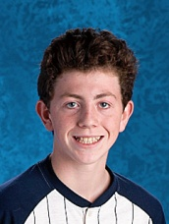
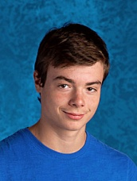
Top Grade 9 Male Athlete
Maxwell Leeder
Lucas Nielsen

Slide 15
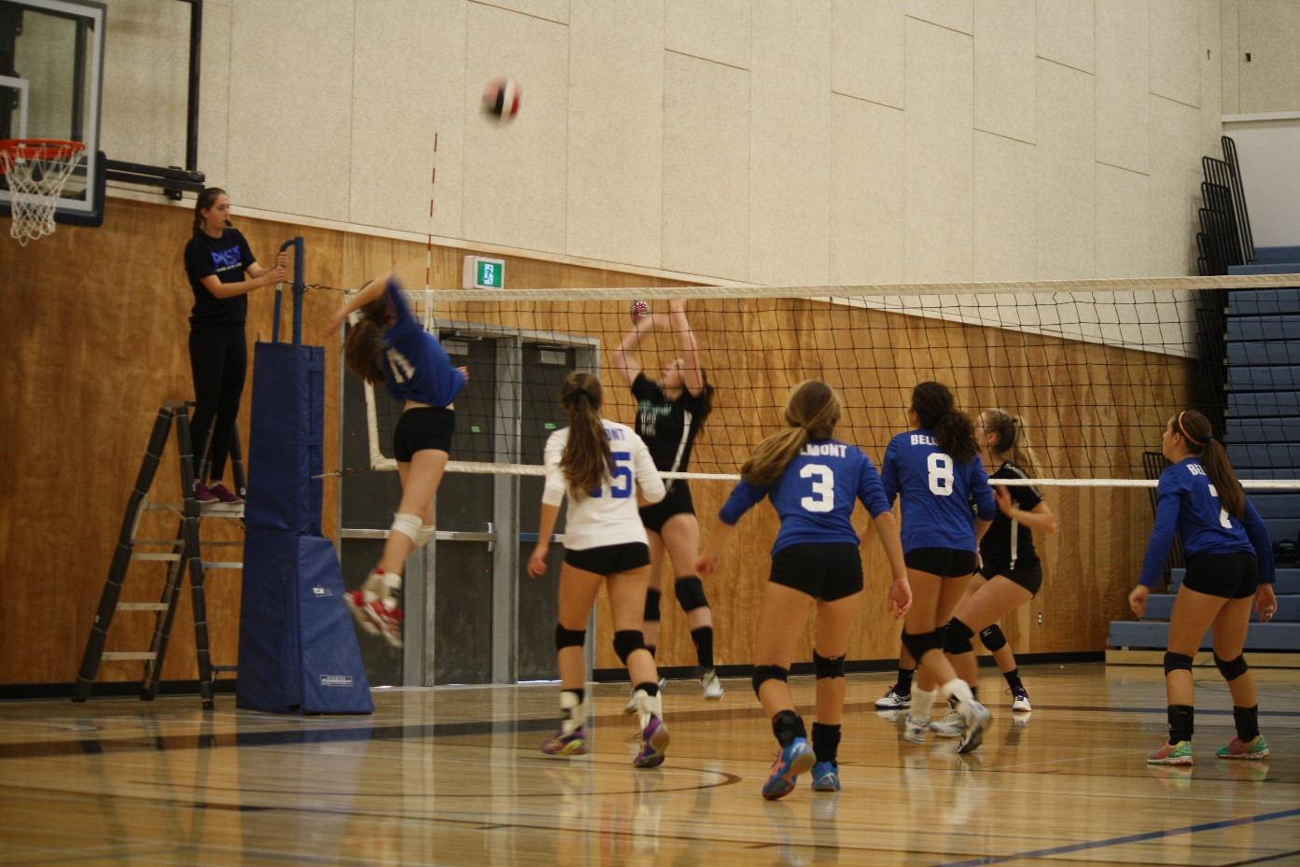
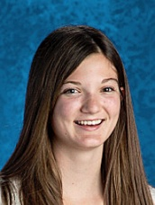
Top Grade 10 Female Athlete
Savannah Purdy

Slide 16
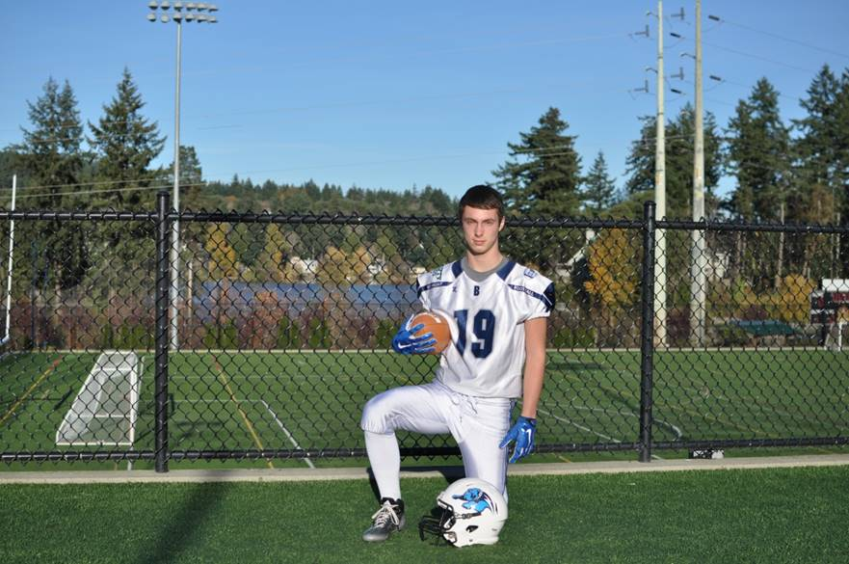
Top Grade 10 Male Athlete
Nathaniel Blondeau

Slide 17
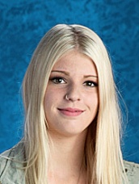
Top Grade 11 Female Athlete
Megan Silveira

Slide 18
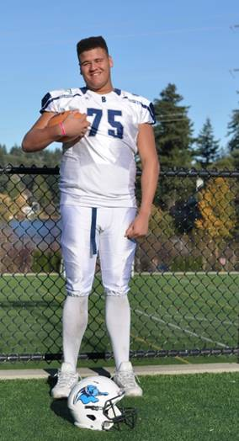
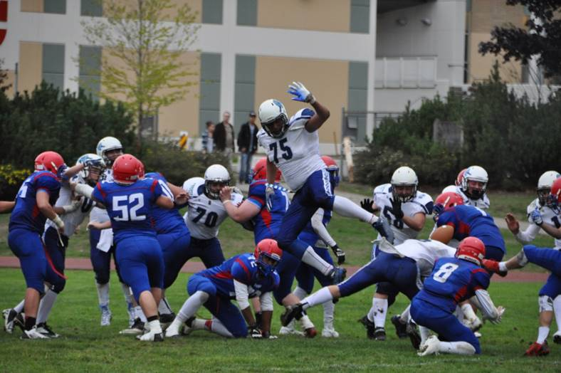
Top Grade 11 Male Athlete
Dontae Bull

Slide 19
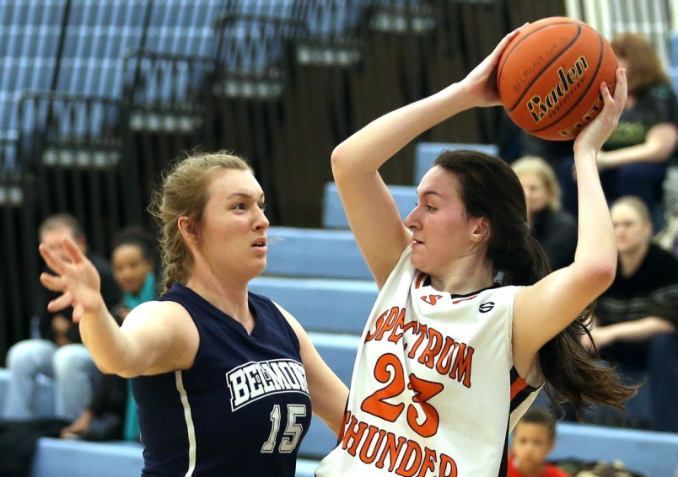
Top Grade 12 Female Athlete
Jess Thomsen

Slide 20
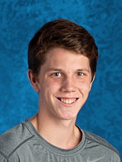
Top Grade 12 Male Athlete
Jackson Leeder

Slide 21
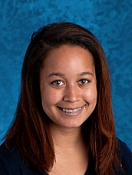
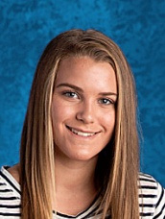
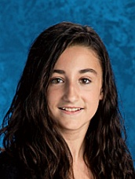
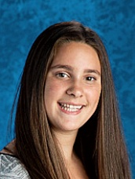
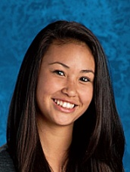
Grade 9 Scholar Athletes earned an 86% GPA and made significant contributions to one or more Belmont sports teams
Maggie Mackinnon
Emma Hansen
Ashanti Whyte
Taylee Pomponio
Silken Tschofen

Slide 22
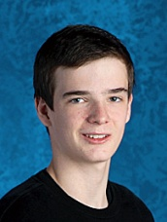
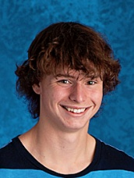
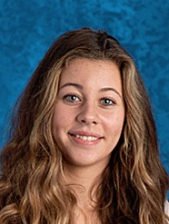
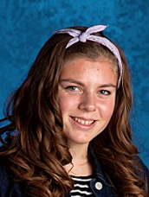
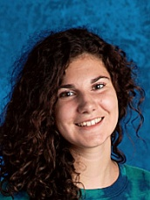
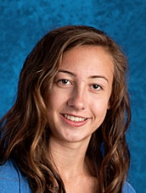
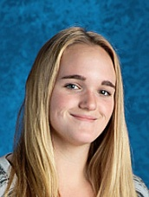
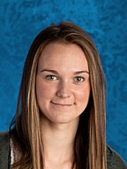
Grade 10 Scholar Athletes earned an 86% GPA and made significant contributions to one or more Belmont sports teams
Lucas Gage
Tyler Hardy
Savannah Purdy
Olivia Godek
Sydney Belton
Devon Woolley
Paige Sutton
Megan Wilson
Hannah May

Slide 23
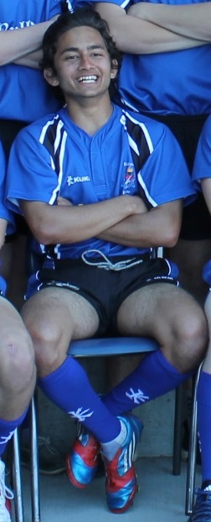
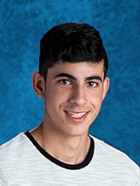
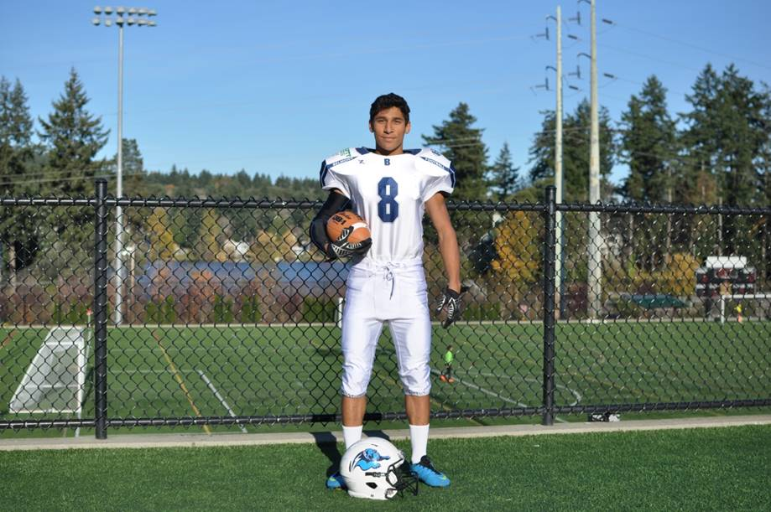
Grade 11 Scholar Athletes earned an 86% GPA and made significant contributions to one or more Belmont sports teams
Nathan Johal
Rahul Roy
Connor Klatt
Jared Barrow

Slide 24
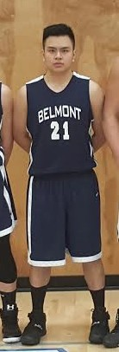
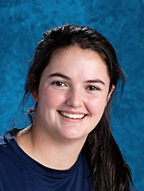
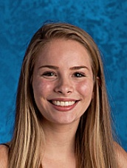
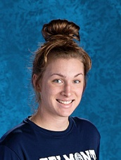
Grade 12 Scholar Athletes earned an 86% GPA and made significant contributions to one or more Belmont sports teams
Kirsten Barry
Natalie McFall
Jess Thomsen
Luke Baloran

