Slide 1
Belmont’s Sporting Families
There are many family connections throughout Belmont’s athletic history,
in some cases spanning three generations. Each of the following slides
highlights one family that featured two or more Belmont athletes. The slides
are arranged alphabetically in order to make it easier to find a particular
person or family.
We would love to have many more Belmont sporting families represented in this
power point. If you would like to see your family included, please send photos
and a brief description to Cindy Cullen (ccullen@sd62.bc.ca) or drop them off
at the Belmont main office for us to scan.

Slide 2
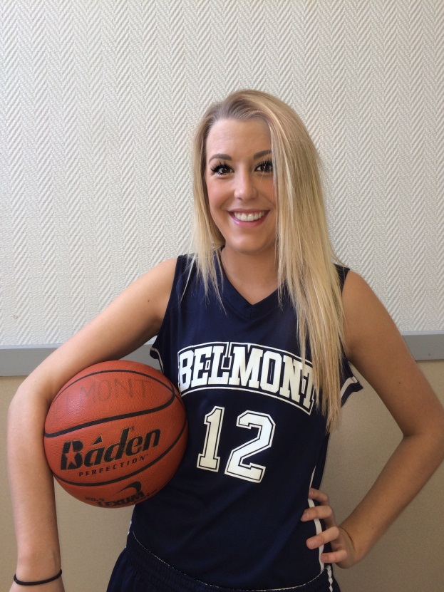
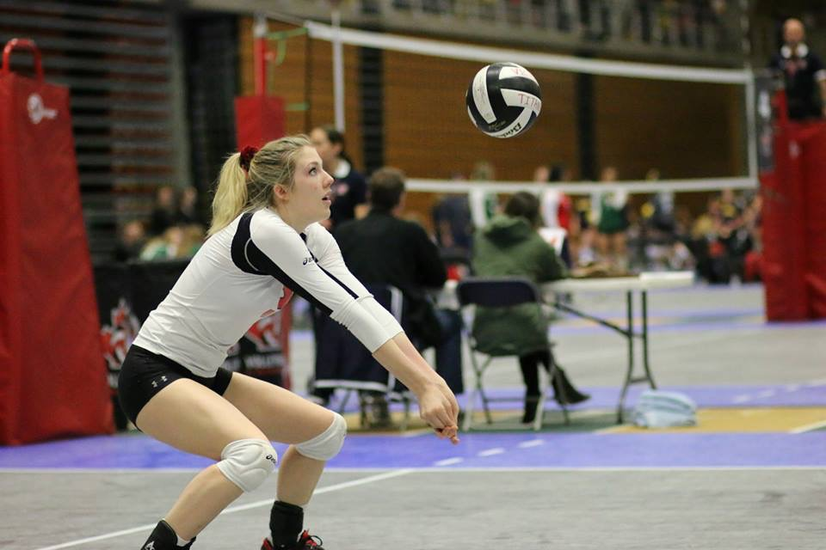
The Allens
Cassy
Hannah
Twins Cassy and Hannah Allen were key contributors to Belmont’s
basketball and volleyball programs from 2012-2015. Cassy was a Vancouver
Island first team all star in volleyball and helped lead the Bulldogs to the
BC tournament in 2015, while Hannah was captain of both the junior
and senior girls’ basketball teams during her time at Belmont.

Slide 3
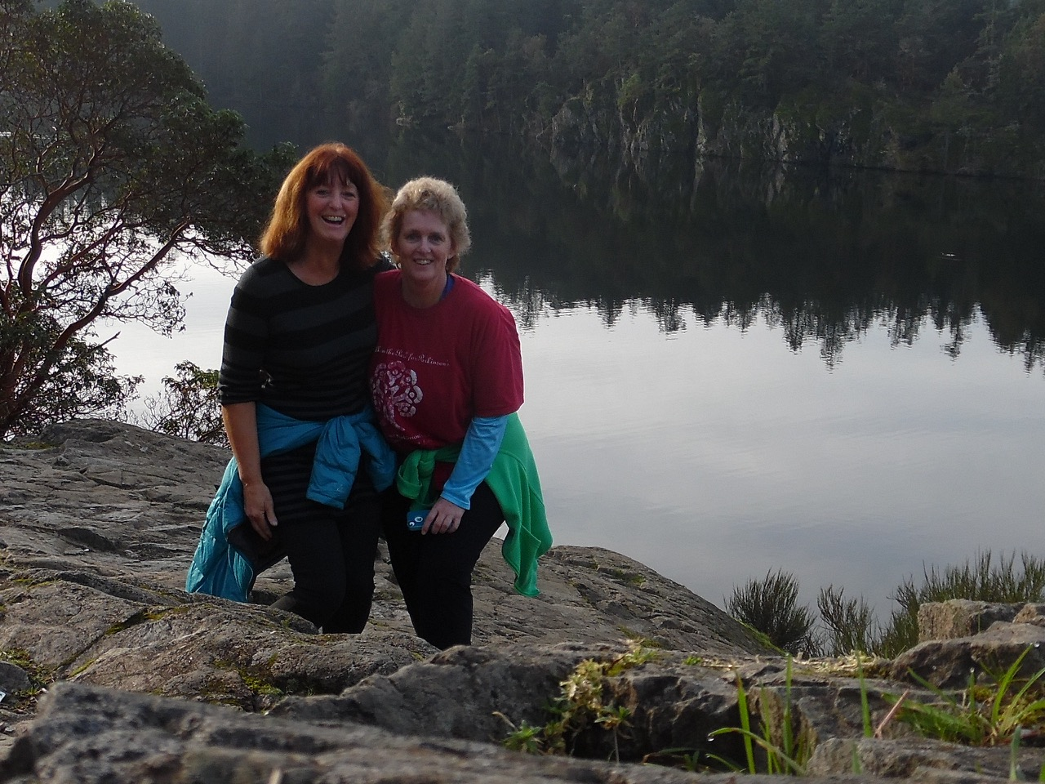
The Auburns
Cathy and Sandy
at Thetis Lake
Cathy Auburn, Belmont’s outstanding senior girls’ athlete in 1972, was
a basketball and volleyball standout. She later played for the powerful
Uvic Vikes women’s basketball team. Younger sister Sandy was also an
all round athlete and earned Belmont’s top sportsmanship trophy in 1974.

Slide 4
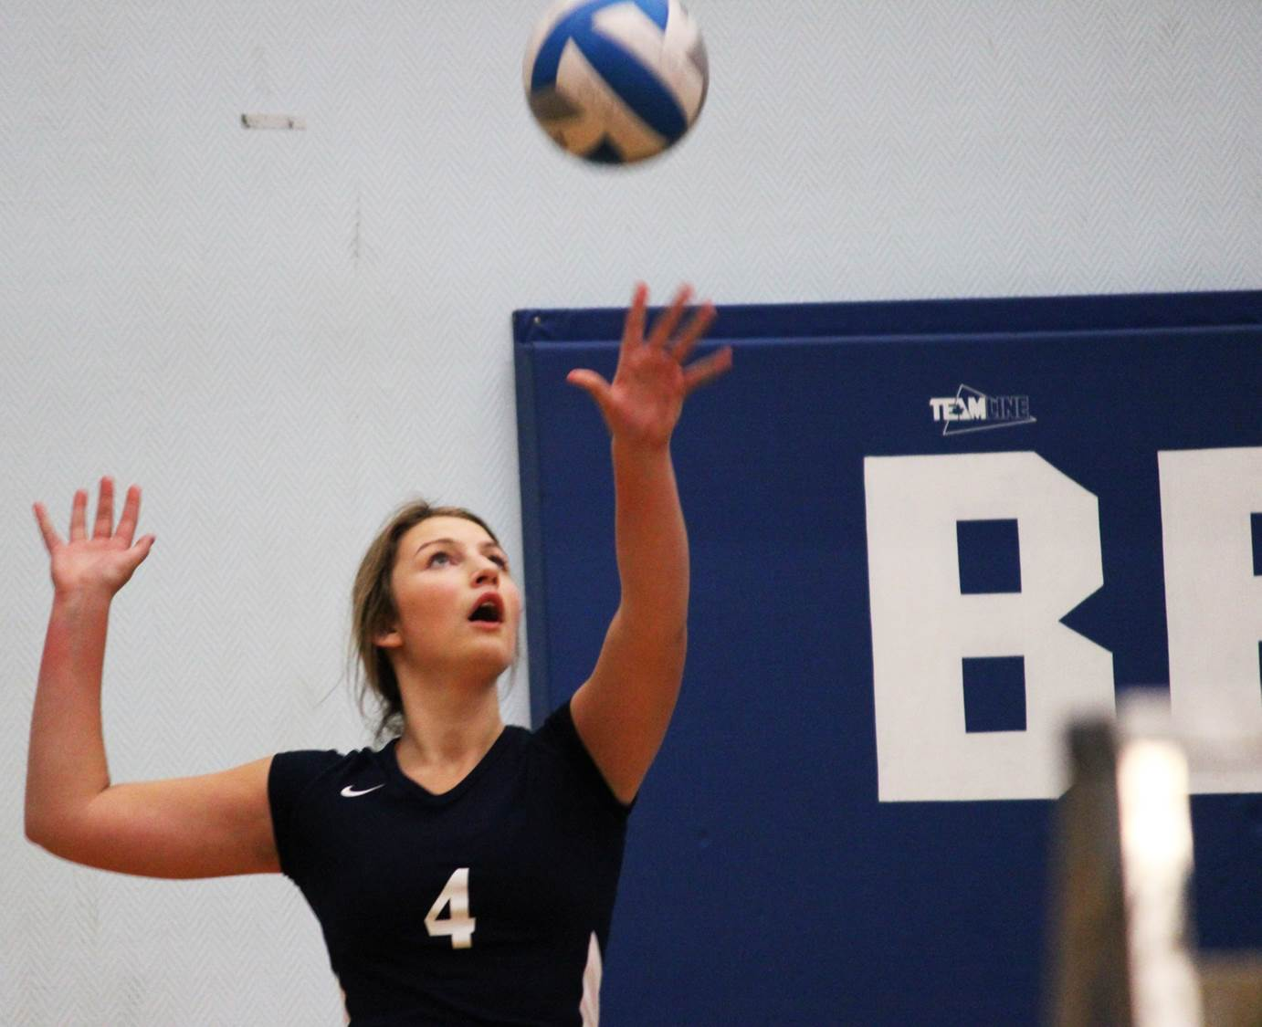
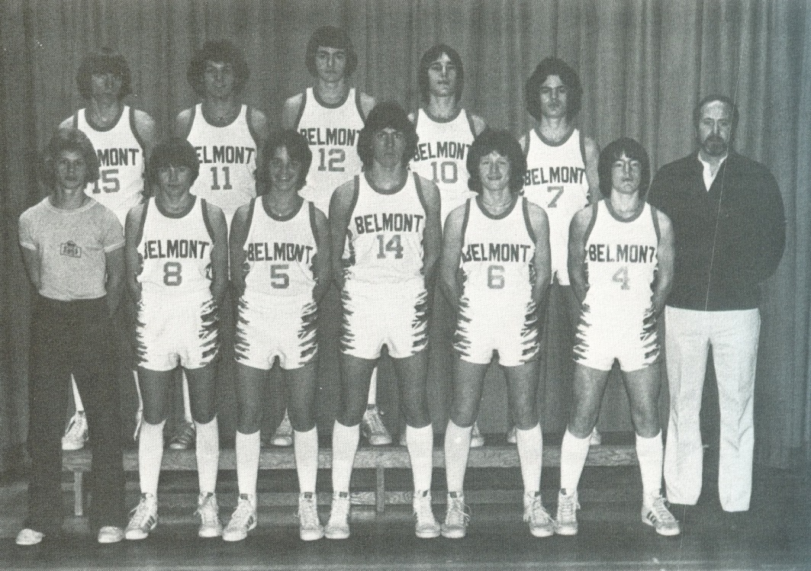
The Bracewells
Nicole concentrates as she
starts her serving motion
Marvin with his 1979-80 basketball team-mates.
He is in the back row wearing uniform #12 .
Marvin Bracewell was a member of the Belmont Braves basketball team in
the early 1980’s. Daughter Nicole was a star volleyball player from 2011-2014.

Slide 5
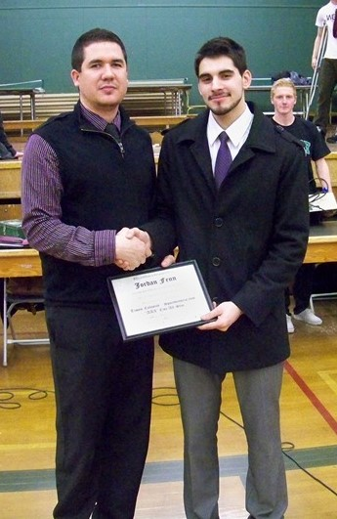
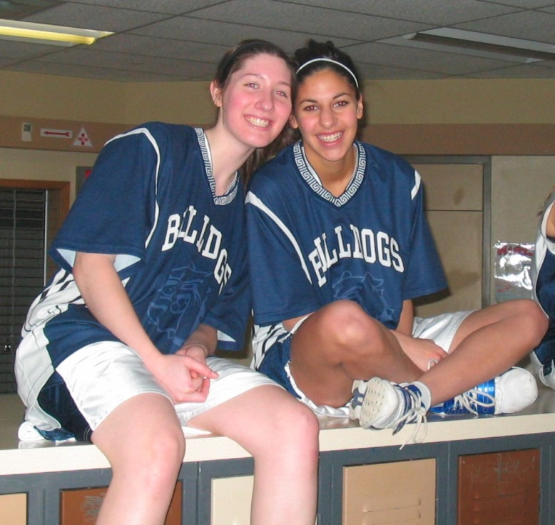
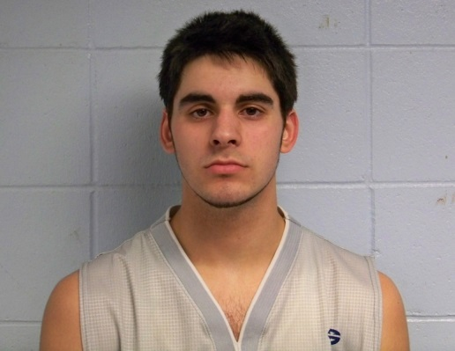
The Fenns
Jordan with Coach
Kevin Brown
Steph Fenn (on right)
Steph Fenn was a strong basketball and soccer player who competed for Belmont in
the late 2000’s. Brother Jordan, Belmont’s top grade 11 athlete in 2010 and top
senior athlete in 2011, was a basketball star who captured the MVP trophy at
the 2011 Island championship and led the Bulldogs to a berth in the BC’s. He
was also a strong cross country runner.

Slide 6
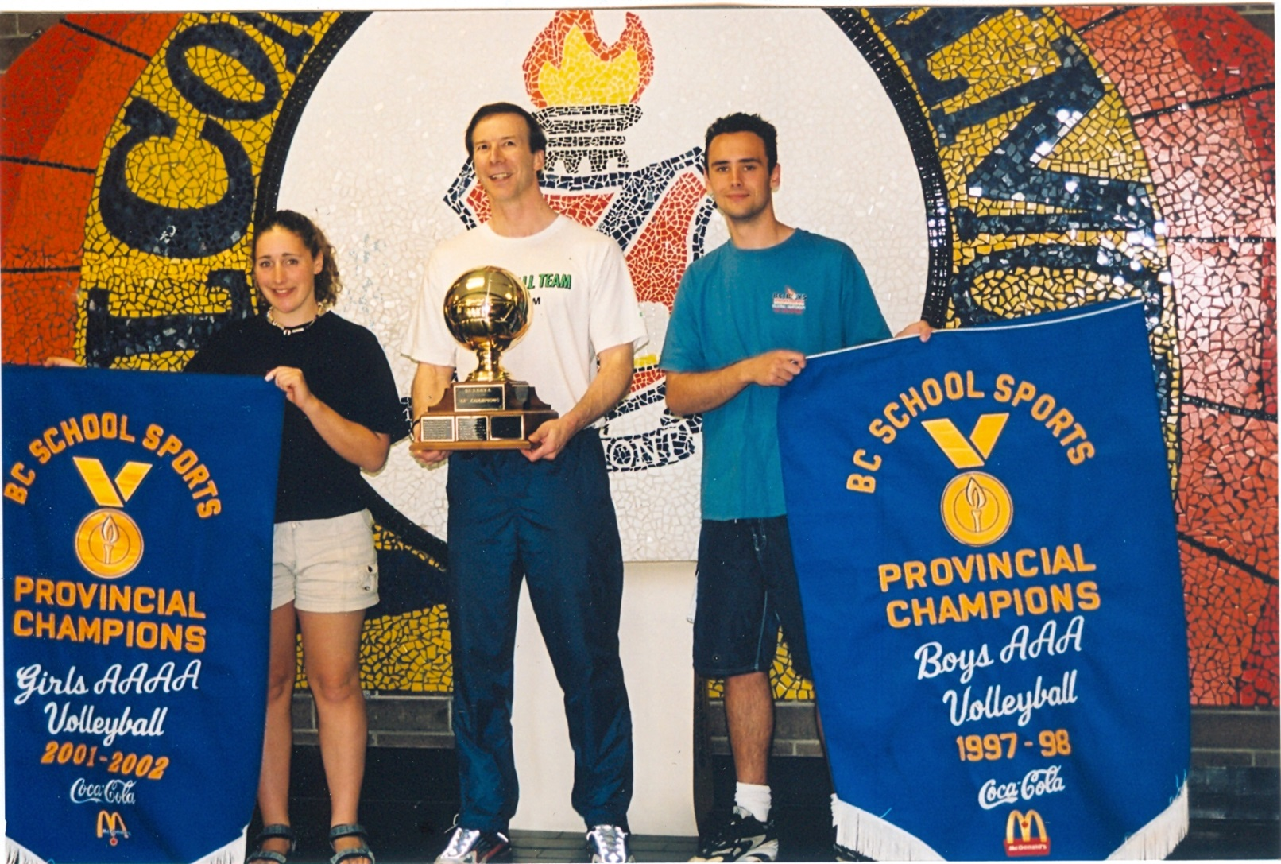
The Gollmers
Andrea and Ben, along
with coach Mike Toakley,
proudly display the BC
Championship banners.
.
Ben and Andrea Gollmer both helped lead their teams to provincial
championships in volleyball. Ben was setter for the 1997-98 boys’ team, while
Andrea was setter for the 2001-02 girls’ team. Both siblings were selected
as entrants into Belmont Sports Hall of Fame as individual athletes.

Slide 7
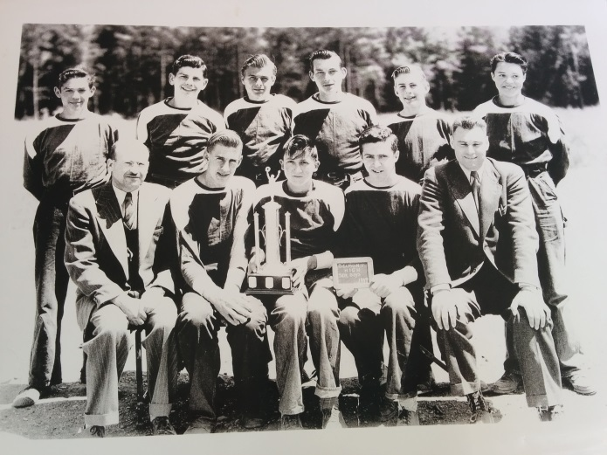
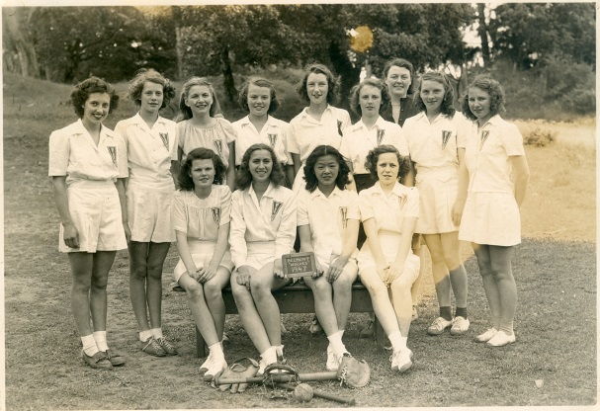
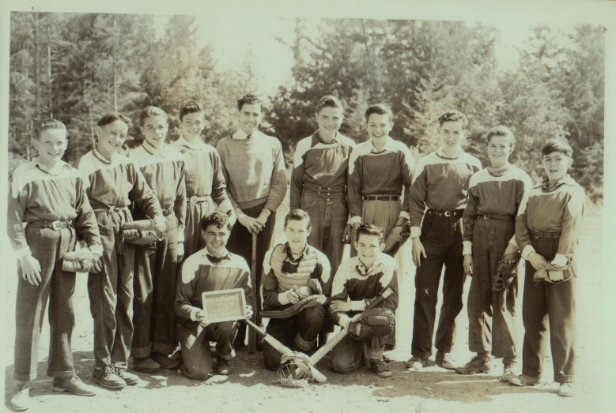
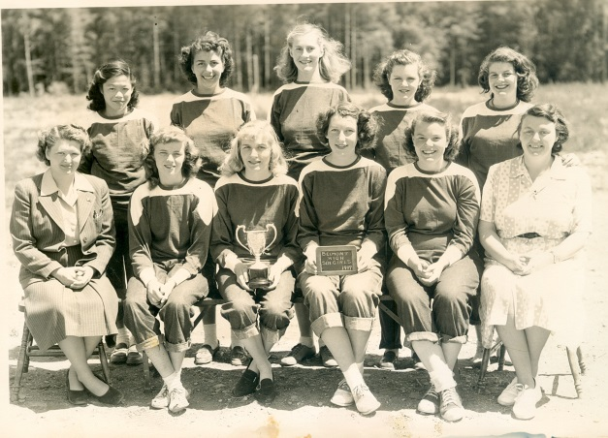
The Helgesens
Eric is in the back, 2nd
from the right. Ray is 2nd
from the left in the front
row.
Isabel is in the back, 2nd left.
Alvin is 2nd from the
right in the back row.
Eileen is in the middle back.
The Helgesen boys, Ray, Eric, and Alvin, were talented athletes in the 1950’s who
helped establish Belmont’s early athletic traditions. Their sisters were also
strong softball players. Isabel Helgesen was a member of Belmont’s first girls’
softball team: the 1947-48 Wolves, and Eileen Helgesen played for the 1949 team.
Eric was offered a tryout with the New York Yankees, but unfortunately was not
able to raise the money to travel across the country.

Slide 8
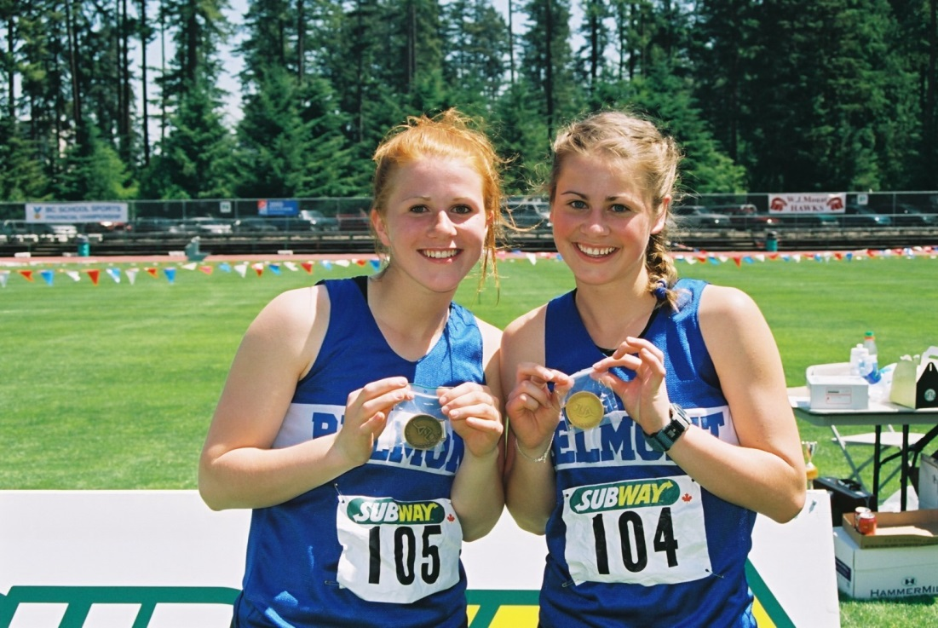
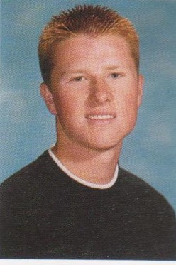
The Huzzeys
Kaitlin (left) and Megan (right) proudly display their bronze and gold
Medals in the race walk from the 2003 BC High School championship.
Kaitlin would earn her old gold medal a year later in the same event.
Bryn
The Huzzey sisters Megan and Kaitlin, both Hall of Fame entrants were
Outstanding race walkers who captured provincial titles. Megan went on to a
very successful NCAA career, and later competed for Canada’s national team.
Brother Bryn was a strong Belmont swimmer.

Slide 9
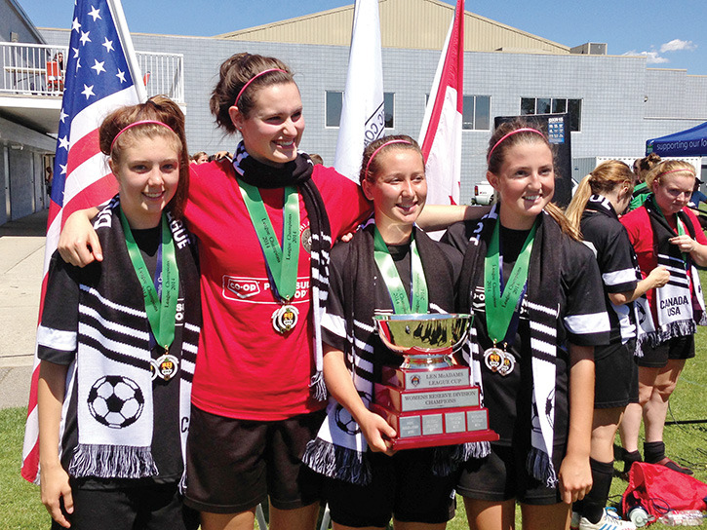
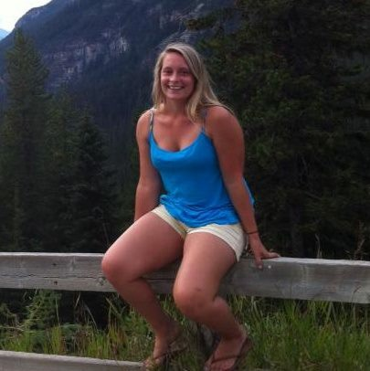
The Joyces
Claire is holding the trophy.
Caitlyn
Caitlyn Joyce was an excellent soccer player who competed for Belmont from
2009-2011. Younger sister Claire was also a soccer standout and played on
the 2013 squad that went undefeated but lost out on a provincial berth on a
heartbreaking goal differential formula at the Island tournament. She also
was a member of the Bulldogs junior and senior girls’ basketball teams.

Slide 10
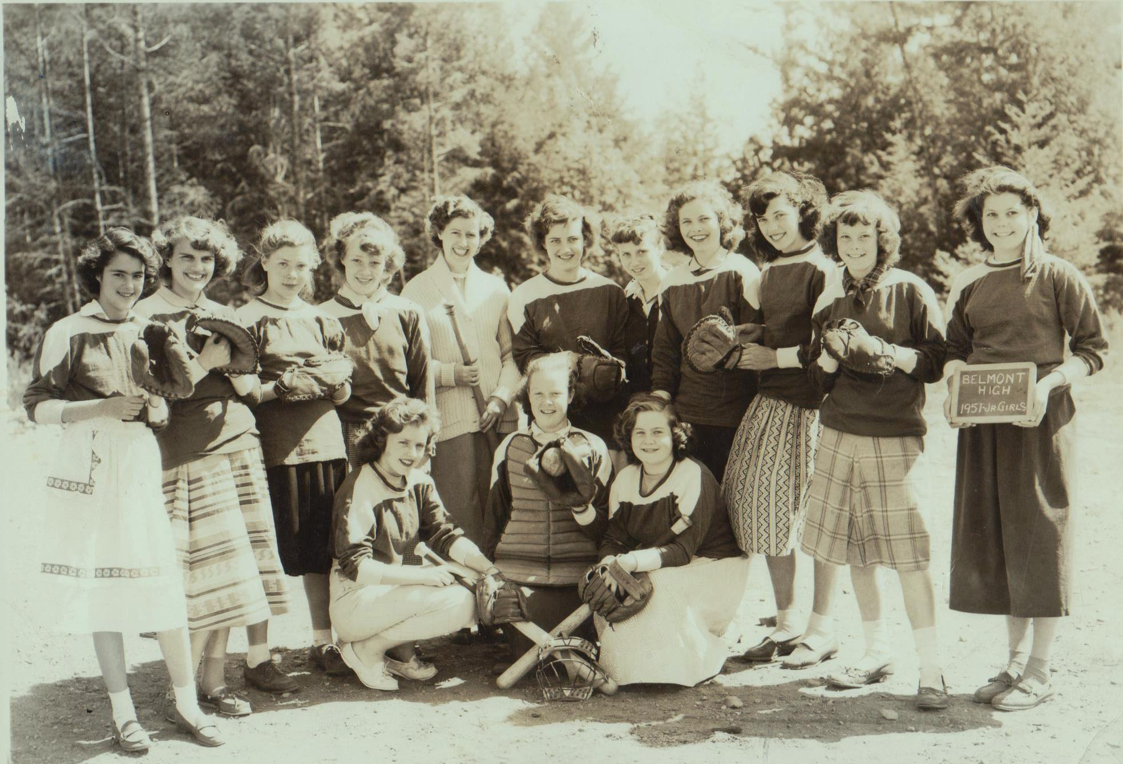
The Kennedy’s
Pat is in the
back row 4th from
the left and Maxine
is 2nd from the left
The Kennedy sisters, Pat and Maxine, both were strong athletes and played
on a number of Belmont’s early sports teams in the 1950’s. They helped to
establish the school’s strong athletic tradition.

Slide 11
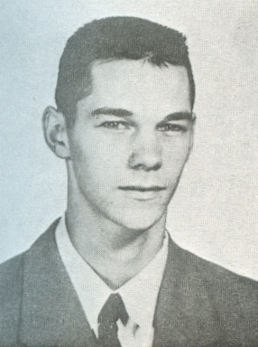
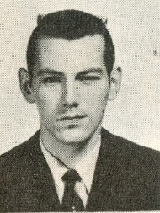
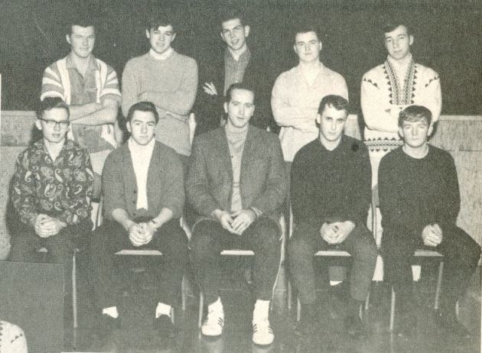
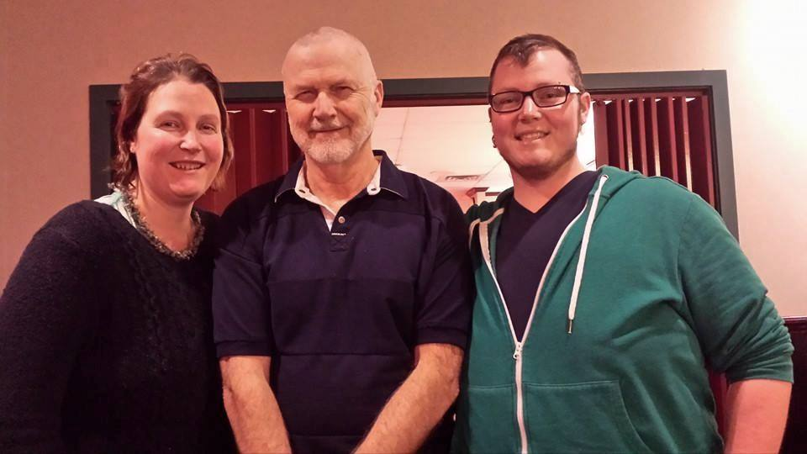
The Kilduffs
Rod Kilduff, 1961
Cliff Kilduff, 1960
Carlie rowing for Belmont
Glen is standing in the back row on
the far left in this 1968 basketball photo.
Carlie, Glen and Marshall
2014
The three Kilduff brothers, Cliff, Rod and Glen, were all terrific all round-athletes
in the 1950’s and 60’s. Cliff won Belmont’s top male athlete award in 1960, while
Glen won the same award in 1968 and 1969. Glen’s two children were also Belmont athletes. Carlie rowed and played basketball for the Tomahawks, while Marshall competed in softball, basketball, volleyball, and track and field.

Slide 12
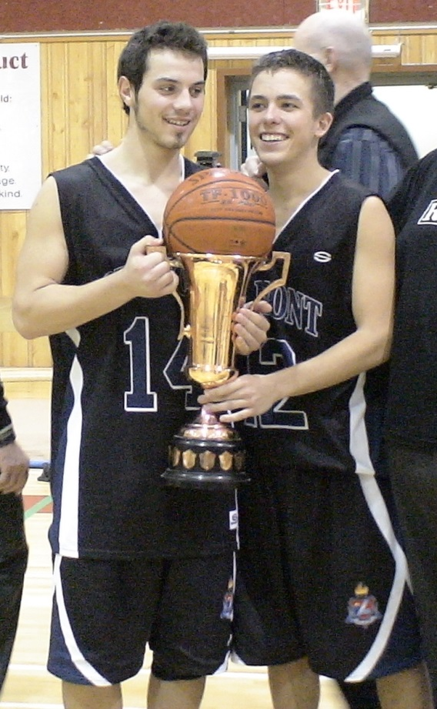
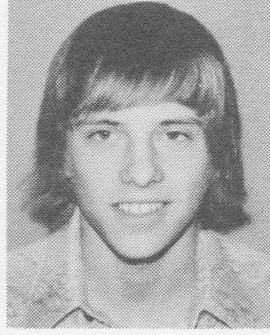
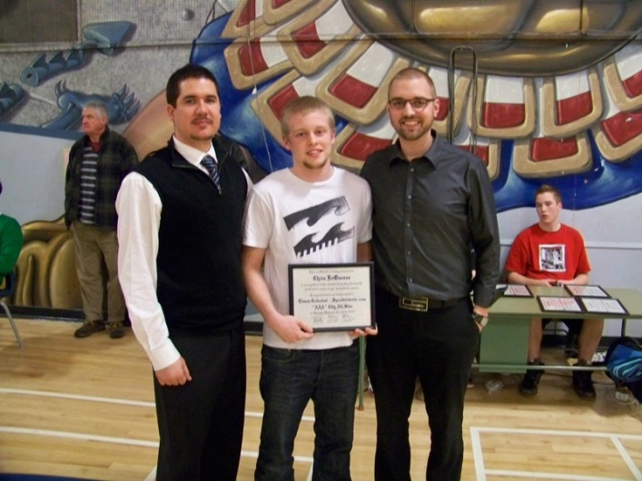
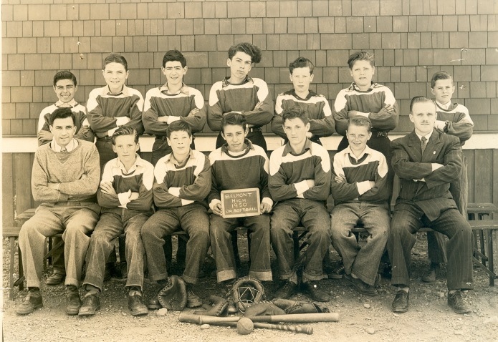
The Lequesnes
Tom
Chris
Craig
Alan is 2nd from
the left
Alan Le Quesne played on Belmont’s softball team in the early 1950’s. His nephew
Tom Lequesne was an excellent basketball and volleyball player for the Braves
in the 1970’s. Tom’s son Craig captained the Island Championship basketball
basketball team in 2007-08 and was named a city all star. He also played goal
for the Bulldogs’ soccer team. Younger brother Chris, also a basketball all star,
won the Lower Island scoring title his grade 12 year, and was selected as the
top male athlete for all three of his years at Belmont!

Slide 13
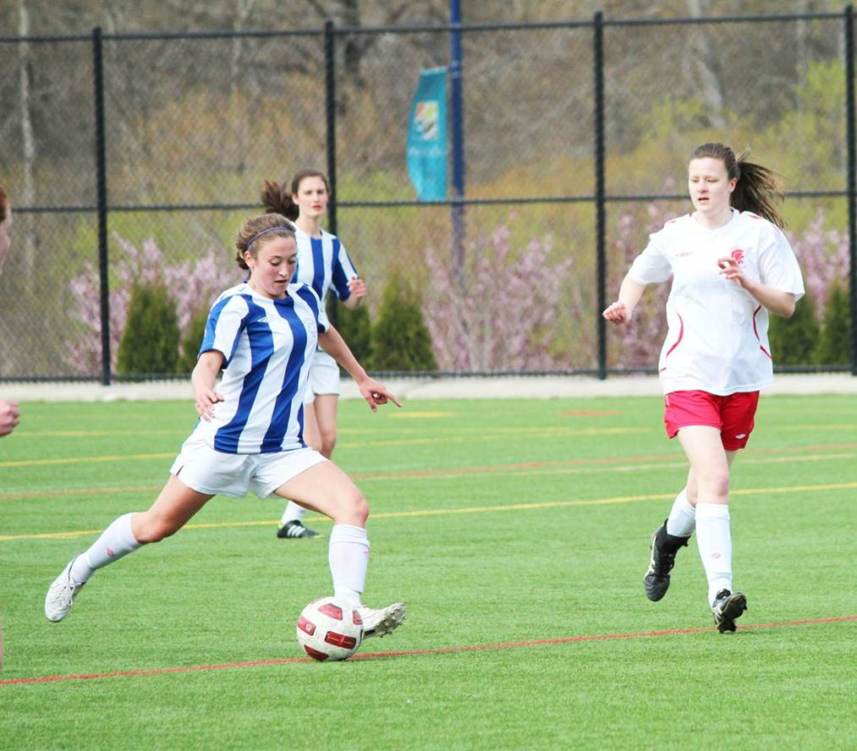
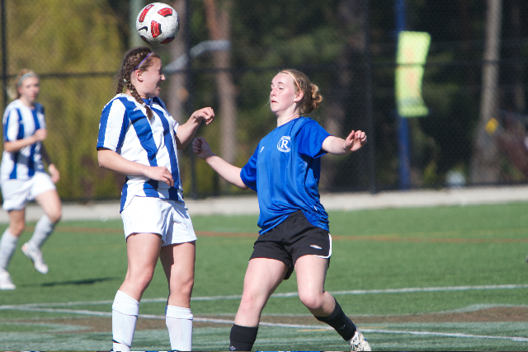
The Livingstones
Kristen
Marisa
Kristen Livingstone was captain of both the senior girls’ soccer and basketball
teams in 2013. She won the junior girls’ sportsmanship award in grade 10,
was named top female athlete in grade 11 and 12, and also earned the top
scholar athlete trophy her senior year. She is currently playing CIS soccer for
the University of Alberta. Younger sister Marisa was also a soccer standout
and shared the top grade 11 female athlete award in 2013. Their father Bud
coached the Belmont girls’ soccer team from 2010-2014.

Slide 14
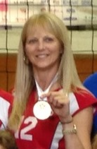
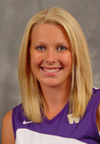
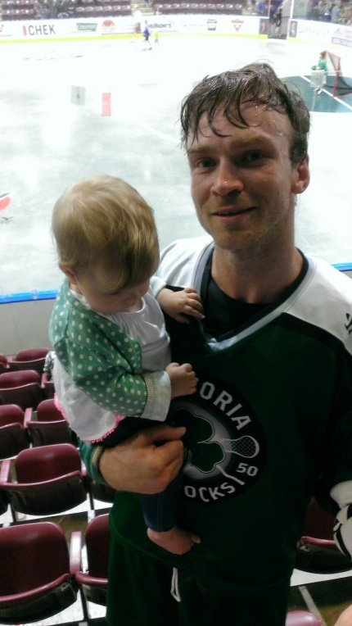
The Montgomery/ Myhre/ Hass’s
Denise Montgomery, Belmont’s top female athlete in 1973, was a Belmont
volleyball, basketball and track standout who played CIS volleyball at Uvic.
Daughter Darla led the 2001-02 Belmont volleyball team to a provincial title
and was named MVP at the BC’s. She later won an NCAA championship with
the University of Washington and played for Canada’s junior national team.
Darla’s cousin Tyler Hass was Belmont’s top male athlete in 2003, and played
basketball at Uvic for 5 years, and followed that up with a professional lacrosse
career.

Slide 15
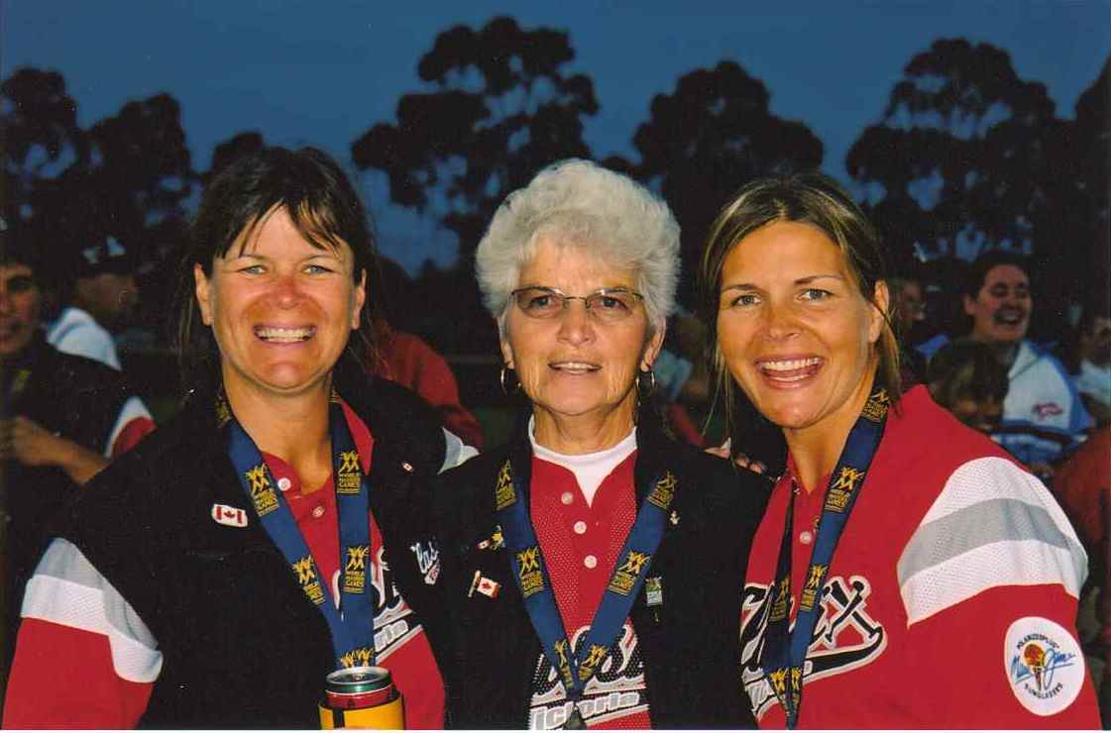
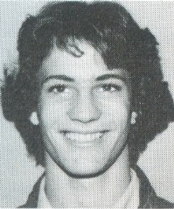
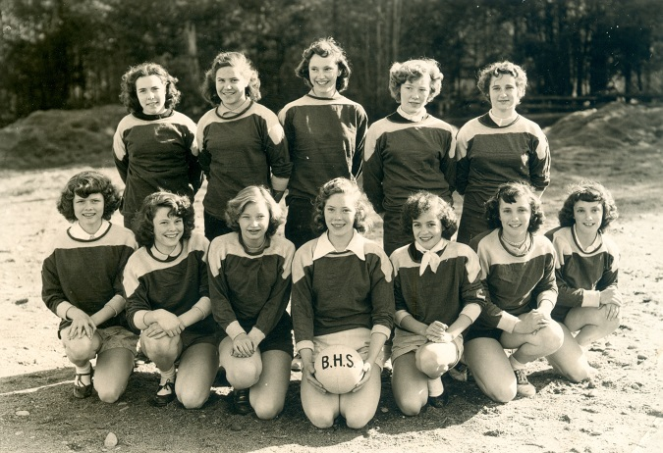
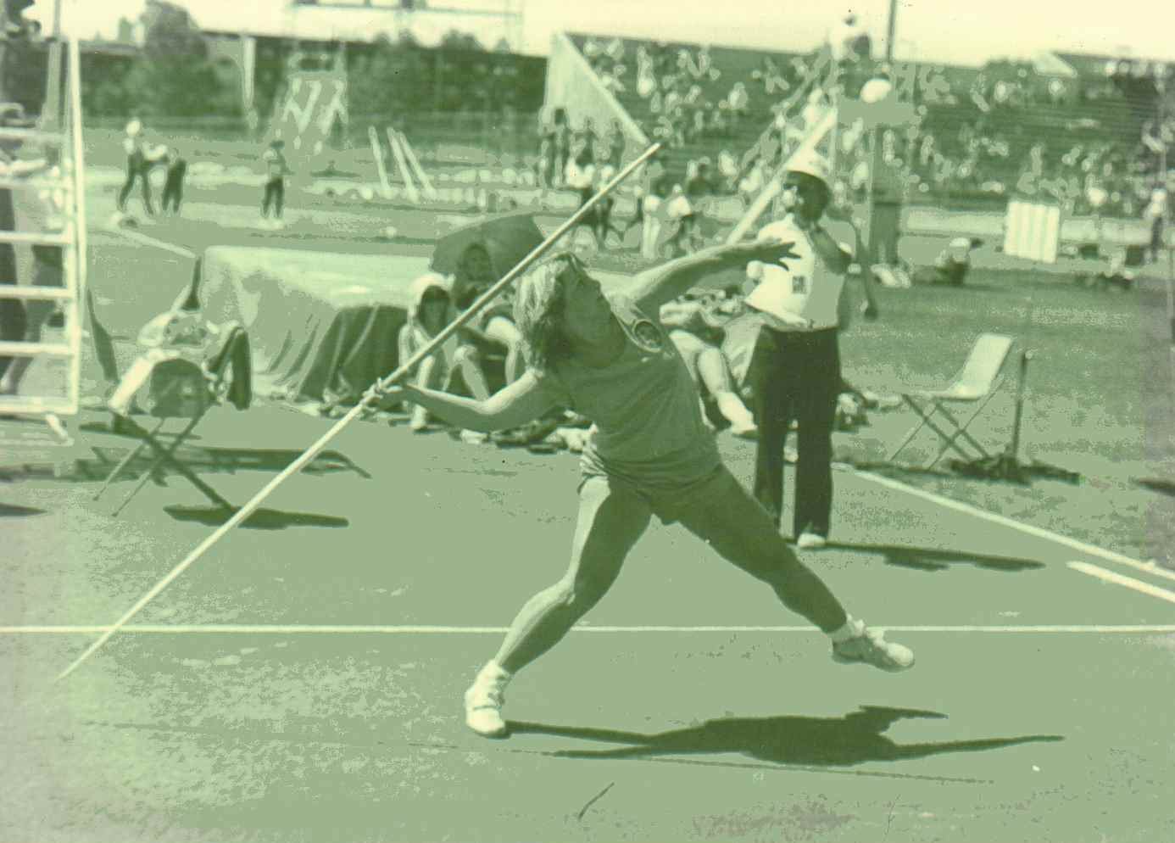
The Moseleys / Smiths / Hepworths /Evans
Shirley Moseley Smith, flanked by her
older daughter Della and younger daughter
Jenny at the 2002 World Masters games in
Australia, where all three competed in softball.
Ian Evans
Marilyn (Babe) Moseley Hepworth is
holding the volleyball in the front row for the 1953 Belmont jr. girls’ team photo.
Kristy throwing the javelin
Sisters Shirley and Marilyn (Babe) Moseley were two of Belmont’s outstanding
athletes of the 1950’s. Shirley’s daughters Della and Kristy were also terrific
athletes. Della won Belmont’s top female athlete award in 1978, while Kristy
became a national champion in the javelin. Kristy’s husband Ian Evans was
Belmont’s top grade 10 male athlete in 1975.

Slide 16
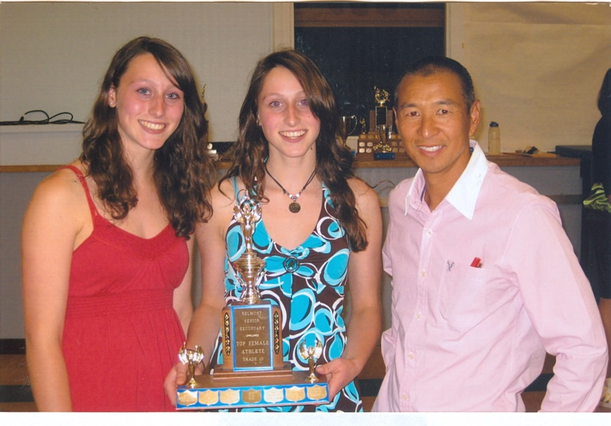
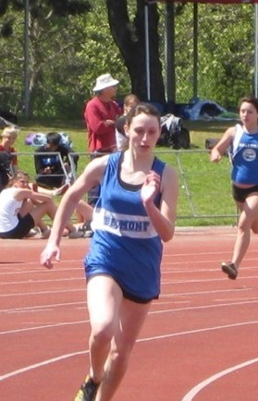
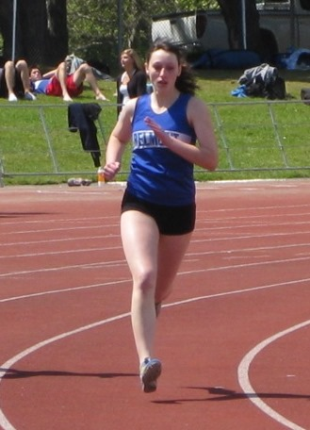
The Nelsons: Carly and Taylor
Carly (left) and Taylor accept the 2009 top junior
athlete award from their volleyball coach Ken Lowe.
Taylor also running the 200m
Carly running the 400 meter
race at the Uvic track
The Nelson twins, Carly and Taylor were talented multi-sport athletes who
competed in volleyball, basketball, soccer, cross country and track. They were
co-winners of the top junior athlete award in 2009. Taylor won the top senior
girls’ sportsmanship trophy in both 2010 and 2011, while Carly was selected as
the outstanding senior athlete in 2011. Both girls played volleyball at the
collegiate level after graduating from Belmont.

Slide 17
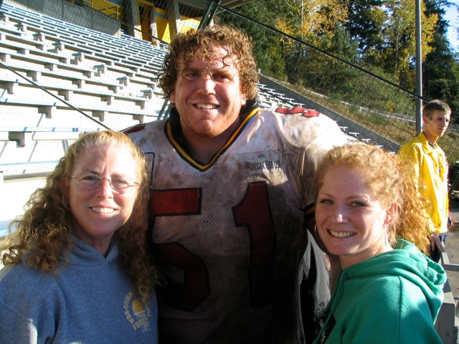
The O’Neills
Patti O’Neill is a Belmont Hall of Fame coach who donated thousands of
hours on behalf of the school’s athletic program. Son Tim was a football
star who has played for many years in the CFL and won a Grey Cup with
the Calgary Stampeders. Daughter Erin was a strong Belmont athlete
Who played basketball, volleyball and softball.

Slide 18
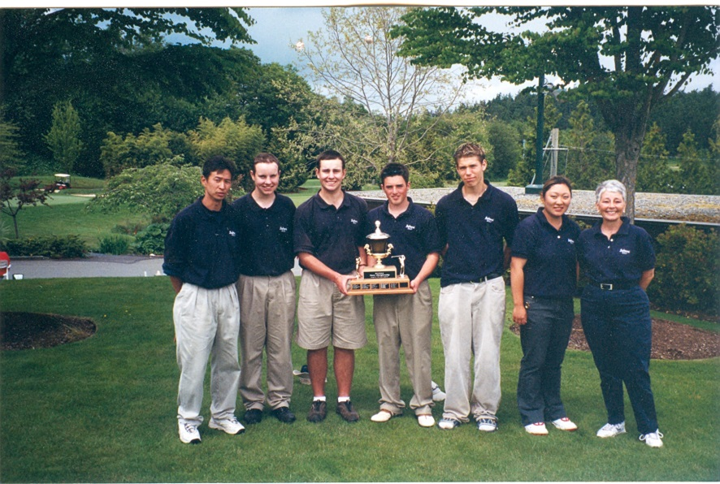
The Pewarchuks
Cody (2nd from left) and Dustin (3rd from left) pose with
their team-mates and coaches after winning the 2002
provincial title.
The three Pewarchuk boys, Jesse, Dustin, and Cody were all outstanding
golfers for Belmont. Dustin and Cody were both members of the 2002 BC
High School Championship team, with Dustin also capturing the individual
title at the provincial tournament. Dustin earned a scholarship to the University
of Oregon, while Cody accepted a “full ride” to the University of Hawaii. Older
brother Jesse also was a strong golfer who competed for Belmont.

Slide 19
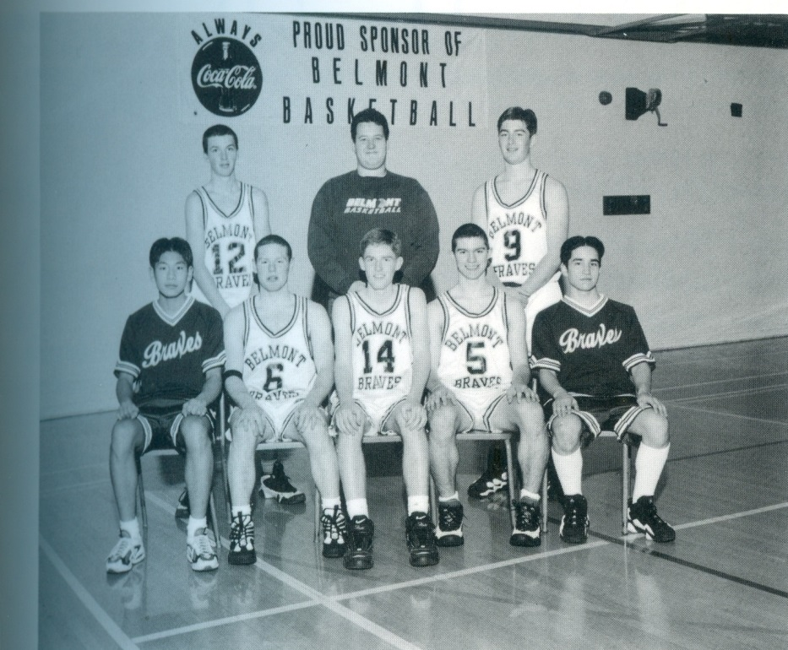
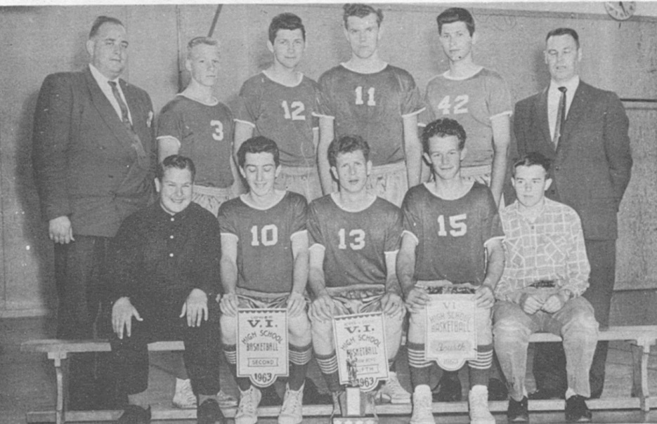
The Powells
Lloyd is #10 in the front row in this 1963 Belmont Braves’
basketball photo.
Todd Powell is #9 in the back row in this 1967 Belmont
Braves’ basketball photo.
Lloyd Powell, a member of the 1962-63 Hall of Fame Braves’ basketball team,
coached Belmont’s senior girls’ soccer team from 1984-2014. His son Todd
played basketball for the Braves, from 1996-98 and now teaches at Edward
Milne Community School

Slide 20
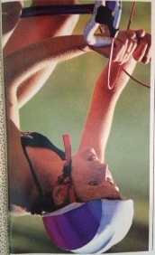
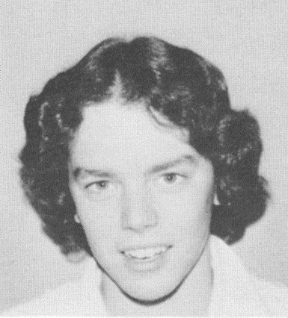
The Raineys
Karen
Julie
Julie and Karen both are Belmont Hall of Fame athletes. Julie was a strong
cross country runner and a key contributor to the 1975-76 swim team that
finished third in BC. Sister Karen, Belmont’s top senior athlete in 1979-80, led
the cross country team to a city and Island title, and became junior national
champion in the sport. She later became a world champion triathlete.

Slide 21
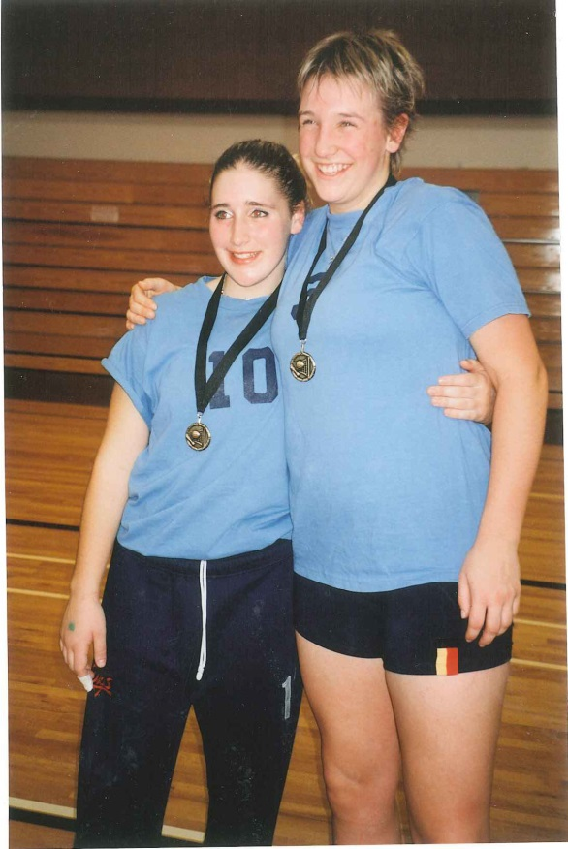
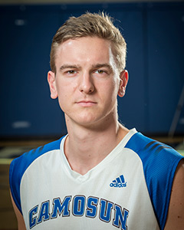
The Sadowskis
Nicki (right)
Alex
Nicola Sadowski, Belmont’s top female athlete in 2001 captained the senior
girls’ volleyball team to a 2nd place finish in the provincial championship. She
played collegiate volleyball, first at Montana State and later at Uvic. Younger
brother Alex qualifed for three provincial championships during his time at
Belmont: in basketball, volleyball and track and field and was an Island all star
in both basketball and volleyball. He was a provincial all star middle blocker
for the Camosun Chargers’ volleyball team and earned All Canadian honours
while helping to lead the Chargers to their first national title in 2014-15..

Slide 22
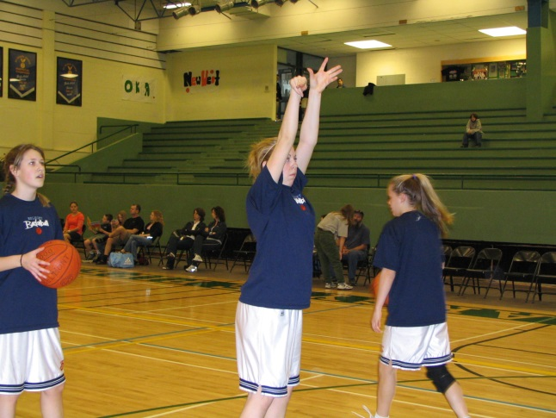
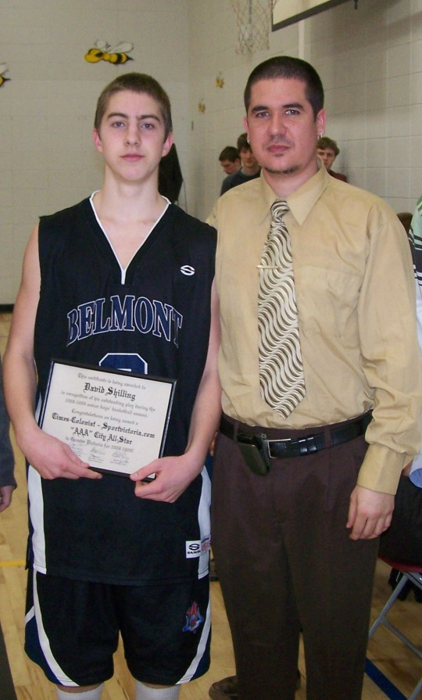
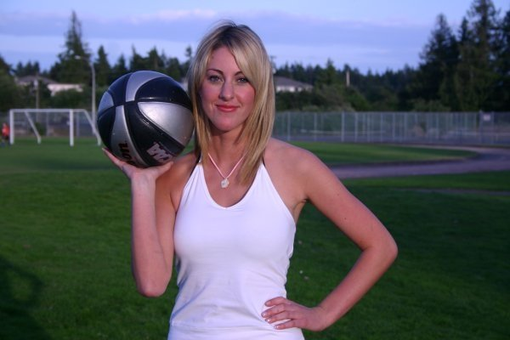
The Shillings
Rachel
David
Brooke
The four Shilling siblings all made significant contributions to Belmont’s
basketball programs in the 2000’s. Justin was a starting guard for the boys’
team and Rachel was a member of the 2005 junior girls that advanced to the
BC championship tournament. Brooke, the winner of Belmont’s top female
sportsmanship award her grade 11 and 12 years, was one of the top posts on
the Island between 2000- and later played for the Camosun Chargers. David
was a Times Colonist city all star point guard and a member of the 2008
Island Championship Bulldogs squad.

Slide 23
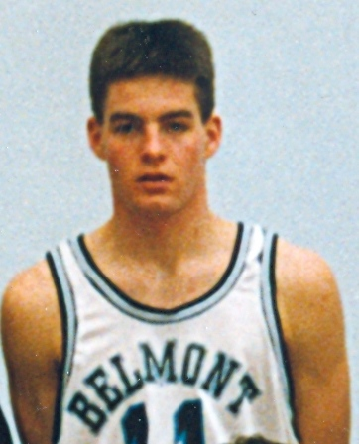
The Spavens
Eric powers up against 3 defenders. Curt is # 11 at the
top right, and Christian is #11 on the bottom right.
Basketball standout Curt Spaven, Belmont’s outstanding senior male athlete of
1991, was selected as a first team all star at the BC High School Championships
in 1992. He is now Belmont’s junior boys’ basketball coach. Curt’s sons Eric
and Christian were both basketball and volleyball players, with Eric winninig
the Lower Island basketball scoring title his senior year and leading the Bulldogs
to a berth in the provincial championship tournament.

Slide 24
The Spotswoods
Mel and Sandi with their 1961
Top Athlete trophies
Bill poses with his team. Kindree is
#14 in the back row.
Bill, Mel and Sandi Spotswood were all outstanding athletes from the 1950’s and
early 60’s. Bill’s daughter Kindree was an excellent basketball player who
helped the 1991-92 Tomahawks earn a 2nd place finish in the province. Bill
coached at the school for 37 years, and the South Gym was renamed in his
honour in 2002.

Slide 25
The Szirmays
Katie Szirmay was a key member of the 2010 girls’ basketball that qualified
for the provincial championship. She placed 2nd in the 3 point shooting
contest at the BC’s that year. Younger sister Chrissy, Belmont’s top grade 10
athlete in 2012, competed in both volleyball and basketball. She was awarded
the Lloyd Powell Service award her grade 12 year.

Slide 26
The Walushkas
The three Walushka siblings all played prominent roles in Belmont’s sports
teams during the 2000’s. Kris, Belmont’s athlete of the year in 2001, was a
basketball, volleyball and soccer star who later went on to play fastball for Canada’s
national team. Shelley, winner of Belmont’s top sportsmanship award in 2002,
competed in volleyball, basketball and track in high school and was also an
Excellent figure skater. Younger brother Darcy played volleyball and basketball at
Belmont and made Canada’s junior national fastball team at the age of 17.

Slide 27
The Willings
Brian rowing for
Belmont in 1994
Glenn holding the Glen Lake run
trophies
Brian surfing
Glenn, Belmont’s top male athlete in 1965, was an outstanding runner who won
the Glen Lake race for 5 of his 6 years at the school. Son Brian, currently a
Belmont teacher, was also an excellent athlete and was awarded the senior
boys’ top sportsmanship trophy in 1994.

